Slide 1
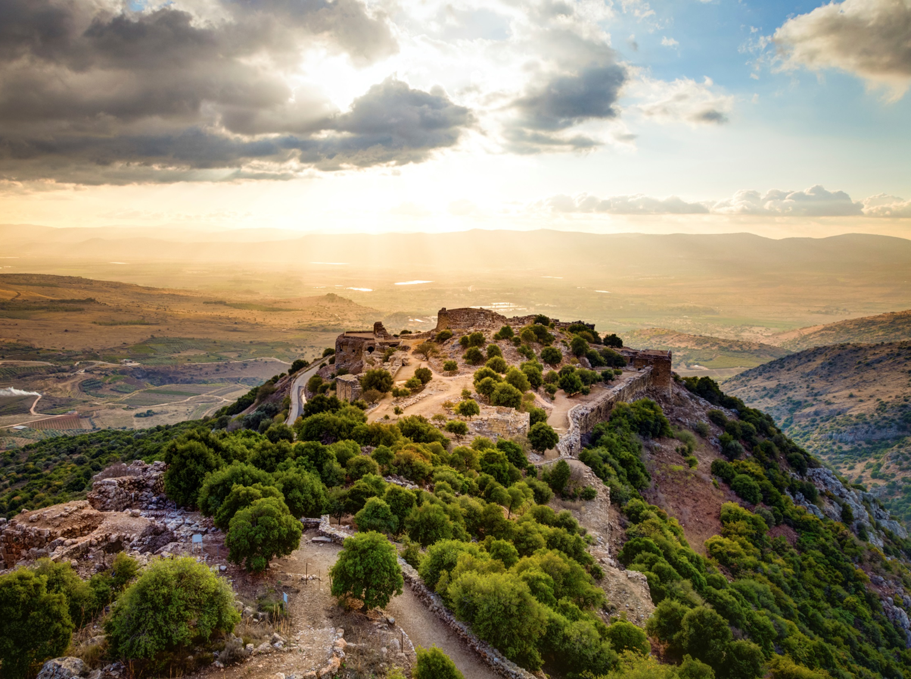
LENTEN QUEST

Slide 2
LENTEN QUEST
This Lent we are going to go on a quest. We will search for ways to put our faith into action and grow closer to God.
What can we do to complete our quest?

Slide 3
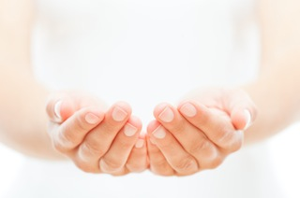
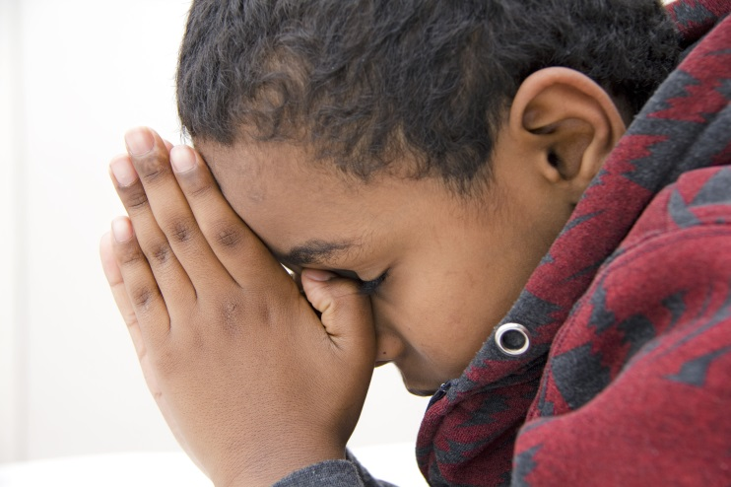
What are the three things we should do during Lent?
FAST
GIVE
PRAY

Slide 4
What are the three things we should do during Lent?
FAST

Slide 5
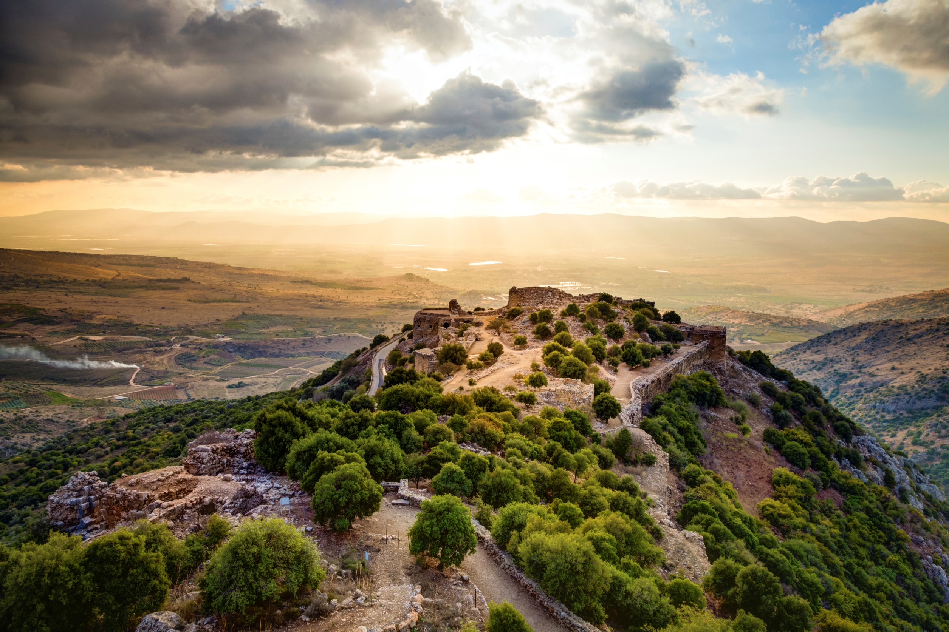
FAST
What is fasting?
Why do we fast?
How can we fast?

Slide 6
FAST
What is fasting?

Slide 7
Imagine. . .
You have travelled to Egypt on a school trip. You are in the middle of a tour of the desert when the bus pulls away without you.
You and your classmates are left stranded in the middle of the desert with just one rucksack of provisions.
You find 12 items in the rucksack. Order the items
1-12 from most important to least important.
1= most important 12= least important
Explain your decisions.

Slide 8
What if you did not have any of these items?
Jesus spent 40 days and 40 nights in the desert without anything!
How must he have felt?
Jesus gave up food, drink and shelter when he went into the desert. When we give up or cut down on something it is called fasting.

Slide 9
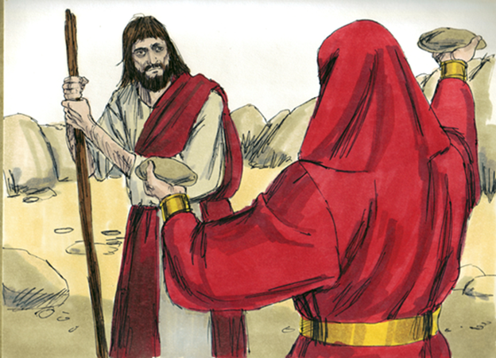
The Temptation of Jesus
Matthew 4.1-11
Then the spirit led Jesus into the desert to be tempted by the Devil. After spending 40 days and 40 nights without food, Jesus was hungry. Then the Devil came to him and said,
“If you are God’s Son, order these stones into bread.”
But Jesus answered,
“The scripture says ‘Human
beings cannot live on bread
alone, but need every word
that God speaks.’”

Slide 10
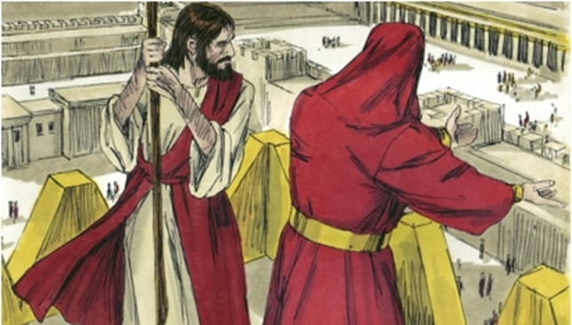
The Temptation of Jesus
Matthew 4.1-11
Then the Devil took Jesus to Jerusalem, the Holy City, set him on the highest point of the Temple, and said to him, if you are God’s Son, throw yourself down, for the scripture says:
‘God will give orders to his angels about you; they will hold you up with their hands, so that not even your feet will be hurt on the stones.’”
Jesus answered,
“But the scripture also says,
‘Do not put the Lord your God
to the test.’”

Slide 11
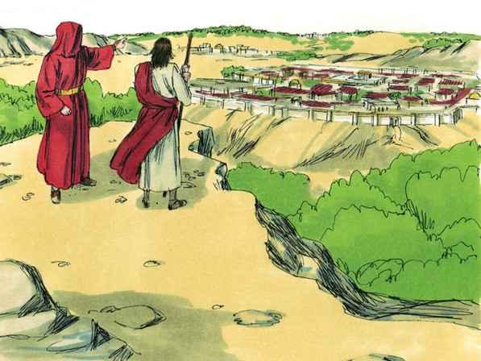
The Temptation of Jesus
Matthew 4.1-11
Then the Devil took Jesus to a very high mountain and showed him all the kingdoms of the world in all their greatness.
“All this I will give you,” the Devil said, “if you kneel down and worship me.”
Then Jesus answered, “Go away, Satan!
The scripture says, ‘Worship the
Lord your God and serve only him!’”
Then the Devil left Jesus;
and angels came and helped him.

Slide 12
FAST
Why do we fast?

Slide 13
Why did Jesus fast?
Fasting:
Helps us to be more self-disciplined
Reminds us of all of the good things which God has given us
Helps us think of those who are less fortunate than ourselves

Slide 14
FAST
How can we fast?

Slide 15
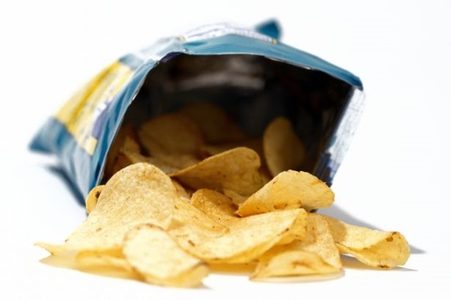
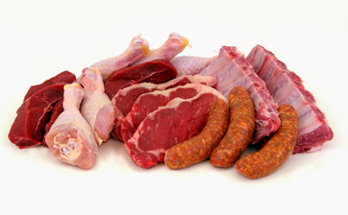
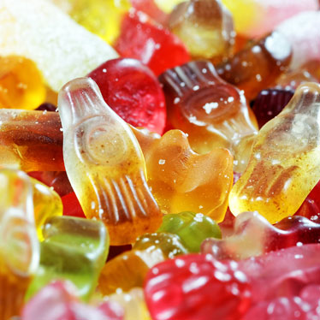
Main Menu
LENTEN QUEST
FAST
I will give up my laptop/ computer/ tablet
I will give up crisps
I will give up TV
I will give up my games console
I will give up meat
I will give up sweets

Slide 16
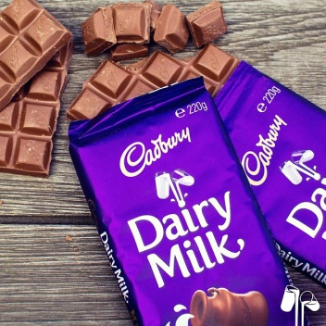
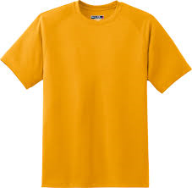
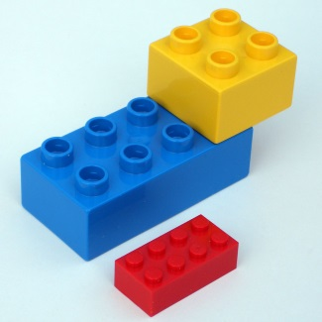
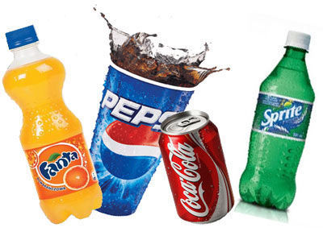
Main Menu
LENTEN QUEST
FAST
I will give up chocolate
I will give up buying new clothes/toys
I will give up my phone
I will give up fizzy drinks
I will give up social media

Slide 17
What are the three things we should do during Lent?
GIVE

Slide 18
GIVE
What is almsgiving?
Why do we give alms?
How can we give alms?

Slide 19
GIVE
What is almsgiving?

Slide 20
What is almsgiving?
Alms are money or goods given to those in need. We can also give our time and talents
to help others.

Slide 21
GIVE
Why do we give alms?

Slide 22
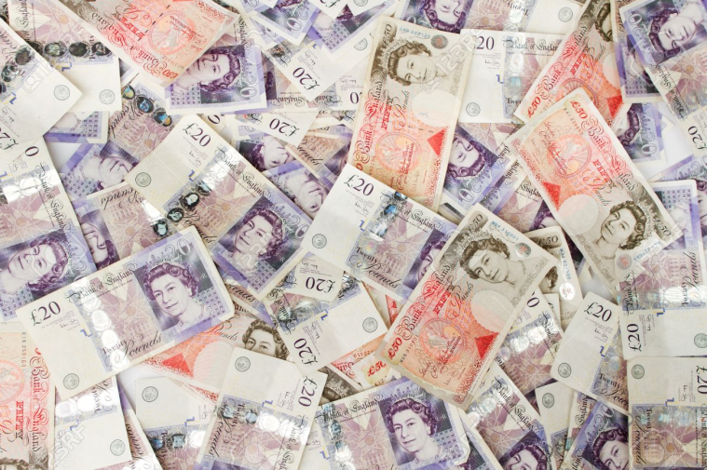
GIVE
Who should get how much money?
How do you feel about how much money you have?
How do you feel about how much money you have now?
How do you fell about the way money is shared between people in the UK?

Slide 23
Matthew 25. 37-40
‘I was hungry and you fed me, thirsty and you
gave me a drink; I was a stranger and you received me in your homes, naked and you clothed me; I was sick and you took care of me, in prison and you visited me.’
“The righteous will then answer him, ‘When, Lord, did we ever see you hungry and feed you, or thirsty and give you a drink? When did we ever see you a stranger and welcome you in our homes, or naked and clothe you?
When did we ever see you sick or in prison, and visit you?’ The King will reply, ‘I tell you, whenever you did this for one of the least important members of my family, you did it for me!’

Slide 24
GIVE
How can we give alms?

Slide 25
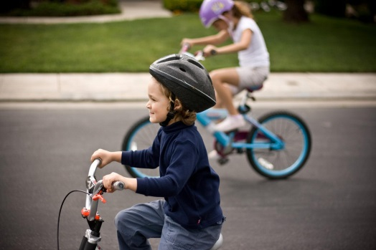
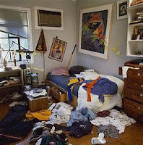
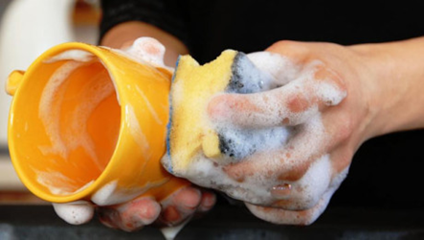
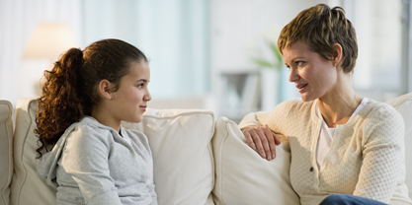
Main Menu
LENTEN QUEST
GIVE
I will give by . . .
I will raise money by baking and selling cakes
I will raise money by getting sponsored to do a readathon
I will raise money by getting sponsored to run/cycle
I will sort through my clothes/toys and give some to those in need
I will raise money by doing extra chores
I will tell someone I know about the work of CCS

Slide 26
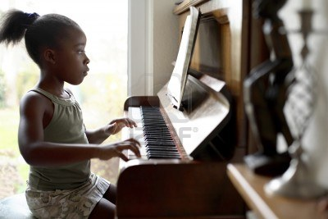
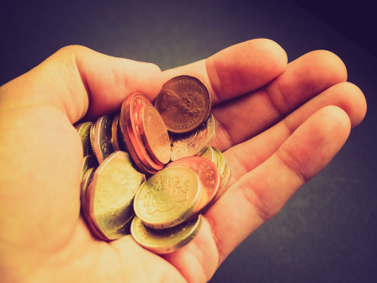
Main Menu
LENTEN QUEST
GIVE
I will give by . . .
I will volunteer to help someone in need
I will support our CCS day in school
I will take my Lenten box to my club and explain where the money will go
CCS Day
Friday 9th March
I will do something creative to raise money for those in need
When I go to the shops I will put my spare change in my Lenten box

Slide 27
What are the three things we should do during Lent?
PRAY

Slide 28
PRAY
What is prayer?
Why do we pray?
How can we pray?

Slide 29
PRAY
What is prayer?

Slide 30
PRAY
Pray in silence
Write down your prayer on a post-it note
What did you say when you spoke to God?

Slide 31
PRAY

Slide 32
PRAY
1
John 12.27-28
“Now my heart is troubled – and what shall I say? Shall I say, ‘Father, do not let this hour come upon me’? But that is why I came – so that I might go through this hour of suffering. Father, bring glory to your name!”
Then a voice spoke from heaven, “I have brought glory to it, and I will do so again.”

Slide 33
PRAY
2
Luke 6.12-13
At that time Jesus went up a hill to pray and spent the whole night there praying to God. When day came, he called his disciples to him and chose twelve of them, whom he named apostles.

Slide 34
PRAY
3
John 11. 41-42
Jesus looked up and said, “I thank you, Father, that you listen to me. I know that you always listen to me, but I say this for the sake of the people here, so that they will believe that you sent me.”

Slide 35
PRAY
4
Mark 1.35-38
Very early the next morning, long before daylight, Jesus got up and left the house. He went out of the town to a lonely place, where he prayed. But Simon and his companions went out searching for him, and when they found him, they said, “Everyone is looking for you.”
But Jesus answered, “We must go on to the other villages round here. I have to preach in them also, because that is why I came.”

Slide 36
PRAY
5
Luke 10.21
At that time Jesus was filled with the Holy Spirit and said “Father, Lord of heaven and earth! I thank you because you have shown to the unlearned what you have hidden from the wise and learned. Yes, Father, this was how you wanted it to happen.”

Slide 37
PRAY
6
Matthew 19.13-15
Some people brought children to Jesus for him to place his hands on them and to pray for them, but the disciples scolded the people. Jesus said, “Let the children come to me and do not stop them, because the Kingdom of heaven belongs to such as these.” He placed his hands on them and then went away.

Slide 38
PRAY
7
Matthew 26.36-39
Then Jesus went with his disciples to a place called Gethsemane, and he said to them, “Sit here while I go over there and pray.” He took with him Peter and two sons of Zebedee. Grief and anguish came over him, and he said to them, “The sorrow in my heart is so great that it almost crushes me. Stay here and keep watch with me.”
He went a little farther on, threw himself face downwards on the ground, and prayed, “My Father, if it is possible, take this cup of suffering from me! Yet not what I want, but what you want.”

Slide 39
PRAY
8
John 6.11
Jesus took the bread, gave thanks to God, and distributed it to the people who were sitting there. He did the same with the fish, and they all had as much as they wanted.

Slide 40
PRAY
9
Matthew 26.36-39
Then Jesus went with his disciples to a place called Gethsemane, and he said to them, “Sit here while I go over there and pray.” He took with him Peter and two sons of Zebedee. Grief and anguish came over him, and he said to them, “The sorrow in my heart is so great that it almost crushes me. Stay here and keep watch with me.”
He went a little farther on, threw himself face downwards on the ground, and prayed, “My Father, if it is possible, take this cup of suffering from me! Yet not what I want, but what you want.”

Slide 41
PRAY
Why do we pray?

Slide 42
Why did Jesus pray?
Jesus needed God’s help (1,2,4,9)
Jesus thanked God (3,5,8)
Jesus prayed for others (6)
Jesus talked to God (7)

Slide 43
PRAY
What did you say in your prayer? Stick your post-it note in one of the categories. If your prayer fits into more than one category, stick it between the categories
Prayer for others
Prayer thanking God
Talking to God
Prayer asking for help

Slide 44
PRAY
Did you pray for others?
Did you thank God?
Did you ask for help?
Did you talk to God?

Slide 45
PRAY
How can we pray?

Slide 46
Main Menu
LENTEN QUEST
PRAY
I will pray for my family
I will say the Lord’s prayer
I will pray for children living in poverty
I will pray for my friends
I will pray to God for forgiveness for something I have done wrong
I will pray the Holy Rosary

