Slide 2
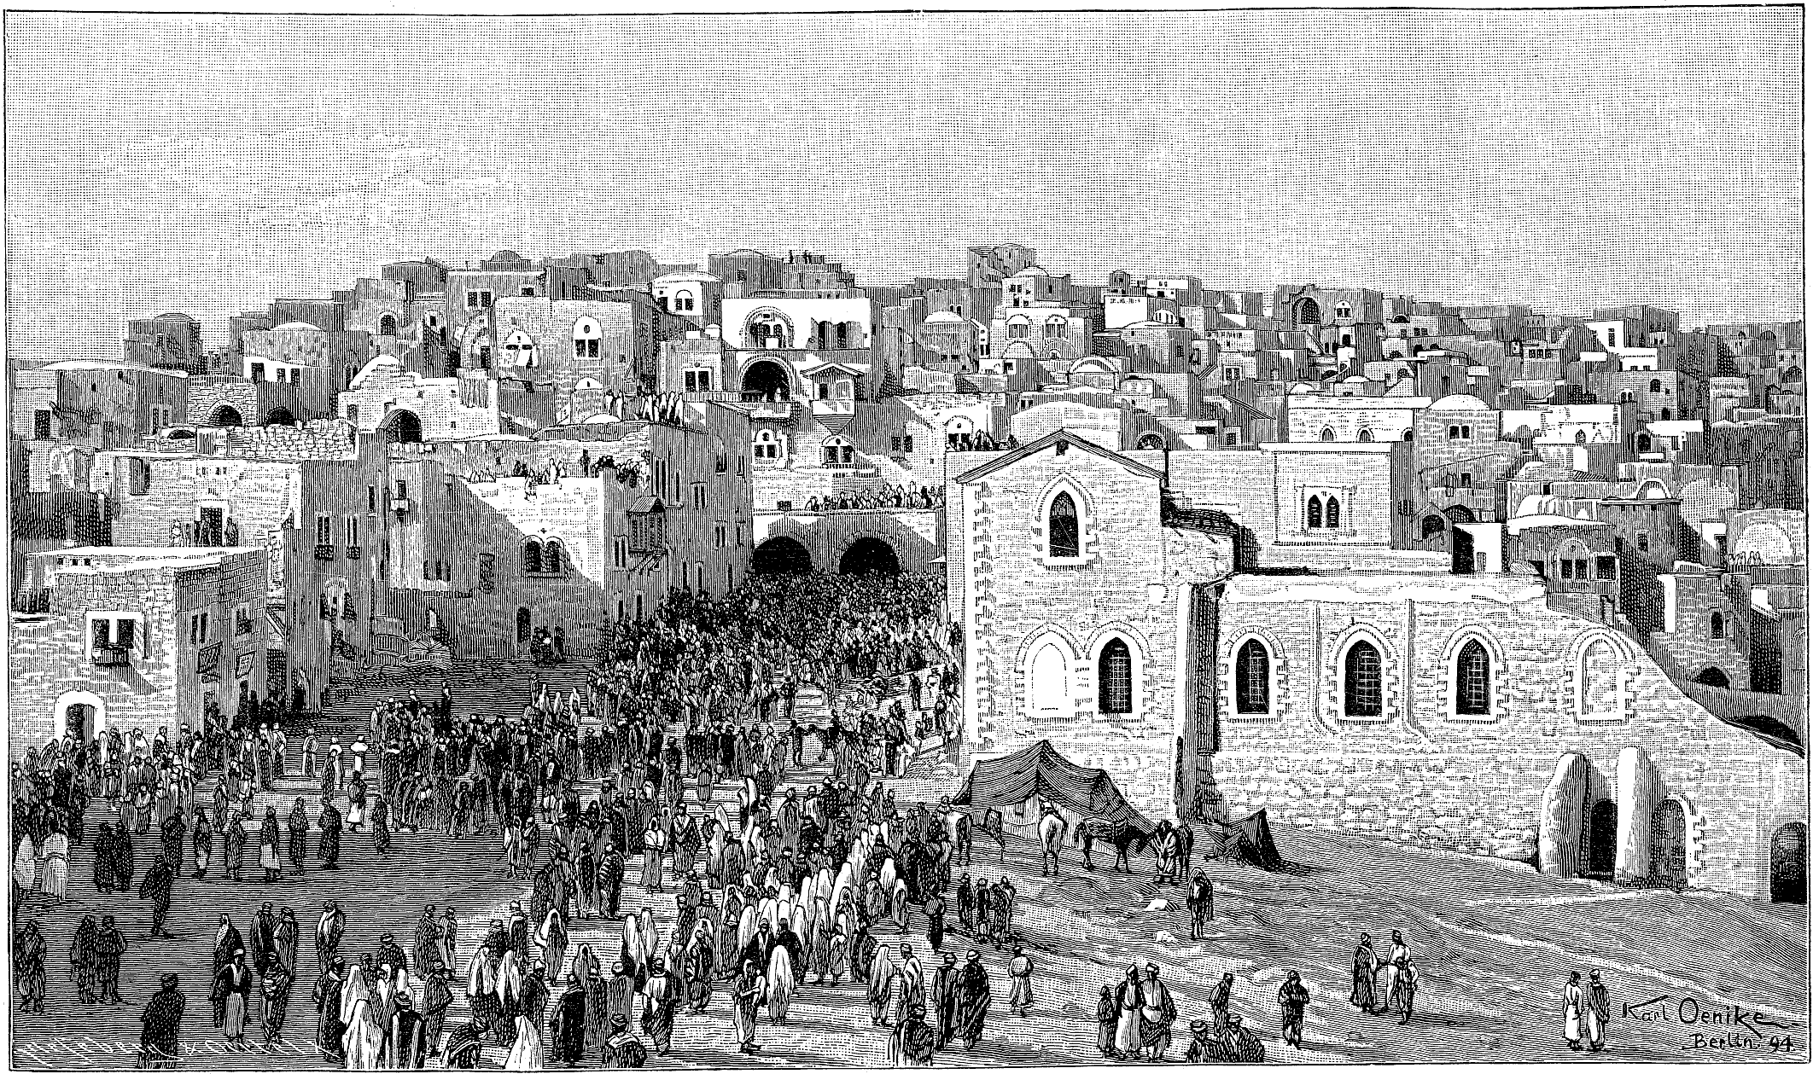
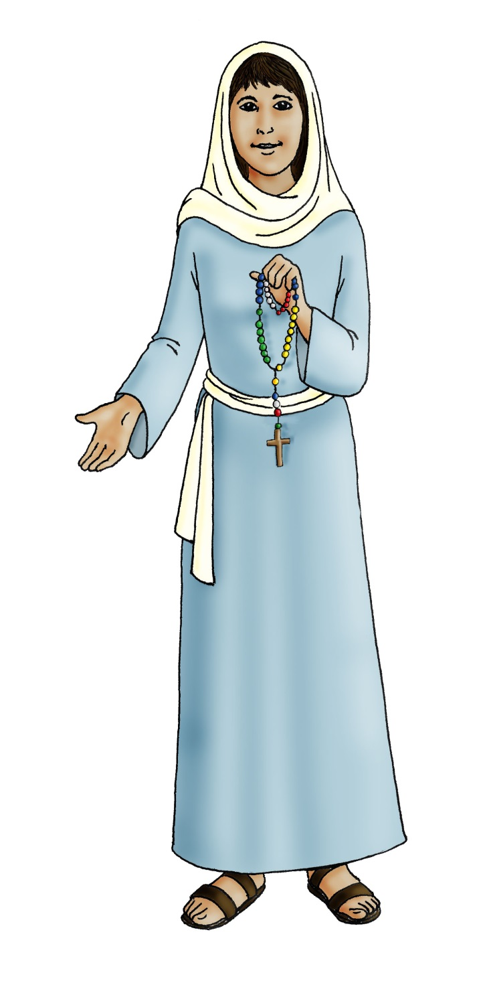

Slide 3
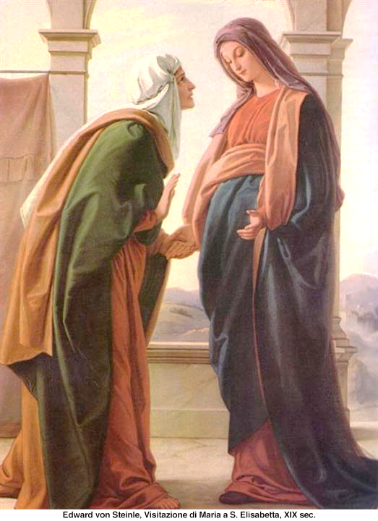
A reading from the Gospel of St Luke 1:39-43 (adapted)
Mary went quickly to a town in the mountains of Judea. She went to Zechariah’s house and greeted Elizabeth.
When Elizabeth heard Mary’s greeting, the unborn baby inside Elizabeth jumped. Then Elizabeth was filled with the Holy Spirit.
She cried out in a loud voice, “God has blessed you more than any other woman. And God has blessed the baby which you will give birth to. You are the mother of my Lord”
This is the Gospel of the Lord.

Slide 4
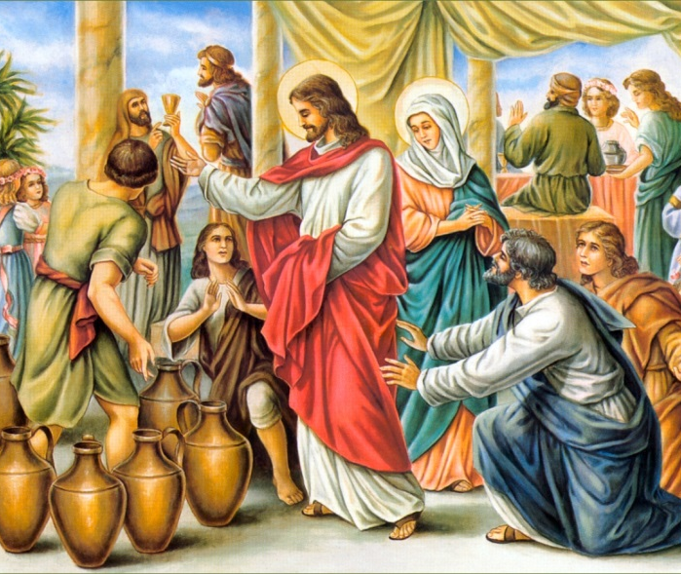
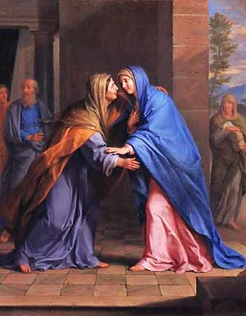
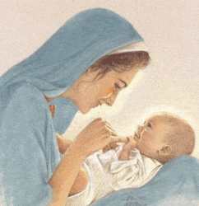
How do we know that Mary was
Generous?

Slide 5
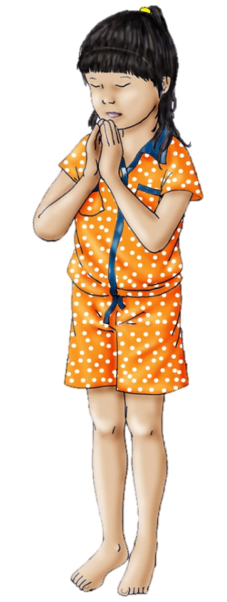
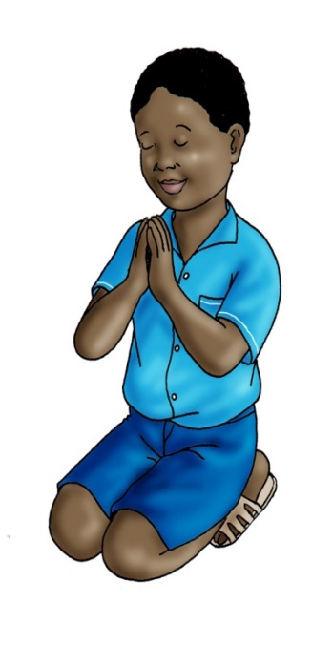
May all children
In the world
Share love
Share friendship and live
In the peace
Of God’s love
Now and forever.
Amen
Hail Mary, full of Grace,
the Lord is with thee.
Blessed art thou among women
And blessed is the fruit of thy womb, Jesus.
Holy Mary Mother of God,
pray for us sinners,
now and at the hour of our death.
Amen

