Slide 1

PROCLAIM WESTMINSTER

Slide 2

Evangelii Gaudium
Evangelii gaudium (English: The Joy of the Gospel) is a 2013 apostolic exhortation by Pope Francis on "the church's primary mission of evangelization in the modern world."^{[1]} In its opening paragraph, Pope Francis urged the entire Church "to embark on a new chapter of evangelism". According to the exhortation, the Church must understand itself as a "community of missionary disciples", who are "permanently in a state of mission".
It has been described as a "remarkable and radical document, one that ranges widely and challenges complacency at every level”, as well as "the manifesto of Francis" and a "Magna Carta for church reform."

Slide 3

In Evangelii Gaudium, Pope Francis calls on all Catholics to be ‘Missionary Disciples’ – to undertake the work of Evangelisation, that is bringing the Good News of the Gospel to others. Jesus commanded the Apostles to “Go therefore and make disciples of all nations”, and we are called to carry on that same mission.
Westminster Diocese is responding to this call through Proclaim Westminster, which aims to establish Parish Evangelisation Teams, to enable and guide the development of Missionary Parishes.

Slide 5
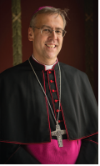
Proclaim Westminster
The Diocese has been on a journey to respond to the Pope's call of discernment to see how we can in our parishes reflect upon our gifts and discern more deeply how we might best share the good news that Jesus Christ has triumphed over sin and death, and walks with us to lead us to new life.
In a document entitled Towards a Vision for New Evangelisation in the Archdiocese of Westminster, Bishop Nicholas provides a reflection on the theme and outlines the many forms that this evangelisation might take. He also unveils a series of initiatives to help us discern how we might discover the charism in our parishes and how we can broaden our outreach further.

Slide 6
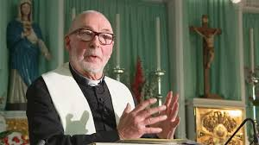
What did we decide to do in our Parish?
Each parish was asked to choose three Evangelising Initiatives thinking about what we already do well in Evangelisation and what more might we do in the light of Evangelii Gaudium?
Some parishioners gathered together with Father John and took the decision to focus on the following three areas:
To deepen further our prayer life through looking at the variety of opportunities for prayer available and endeavouring to extend these.
To extend and develop the social action work in our parish.
To endeavour to deepen the sense of belonging of non-churchgoing Catholics in our parish.
We then engaged in planning a range of activities related to these key areas.

Slide 7
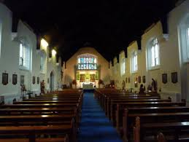
Focus 1: Deepen further our Prayer Life
Church open each morning (Mon – Sat) from 7am for private prayer / Adoration (extended times during Advent and Lent)
Advent / Lent prayer groups led by priest
Rosary group (Wednesday evening)
Legion of Mary (Sunday afternoons)
Advent / Lenten Services of Reconciliation (Examination of Conscience booklets produced) and Novenas e.g. Holy Spirit, Little Chaplet of the 5 Wounds etc.
Masses and Devotions extended e.g. Fatima anniversaries including processions
New statues purchased
Bible Study (priest led)
Holy Hours – e.g. Corporal Works of Mercy, Spiritual Works of Mercy
Easter and Epiphany Acts of Consecration
Morning and Evening prayer

Slide 8
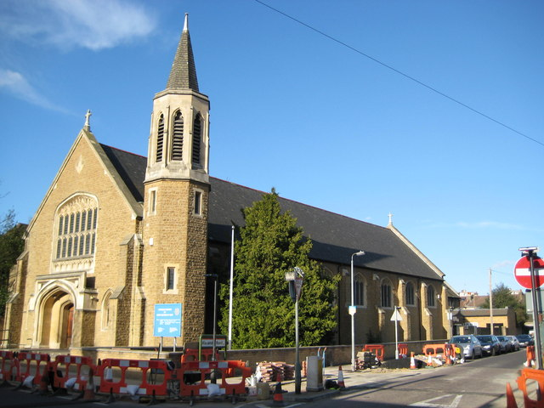
Focus 2: Extend and Develop the Social Action Work in our Parish (Caritas)
Relaunched the SVP
Friday Lunch (parish kitchen improved, storage developed, food sourced, grant gained)
Food Bank
Legion of Mary Weekly Visiting (X 5 care homes, people in sheltered accommodation, people in their own homes)
Weekly Meetings of Legion Praesidium + strong links with other praesidia.

Slide 9
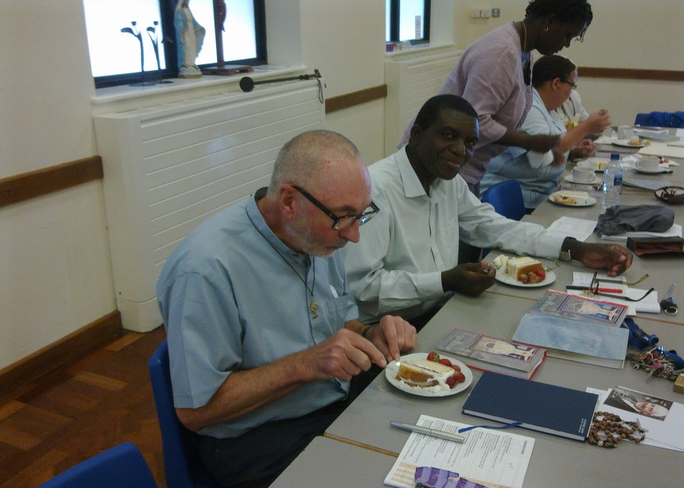
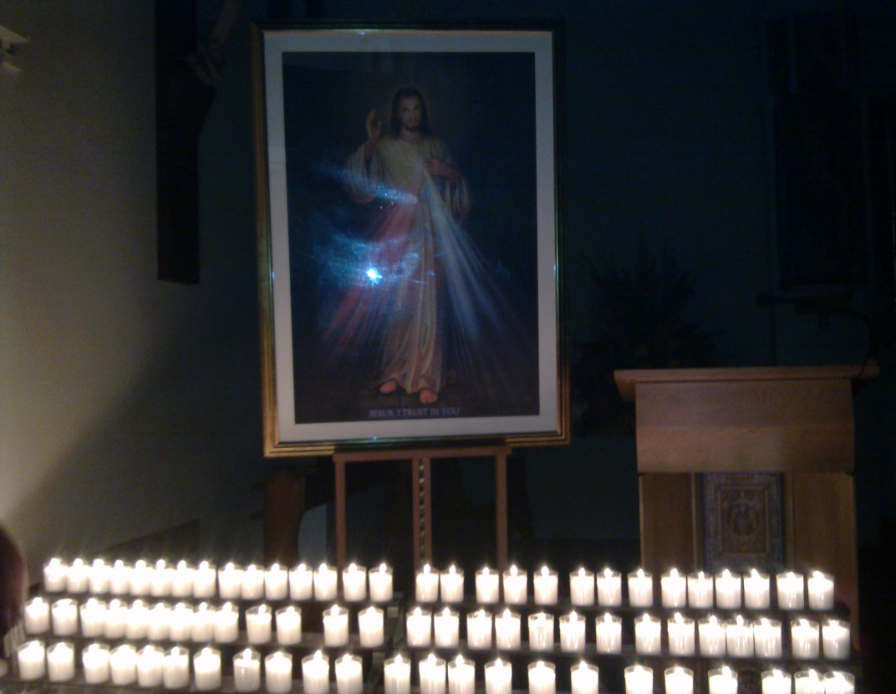
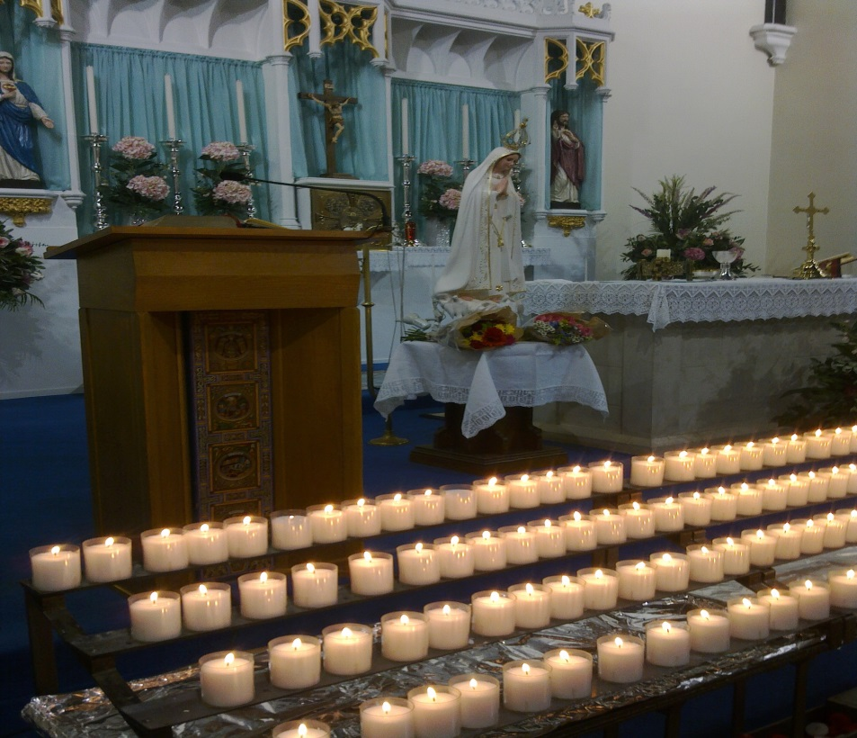
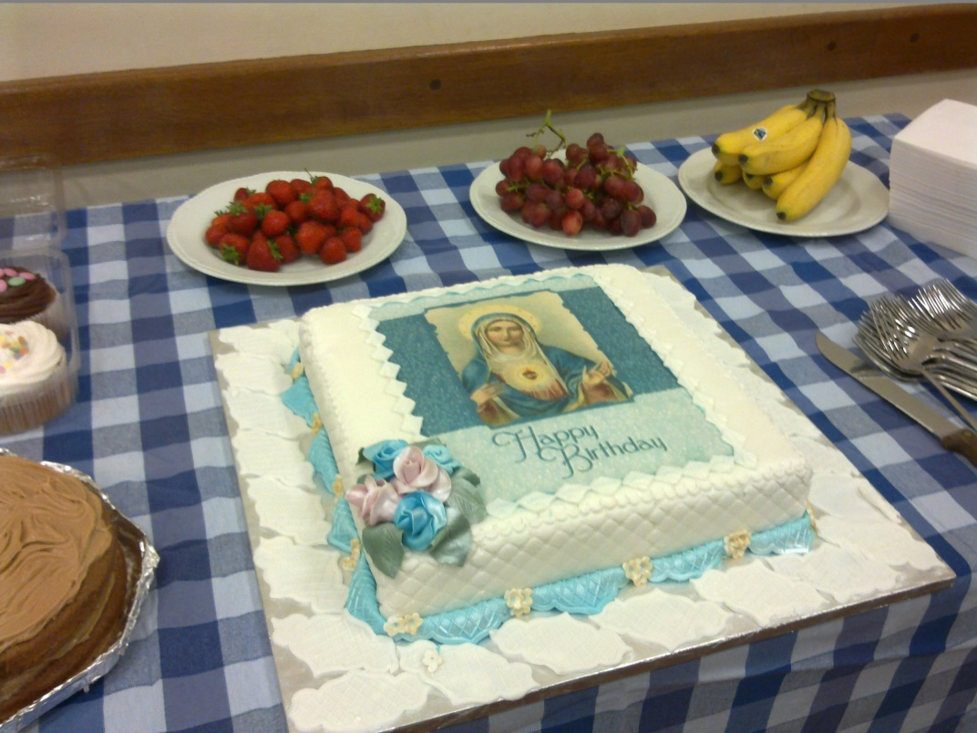

Slide 10
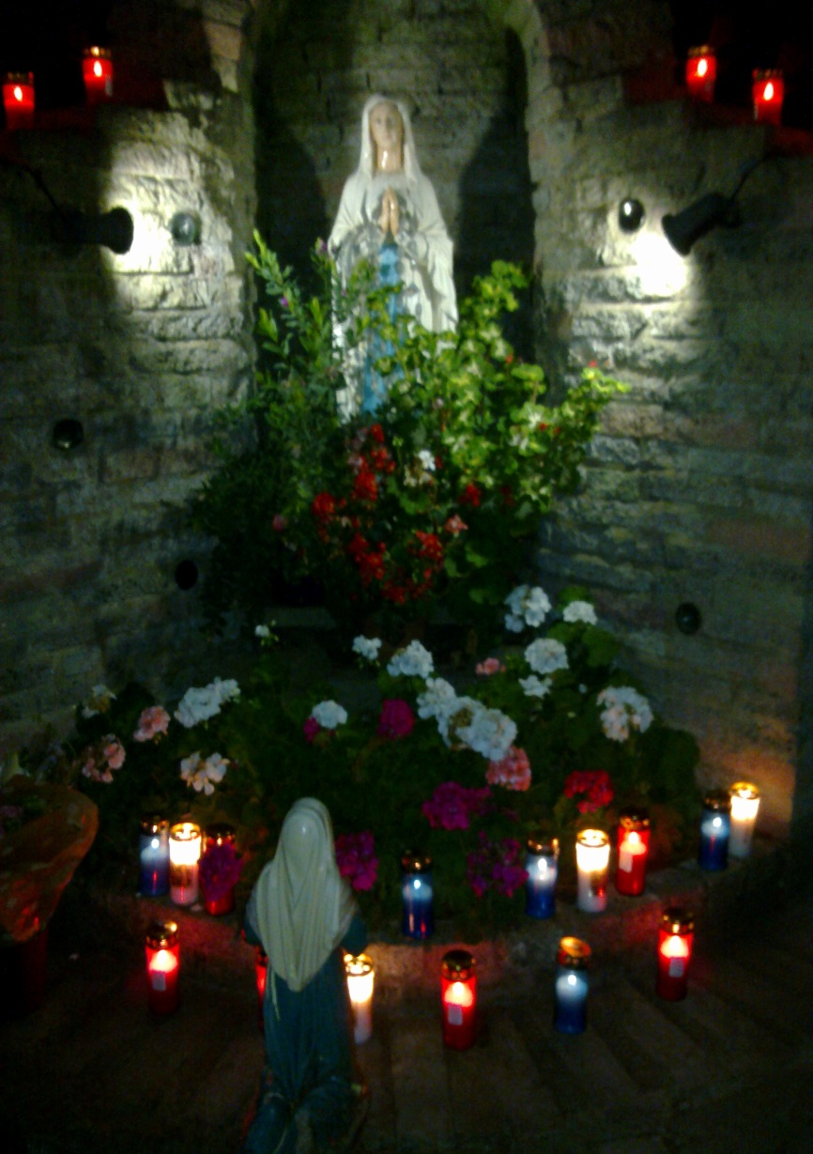
Focus 3: Deepen the Sense of Belonging to our Parish
Mass for Families, ‘God is Love’ with individual family blessings
Masses of Remembrance (bringing crosses forward)
Blessing of Hands (carers)
Consecration of Families to Sacred Heart
Individuals volunteering to help with Friday Lunch and Legion of Mary visiting etc.

Slide 11
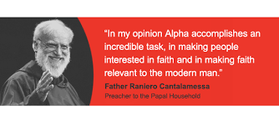
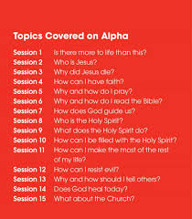

What next?
https://alpha.org/alpha-film-series/blog/new-alpha-film-series-promo-trailer

Slide 12
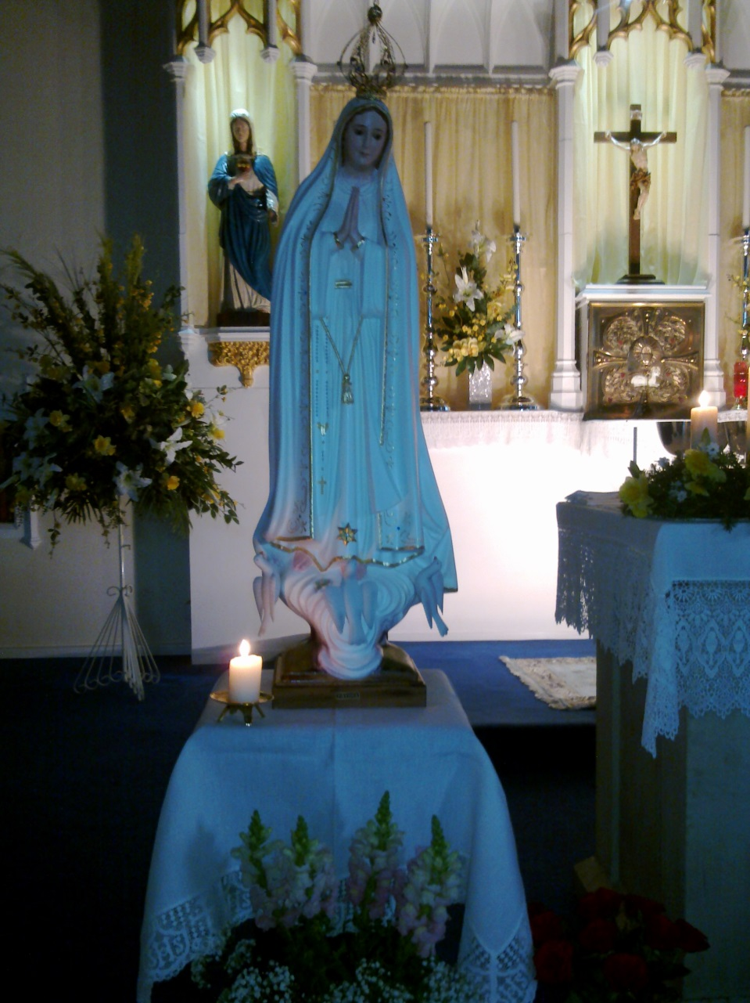
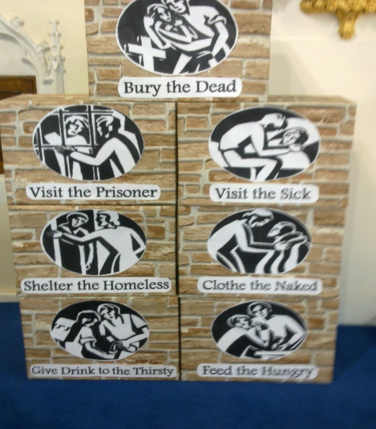
What next?
Welcoming People at Mass Ministry
Praying with people in their homes
Family Occasions
Coffee Mornings

