Slide 1
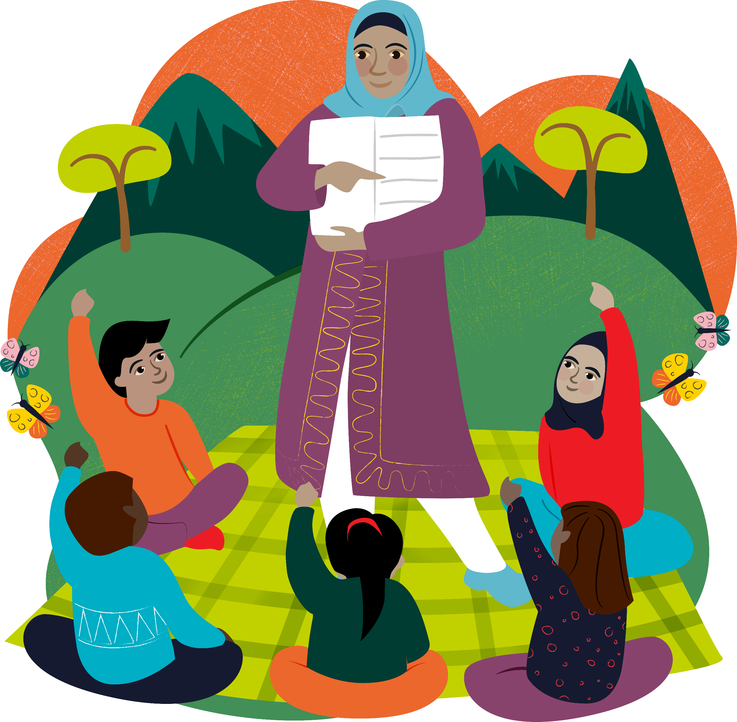
Loving God,
we believe all children
have a right to learn, grow and ask questions.
Today we pray for those
who are not able to go to school.
We ask that more people
have the chance to become teachers,
so that all children can learn new skills
and make a better life for themselves.
Amen

Slide 2
Loving God,
we believe all children
have a right to learn, grow and ask questions.
Today we pray for those
who are not able to go to school.
We ask that more people
have the chance to become teachers,
so that all children can learn new skills
and make a better life for themselves.
Amen

Slide 3
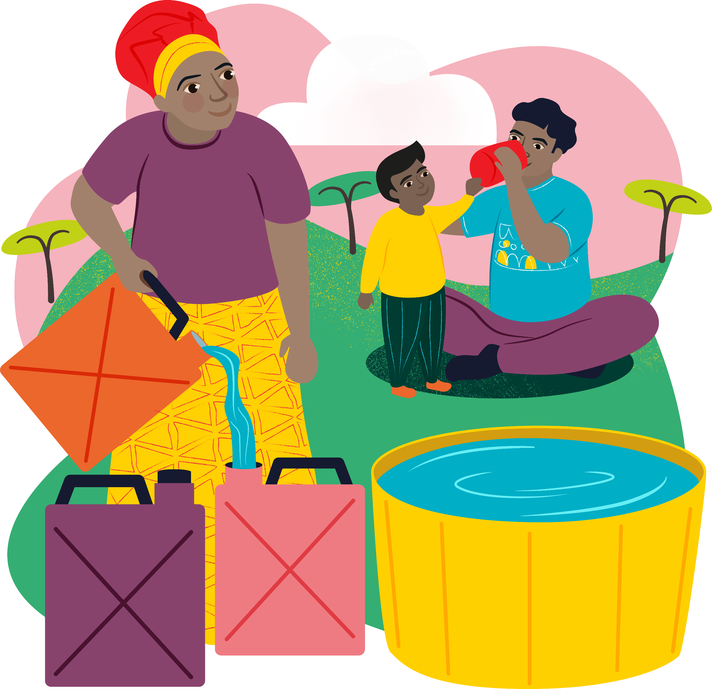
Loving God,
we remember those
who have no clean water to drink
or who look for water but cannot find it.
Help us to share the gifts God gave
us with our sisters and brothers
around the world so that no one
goes hungry and thirsty.
Amen

Slide 4
Loving God,
we remember those
who have no clean water to drink
or who look for water but cannot find it.
Help us to share the gifts God gave
us with our sisters and brothers
around the world so that no one
goes hungry and thirsty.
Amen

Slide 5
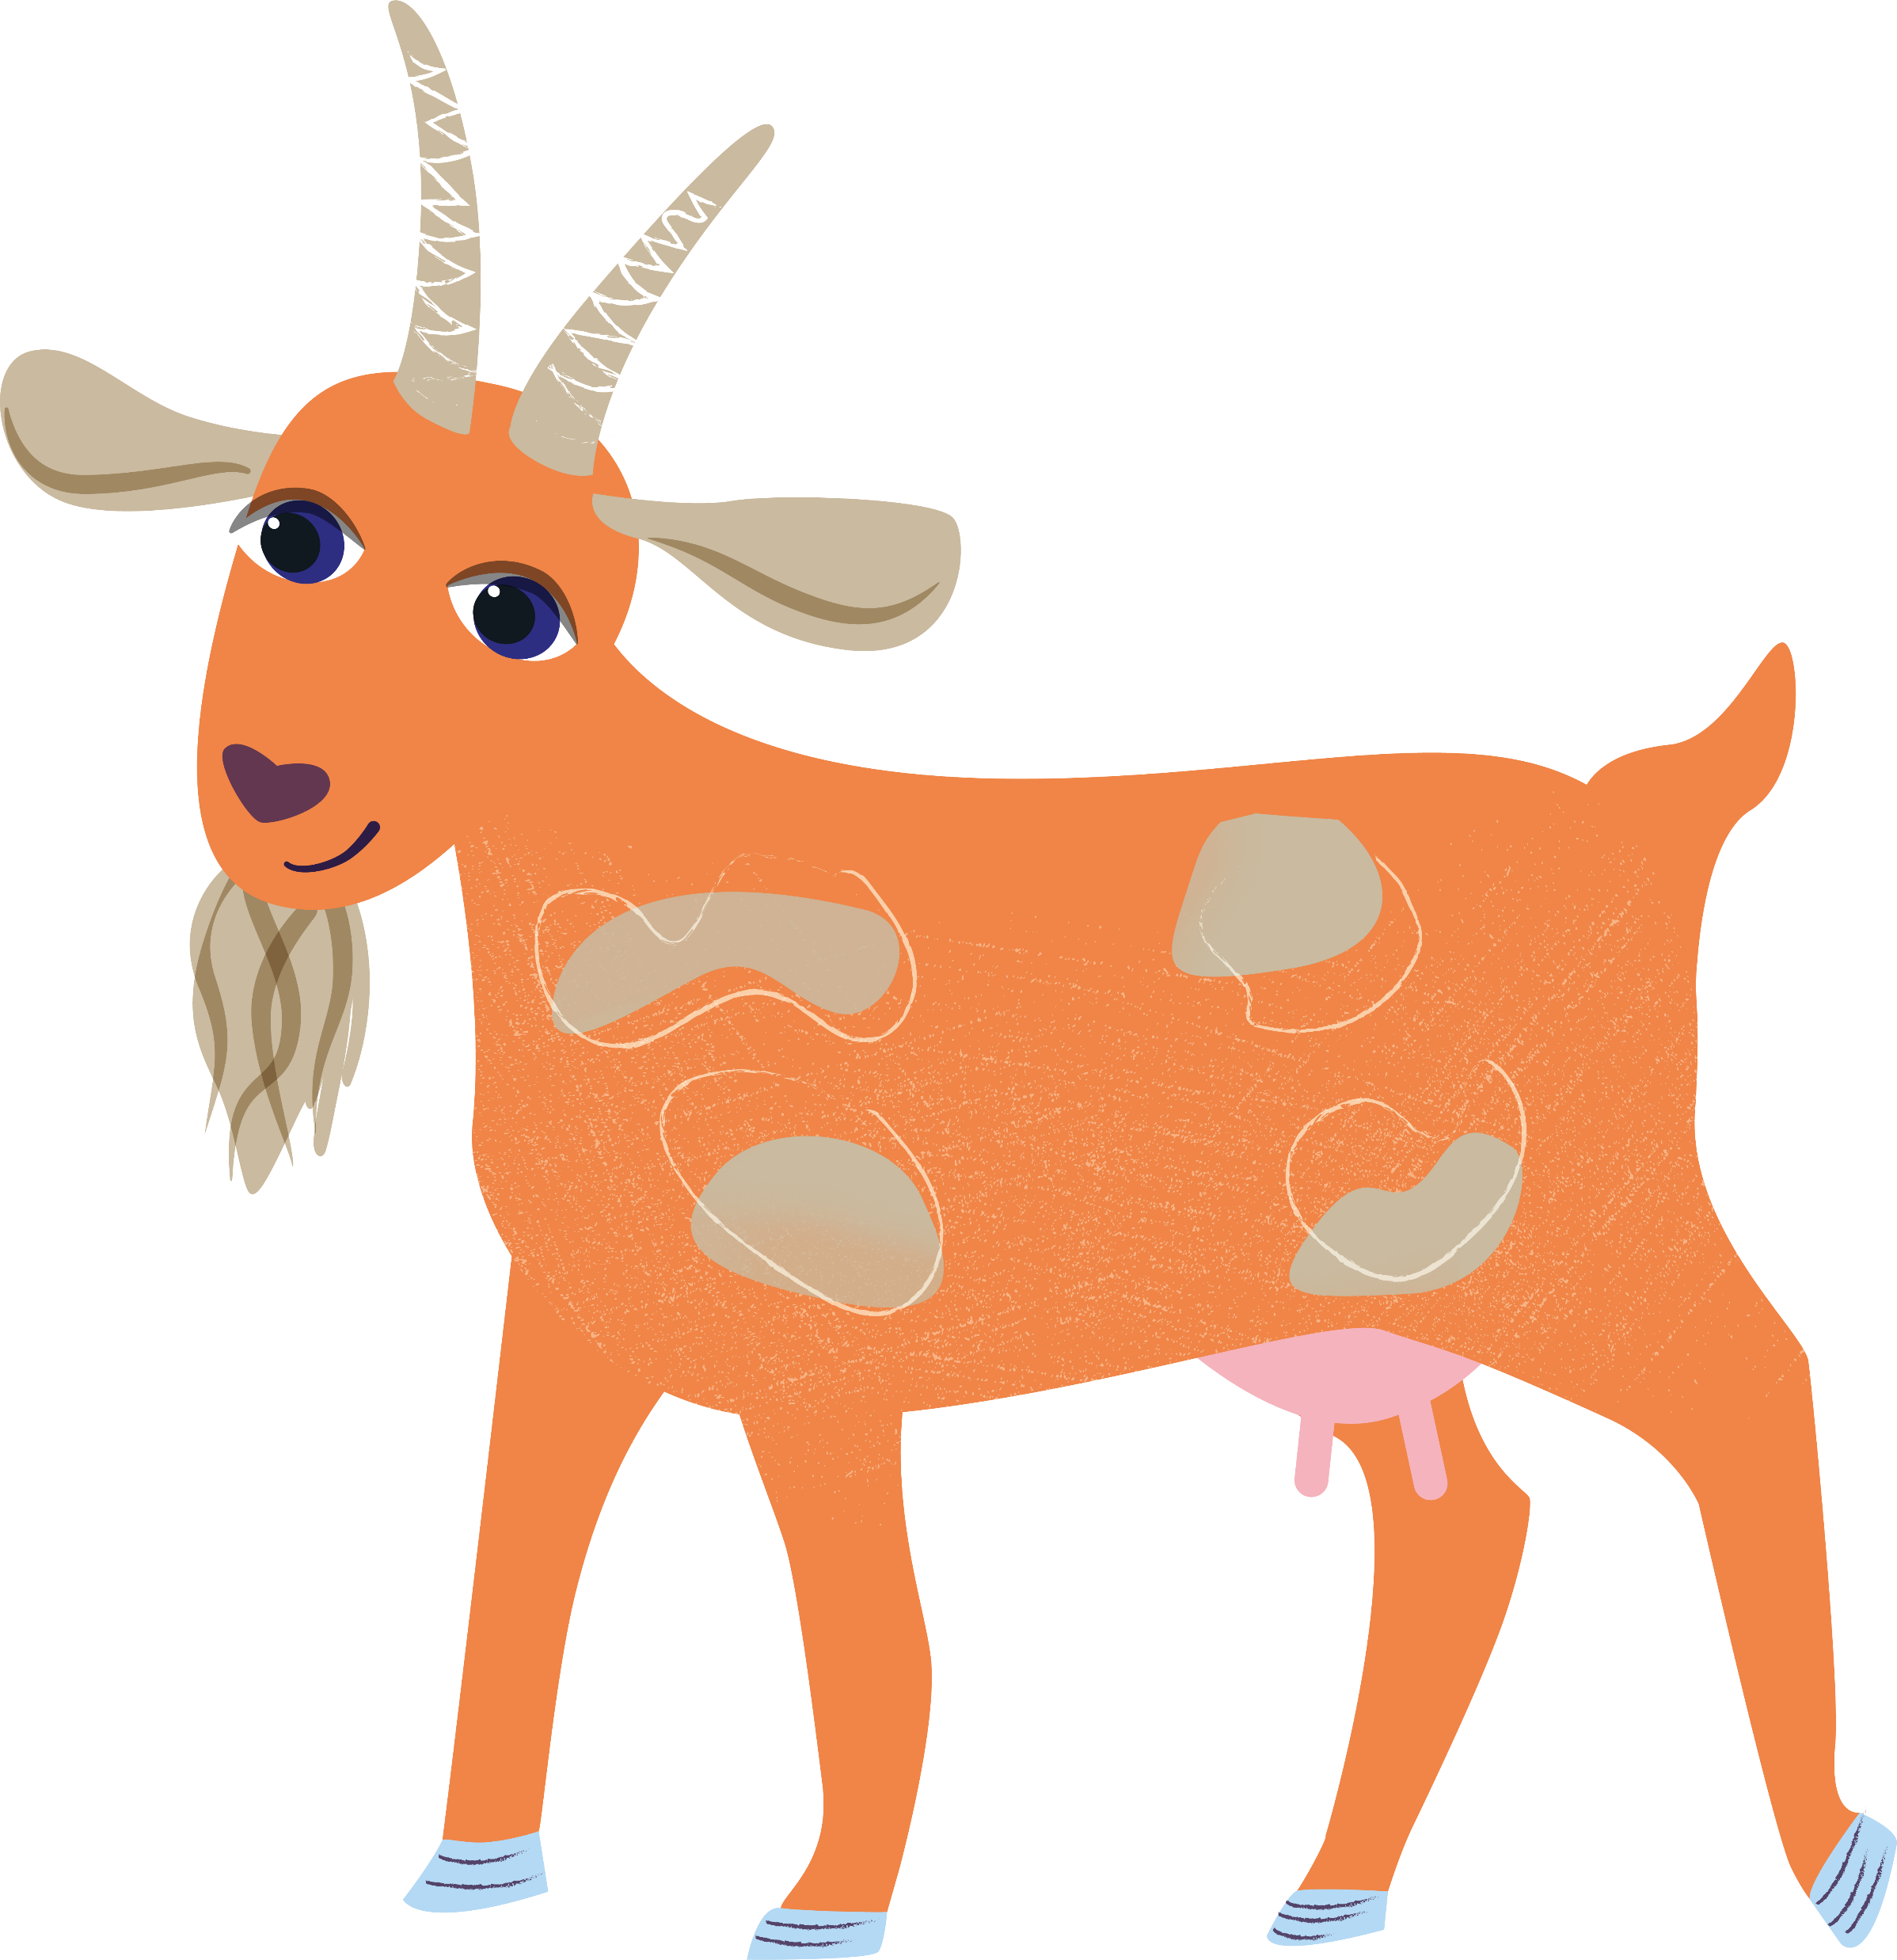
Loving God,
you gave the world for us all to live on,
a world of wonder, beauty and plenty
where no one should go hungry.
We pray today for the people who work hard in the fields
and for those who look after animals.
Lord, teach us to look after the earth
and to take care of our sisters and brothers around the world.
Amen

Slide 6
Loving God,
you gave the world for us all to live on,
a world of wonder, beauty and plenty
where no one should go hungry.
We pray today for the people who work hard in the fields
and for those who look after animals.
Lord, teach us to look after the earth
and to take care of our sisters and brothers around the world.
Amen

Slide 7
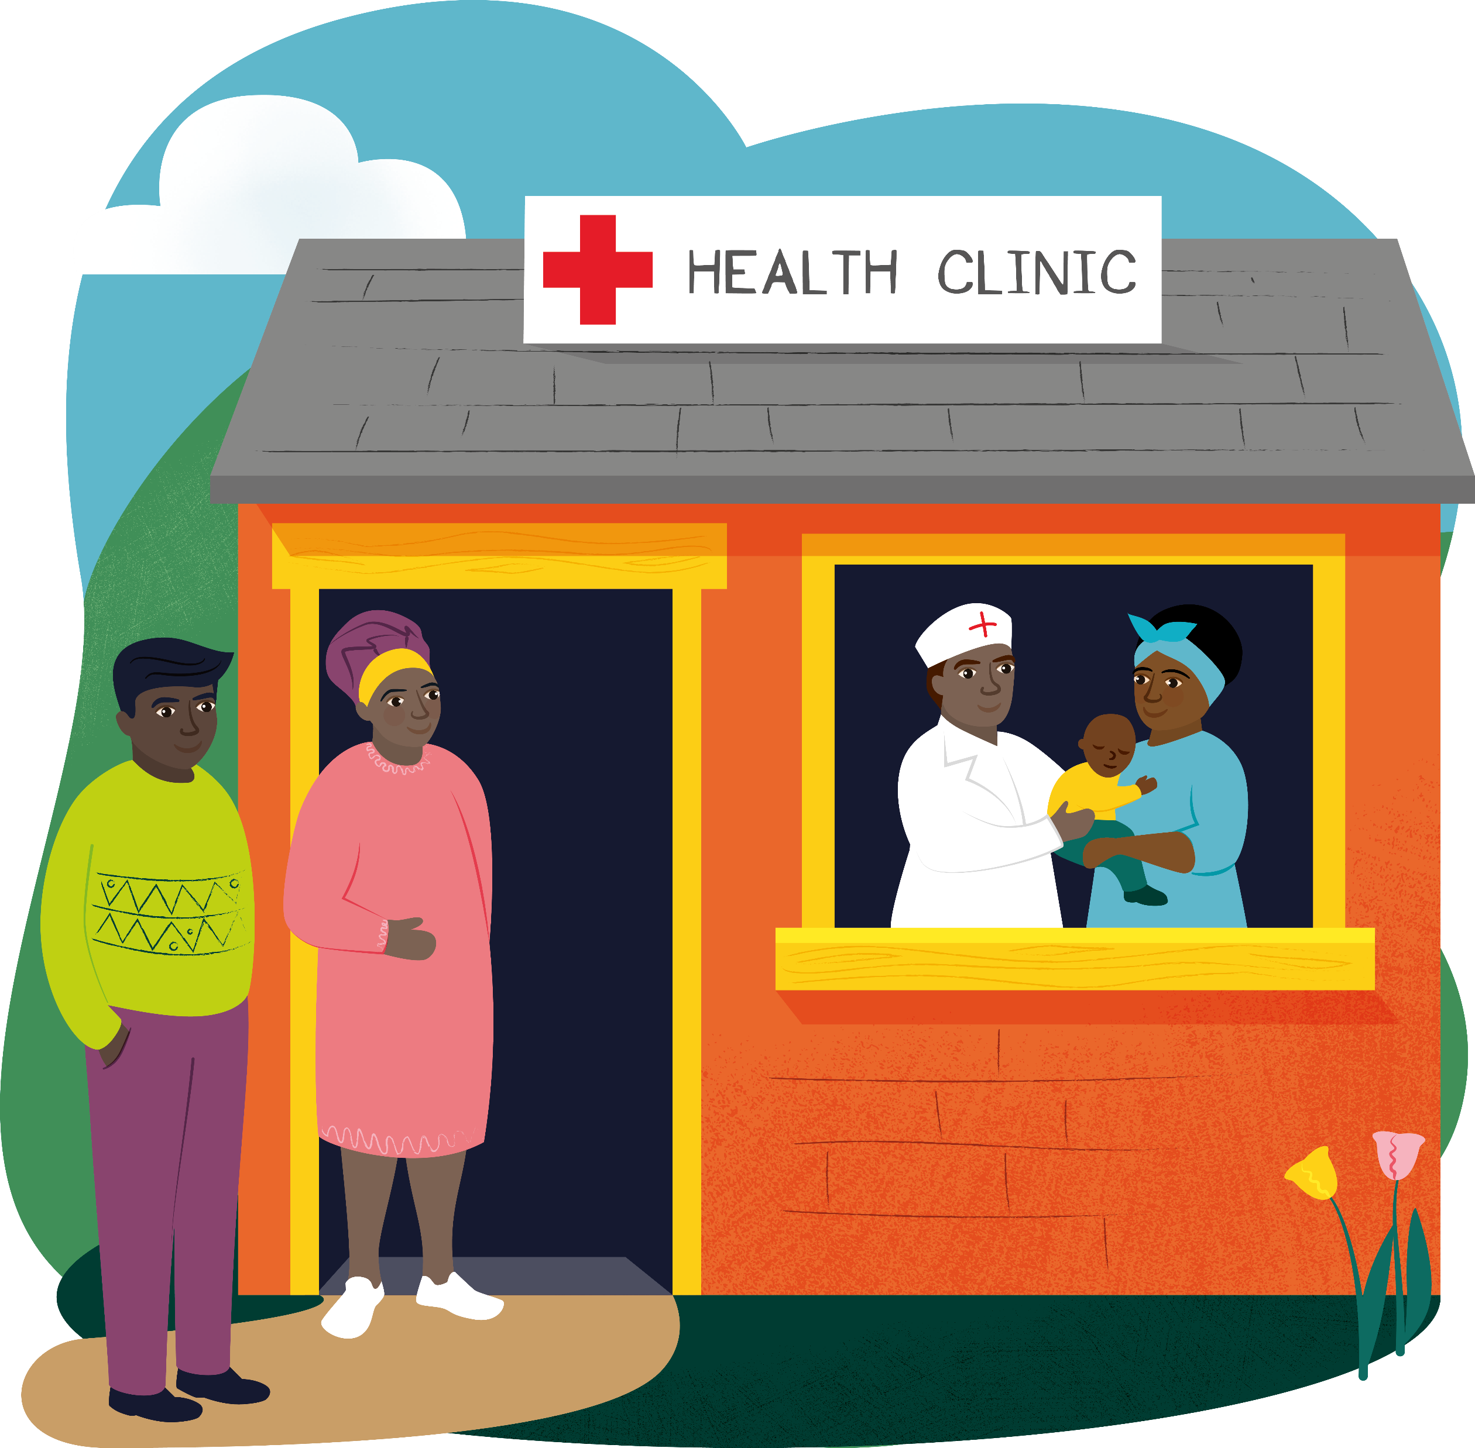
Loving God,
We think of people around the world
who are sick,
and who might be scared and lonely
because of their illness.
Through our prayers,
help the frightened to be brave
and the lonely to find new friends.
Help us to share your love,
so that all who are ill feel cared for.
Amen

Slide 8
Loving God,
We think of people around the world
who are sick,
and who might be scared and lonely
because of their illness.
Through our prayers,
help the frightened to be brave
and the lonely to find new friends.
Help us to share your love,
so that all who are ill feel cared for.
Amen

