Slide 1
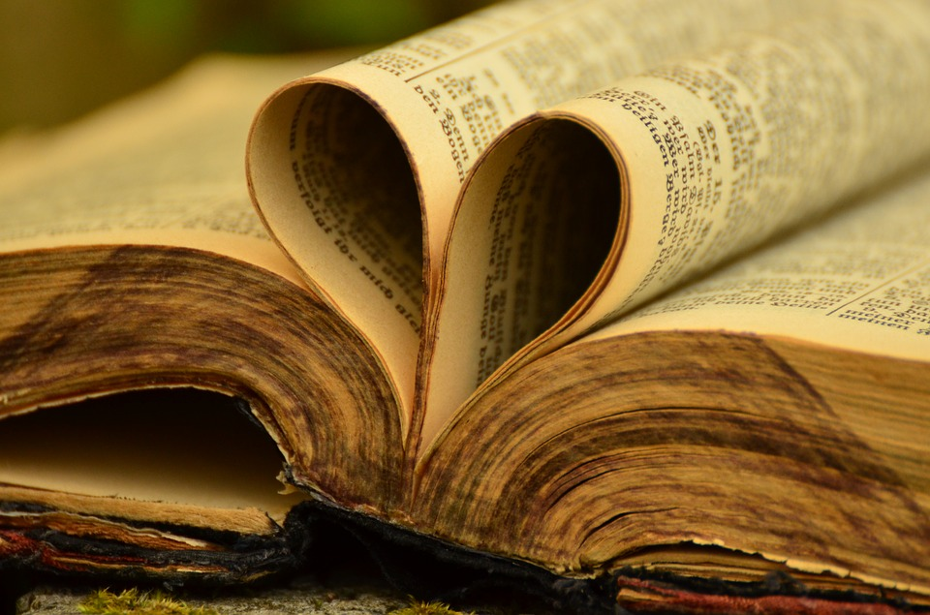
The DIOCESE OF WESTMINSTER
SUNDAY OF THE
WORD OF GOD
SUNDAY 24th JANUARY 2021

Slide 2
The word of God is in no way less than the Body of Christ; nor should it be received less worthily.
I ask you, brothers or sisters, tell me: which to you seems the greater, the word of God, or the Body of Christ? If you wish to say what is true you will have to answer that the word of God is not less than the Body of Christ.
Therefore just as when the Body of Christ is administered to us, what care do we not use so that nothing of it falls from our hands to the ground, so should we with equal care see that the word of God which is being imparted to us shall not be lost to our soul, while we speak or think of something else.
For he who listens carelessly to the word of God is not less guilty than he who through his own inattention suffers the Body of Christ to fall to the ground.
St Caesarius of Arles (469-541)

Slide 3
Teacher/Parent Information
The Sunday of the Word of God takes place on the third Sunday in Ordinary Time, during January. Pope Francis’ Apostolic Letter, issued motu proprio (of his own initiative), Aperuit illis, published on 30 September 2019, establishes that "the Third Sunday in Ordinary Time is to be devoted to the celebration, study and dissemination of the Word of God" The day will take place on Sunday 24th January in 2021.
Pope Francis is inviting Catholics across the world to deepen their appreciation, love and faithful witness to God and his Word.

Slide 4
The Logo!
The official logo for the Sunday of the Word of God was unveiled at the Vatican on 17th January 2020, depicting ‘The Road to Emmaus’. It is based on an icon produced by Benedictine nun Marie-Paul Farran, a member of the Our Lady of Calvary Congregation, who lived and worked at its monastery on the Mount of Olives in Jerusalem.

Slide 5
The logo shows the Resurrected Christ holding in his left hand a scroll, which is ‘the sacred Scripture that found its fulfilment in his person.’
By his side are two disciples: Cleopas and his wife, Mary. They both fix their gaze on Christ while Cleopas holds a stick to indicate ‘a pilgrimage.’
Mary is holding one hand upward and with her other hand seems to be touching the Lord, reaffirming that he has fulfilled the ancient promises and is the living Word that must be proclaimed to the world.

Slide 6
Holding the stick in one hand, Cleopas’ free hand is pointing the road ahead, which all disciples are called to take in order to bring the Good News to everyone, There is a star overhead symbolizing the ‘permanent light’ that guides their journey and shows them the way.
The feet of all three are depicted as being in motion, representing that the proclamation of the Risen Christ cannot be accomplished by ‘tired or lazy disciples’ but only by those who are ‘dynamic’ and ready to find new ways to speak so that sacred Scripture may become the living guide of the life of the Church and its people.

Slide 7
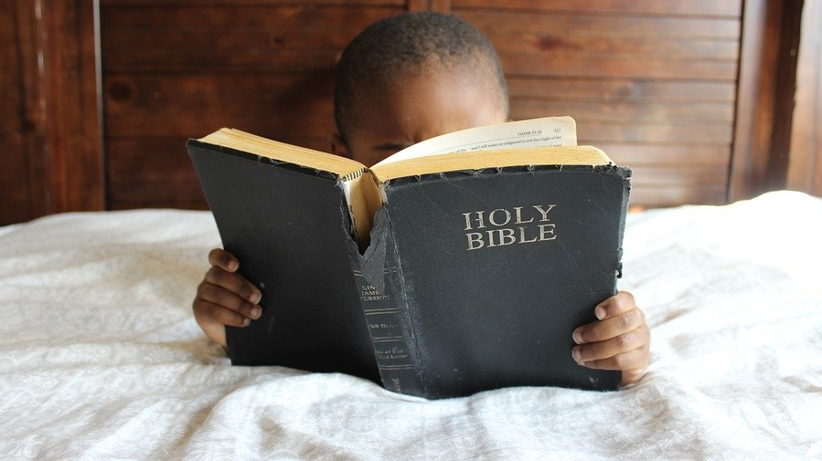
SUNDAY OF THE WORD OF GOD

Slide 8
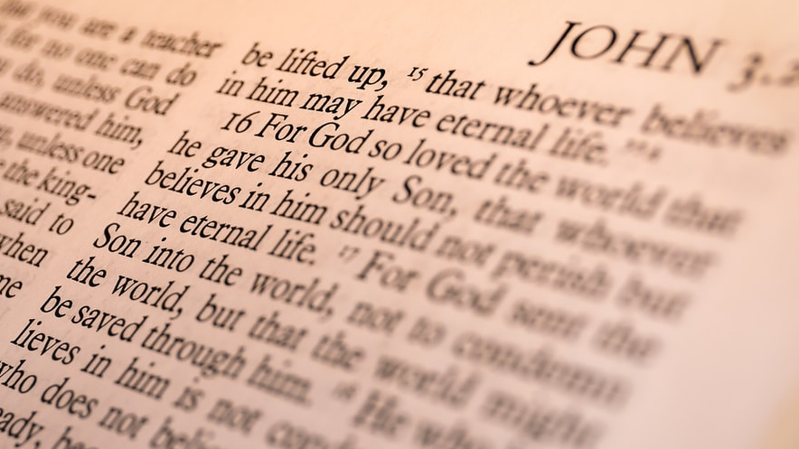
Gather

Slide 9
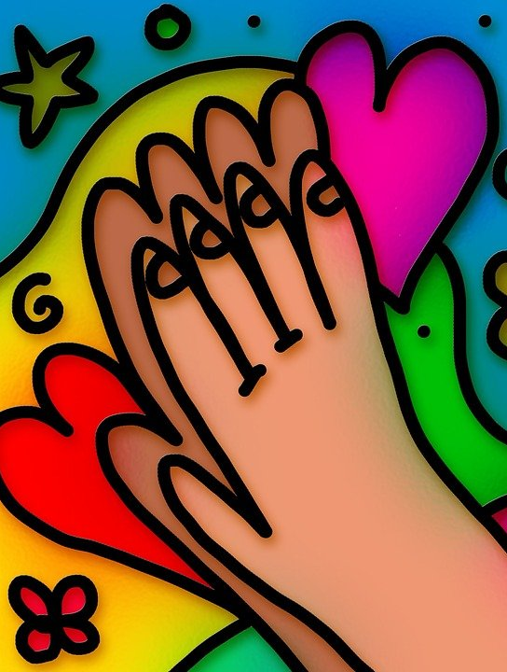
Pilgrim God, you walk alongside us and speak to us throughout the Scriptures: in the message of the prophets, the songs of David and the vision of Paul.
Your Son, Jesus Christ, listens to our hopes and fears and shows us how to live: in our love of neighbour, our desire for justice, and in our dying and rising each day.

Slide 10
Send us the Holy Spirit to open our hearts and minds so that we may be your witnesses throughout the world: in our protection of the vulnerable, our words and actions and in our communion with the earth.
Amen

Slide 11
Listen

Slide 12
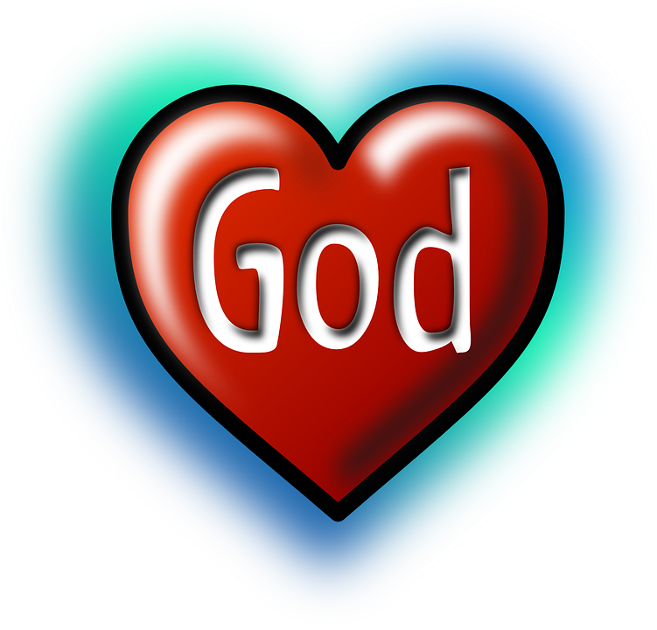
We often identify the Bible as the Word of God. This is not wrong, but God speaks to our hearts in many different ways. For instance, he speaks to us in prayer and through our conscience, and often through other people. Hence, the Word of God covers much more than a printed book. Nevertheless, the Bible is the privileged collection of communications between God and his people.

Slide 13
Mark 1:14 – 20
This Sunday’s Gospel tells us how Jesus called his first disciples.
Jesus also shares the Good News of God…Good News for the whole world!

Slide 14
Mark 1:14 - 20
Jesus Announces the Good News
After John was put in prison, Jesus went into Galilee, proclaiming the good news of God. “The time has come,” he said. “The kingdom of God has come near. Repent and believe the good news!”
Jesus Calls His First Disciples
As Jesus walked beside the Sea of Galilee, he saw Simon and his brother Andrew casting a net into the lake, for they were fishermen.

Slide 15
Mark 1:14 - 20
“Come, follow me,” Jesus said, “and I will send you out to fish for people.” At once they left their nets and followed him.
When he had gone a little farther, he saw James son of Zebedee and his brother John in a boat, preparing their nets. Without delay he called them, and they left their father Zebedee in the boat with the hired men and followed him.

Slide 16
Respond

Slide 17
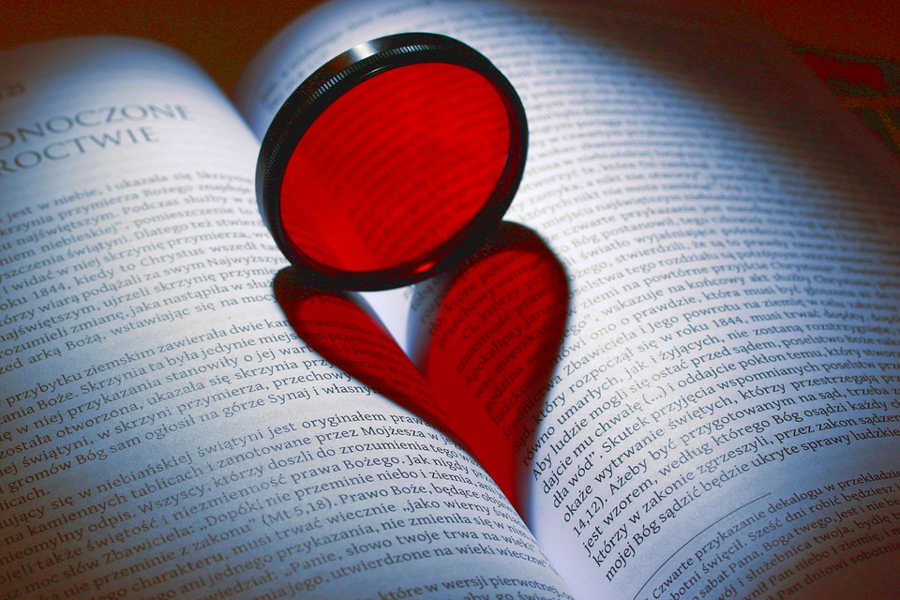
For all who read the word of God; may they be inspired to love God with all their heart and soul.
Lord Hear Us…

Slide 18
For all who pray with the word of God; may their lives be a living witness to the way of the Lord.
Lord Hear Us…

Slide 19
For the Church: that rooted in the Word of God, we may continue to build up the Body of Christ and promote the common good.
Lord Hear Us…

Slide 20
For Christian leaders: that they walk in the ways of the Lord and encourage others to do the same.
Lord Hear Us…

Slide 21
For all who teach and preach the Word of God: that their words may renew the faith of those who listen and encourage them to trust in the promise of God.
Lord Hear Us…

Slide 22
For this community: that we may have an ever-greater openness to the Word of God and allow it to enlighten the darkness of our hearts.
Lord Hear Us…

Slide 23
Everlasting God, when he read in the synagogue at Nazareth, your Son proclaimed the good news of salvation for which he would give up his life.
Bless all who will read from these sacred texts. As they read, listen and reflect on your words of life, strengthen their faith so that what they read in hope, they may live in love and charity.
We ask this through Christ our Lord.
Amen.

Slide 24
Mission

Slide 25
Design your own logo for
The Sunday of the Word
Make sure it shows the importance of the Bible and how it guides Catholics in their beliefs and practices.
Around your logo explain what you have chosen to include and why.
Share what you have done with your parents/carers.

Slide 26
Reflect on…
How can you show the power of the Word of God working through you this week and beyond?
What can you do at home to show that your actions are guided by God’s word?
Choose your favourite piece of scripture and share why it is so important to you with someone at home.

Slide 27
SUNDAY OF THE
WORD OF GOD

