Slide 1
Sports for schools
Introduction to Daniel Lewis

Slide 2
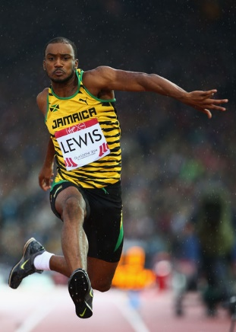
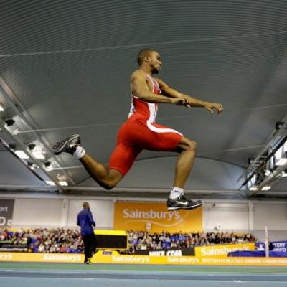
Daniel Lewis – GB Triple Jumper
Daniel Lewis
Daniel’s main discipline is Triple Jump, though he competes in other sports too.
His PB is 16.31m which he achieved in 2014
Getting involved in the triple jump at the age of 15 Daniel quickly progressed to the become one of the best the country has seen, enjoying national successes throughout his youth years.

Slide 3
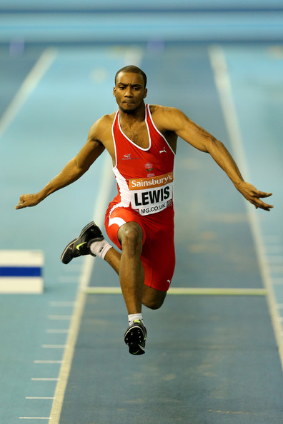
Daniel Lewis – GB Triple Jumper
Daniel Lewis
Being a 4-time National English Schools’ medallist earnt him an invite to the Olympic trials whilst still a junior.
In 2014, Daniel ended the indoor season ranked 3rd in Britain, being called-up to represent England as a senior for the first time.
He was selected to compete at the 2014 Commonwealth Games, representing his parent’s country of origin, Jamaica. He successfully negotiated his way safely through to the final and finished in 7th place, the highest of any Caribbean jumper.

