Slide 2
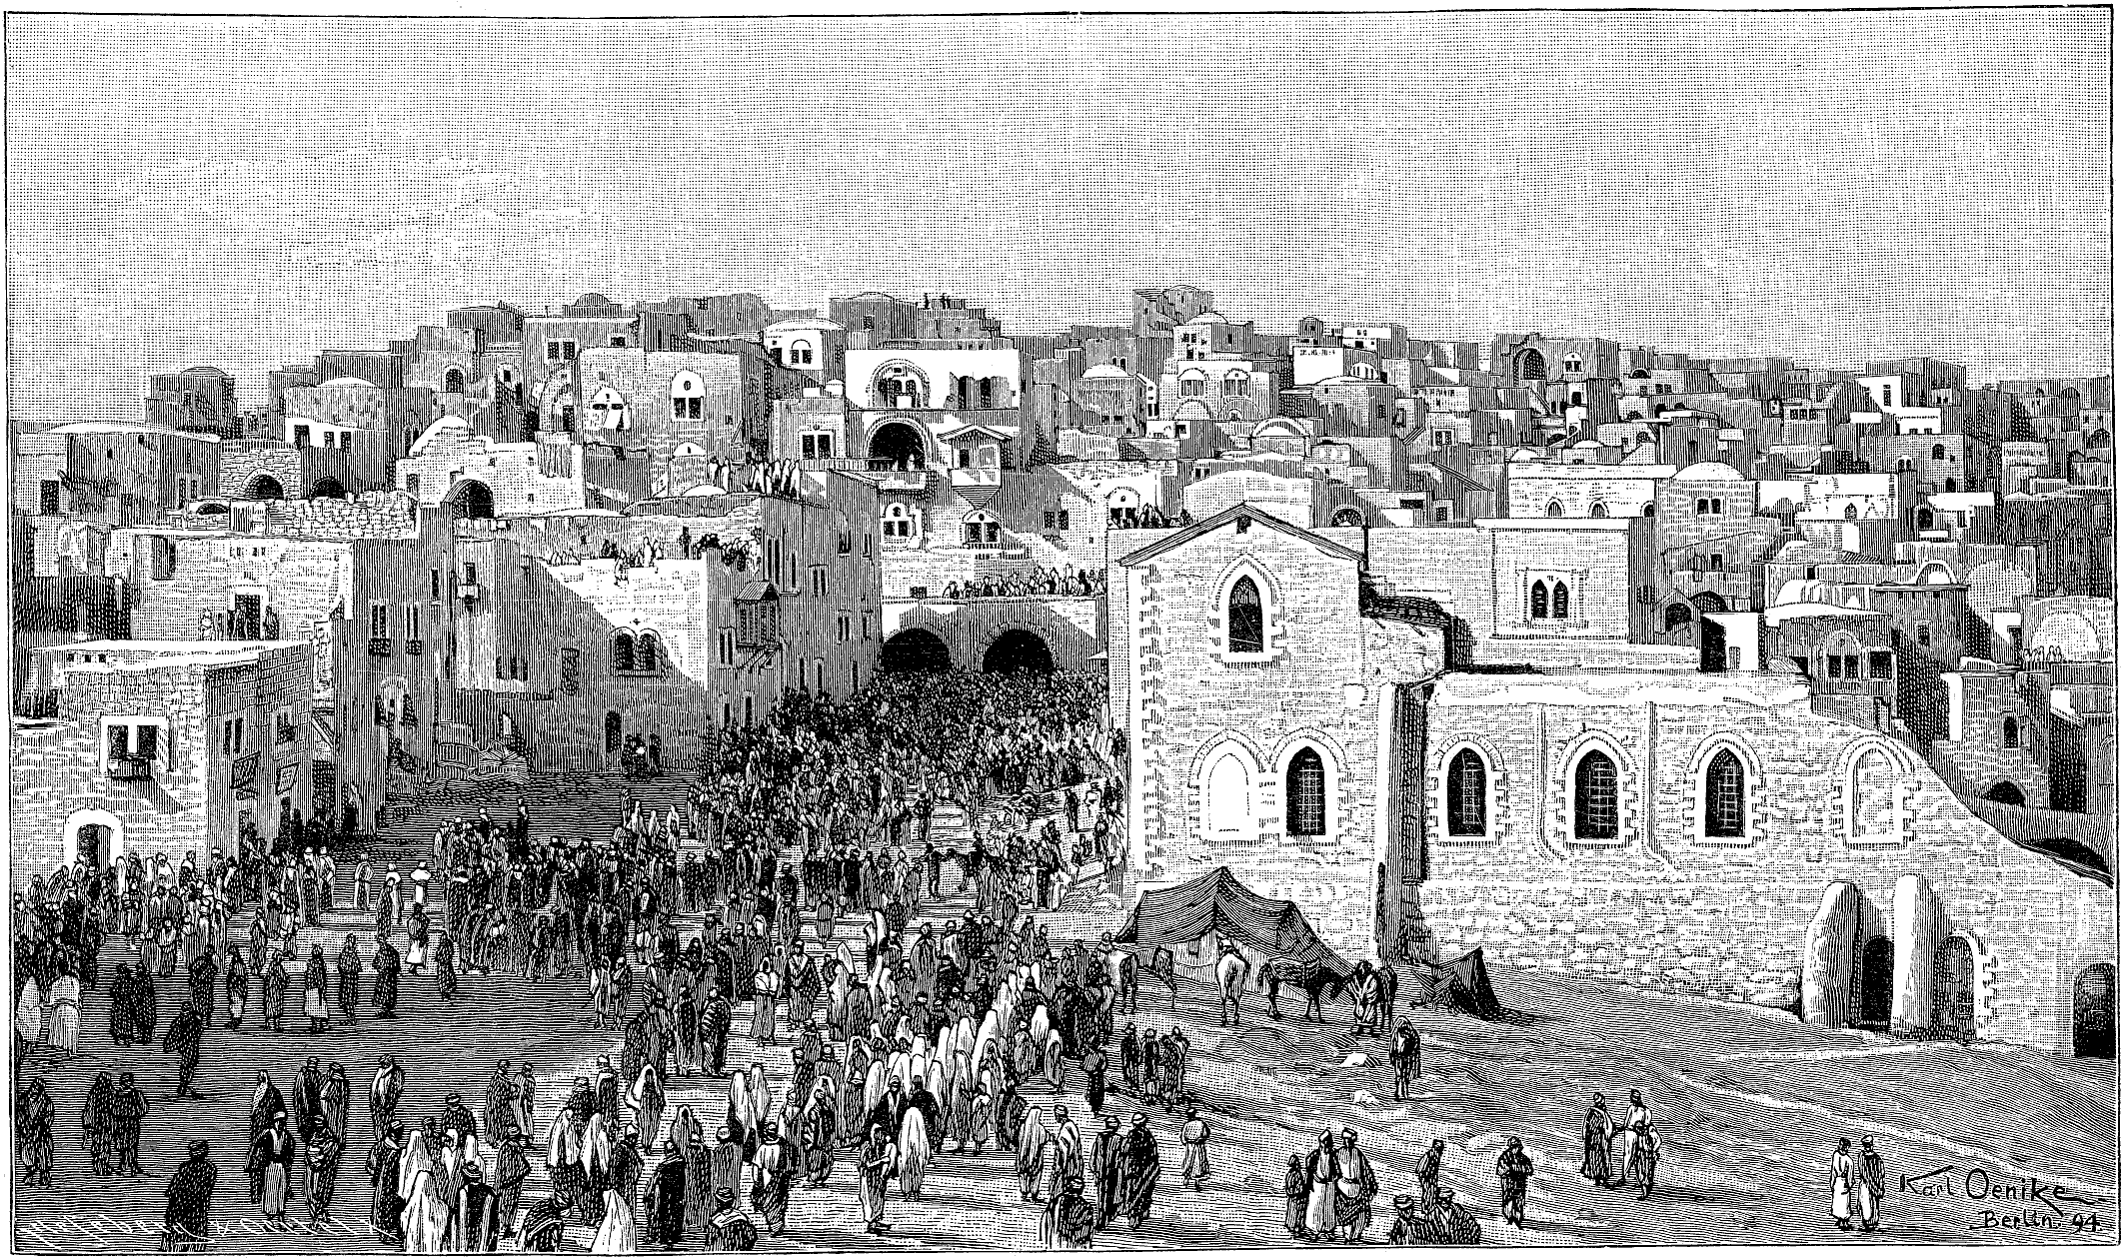
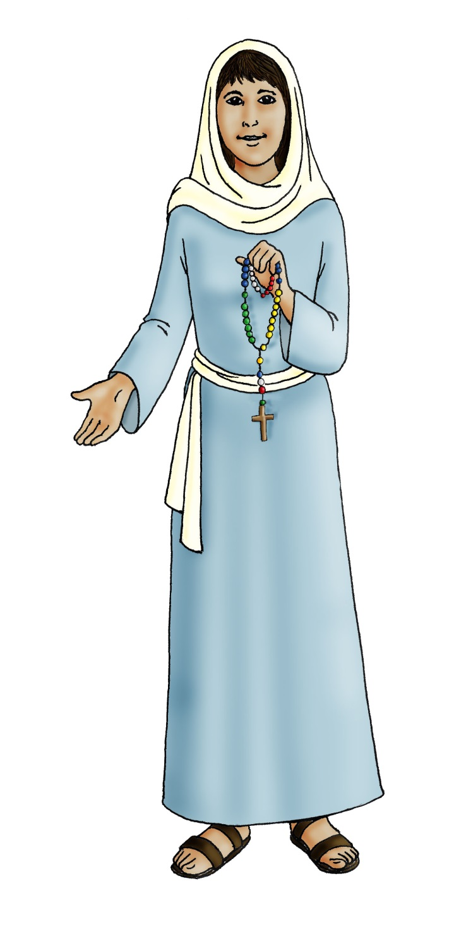
Mary
Immaculate Heart

Slide 3
A reading from the Gospel of St Luke 1:26-38 (adapted)
God sent the angel Gabriel to Mary. The angel came to her and said, “Greetings! The Lord has blessed you and is with you.”
But Mary was confused and wondered, “What does this mean?”
The angel said to her, “Don’t be afraid, because God is pleased with you. Listen!
You will give birth to a son, and you will name him Jesus. He will be great, and people will call him the Son of the Most High.”
Mary said to the angel, “How will this happen?”
The angel said to Mary, “The Holy Spirit will come upon you, and the power of God, the Most High, will cover you. The baby will be holy. He will be called the Son of God.”
Mary said, “I am the servant of the Lord. Let this happen to me as you say!”
The Gospel of the Lord

Slide 4
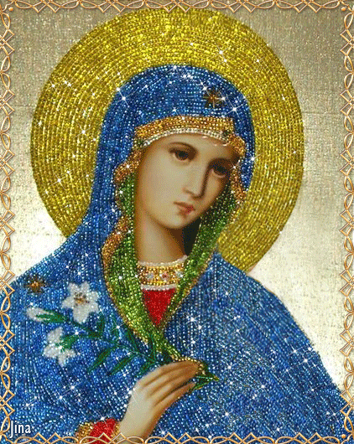
Immaculate
Perfectly clean
Spotless

Slide 5
Gentle
Kind
Immaculate
Caring
Generous
Obedient
Good
Faith-full
Loving

Slide 6
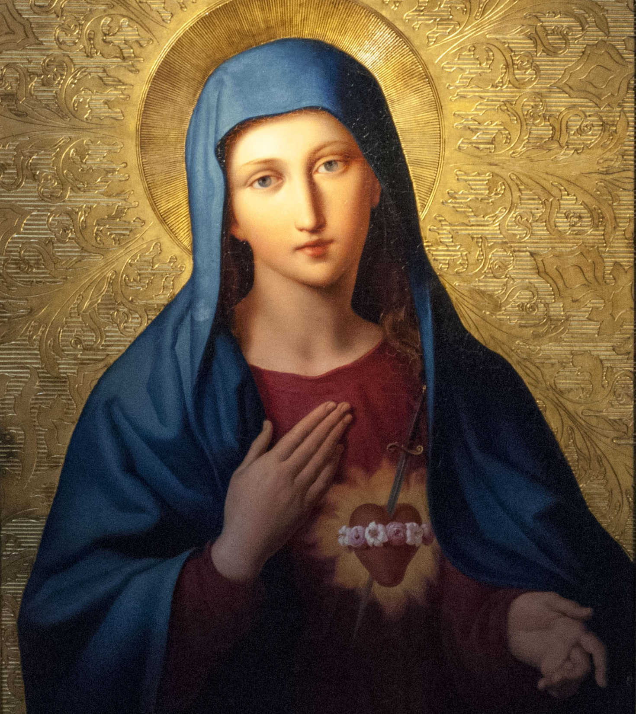

Slide 7
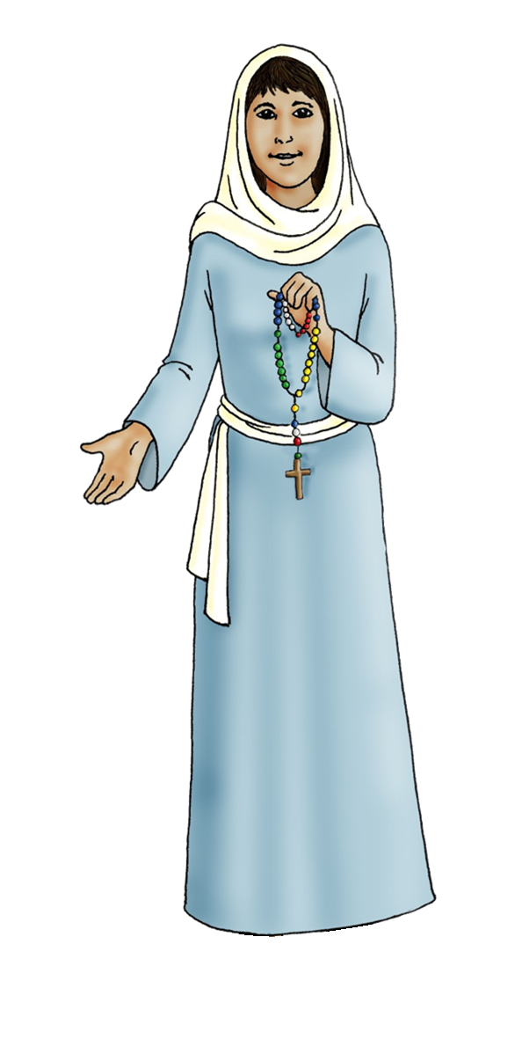
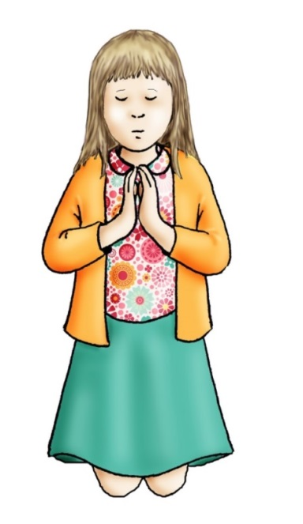
Hail Mary
Hail Mary, full of Grace,
the Lord is with thee.
Blessed art thou among women
And blessed is the fruit of thy womb, Jesus.
Holy Mary Mother of God,
pray for us sinners,
now and at the hour of our death.
Amen
Mission Together Prayer
May all children
In the world
Share love
Share friendship and live
In the peace
Of God’s love
Now and forever.
Amen

