Slide 2
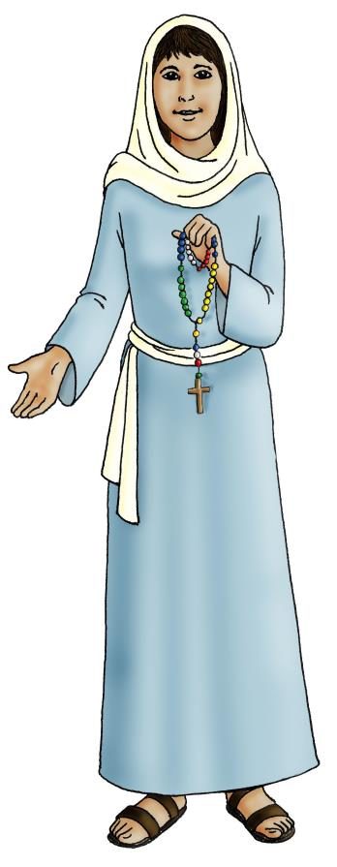
‘Mary said, “Oh, how I praise the Lord. How I rejoice in God my Saviour!
For he took notice of his poor servant girl. From now on people will call me blessed, because God has done great things for me.
God’s mercy goes on down the ages, to all who praise him.
The Gospel of St Luke 1:46-50

Slide 3
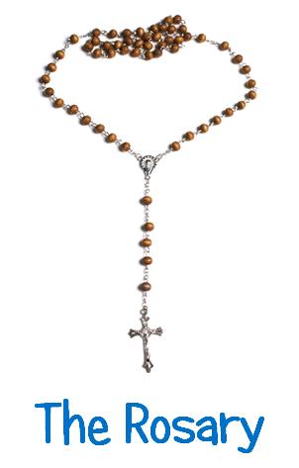

Slide 4
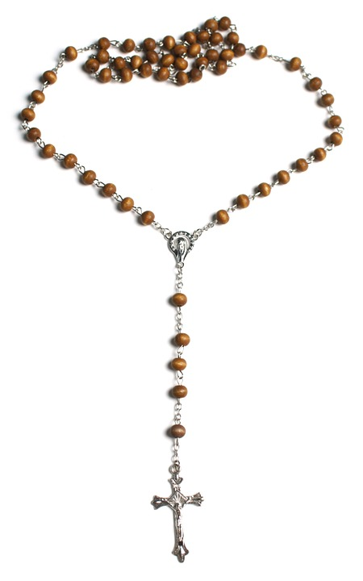
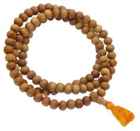
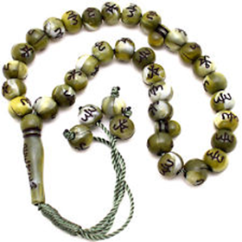

Slide 5
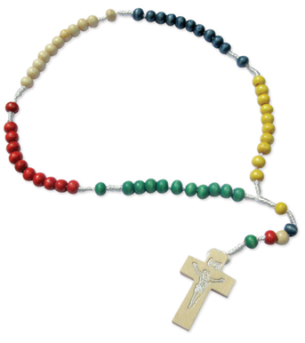
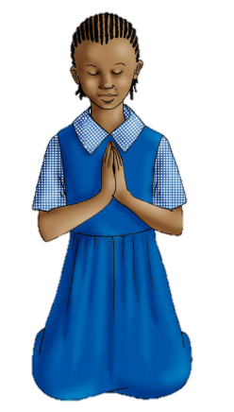
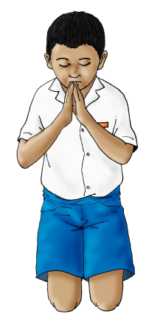

Slide 6
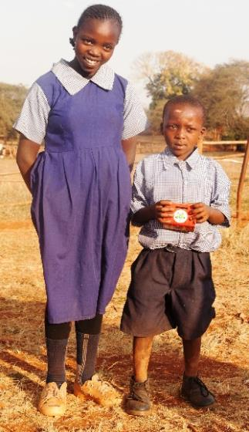
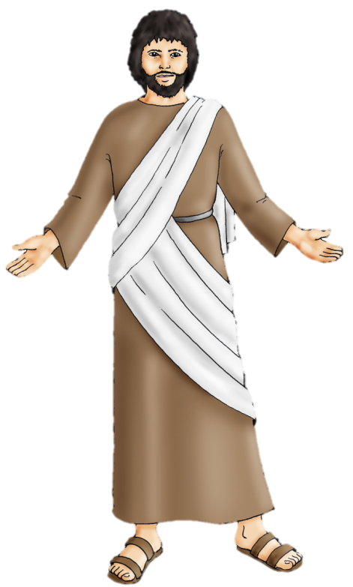
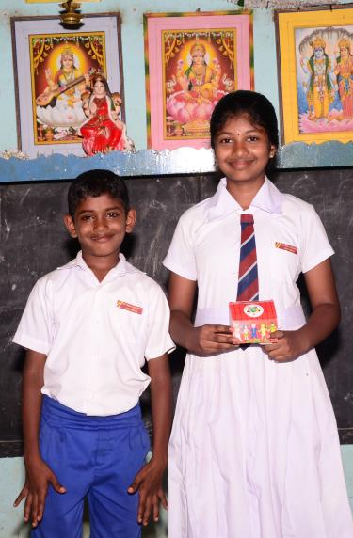
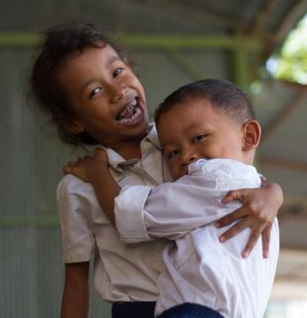

Slide 9
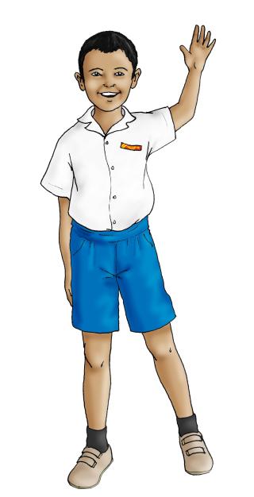
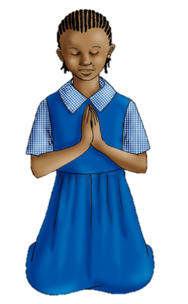
Hail Mary:
Hail Mary, full of grace
The Lord is with you.
Blessed are you among women,
And blessed is the fruit
of your womb, Jesus.
Holy Mary, Mother of God,
Pray for us sinners,
Now and at the hour of our death.
Amen.
Mission Together Prayer:
May all children
In the world
Share love
Share friendship and live
In the peace
Of God’s love.
Now and forever.
Amen

