Slide 1
Lesson 4

Slide 2
Today I am learning to retell the events of the Holy Spirit appearing to the disciples.

Slide 3
Explain that after the resurrection Jesus appeared to the disciples and promised that he would send the Holy Spirit to be their support and guide. White Hat

Slide 4
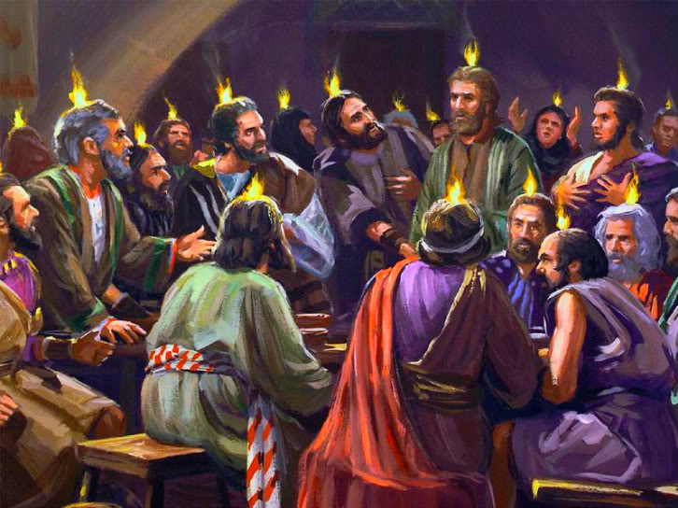
The Holy Spirit Comes at Pentecost
When the day of Pentecost came, they were all together in one place.
Suddenly a sound like the blowing of a violent wind came from heaven and filled the whole house where they were sitting.
They saw what seemed to be tongues of fire that separated and came to rest on each of them.
All of them were filled with the Holy Spirit and began to speak in other tongues as the Spirit enabled them.

Slide 5
Pentecost celebrates and remembers the coming of the Holy Spirit, 50 days after Passover. White Hat
Matthew does not have a story of the coming of the Holy Spirit: we find it in Luke’s writing. Read Acts 2:1-4

Slide 6
The passage says the coming of the Spirit that comes ‘like the sound of a powerful wind from heaven’. We will use instruments and voices to explore what this noise might have sounded like.

Slide 7
Make streamers with red, yellow and orange [fire] and blue [wind] streamers to wave. Role play the moment the Disciples were in the room. Ask your child to imagine what it would have been like. How do we feel when we get a fright? Red hat If possible tell and role play these stories rather than read them.

