Slide 1
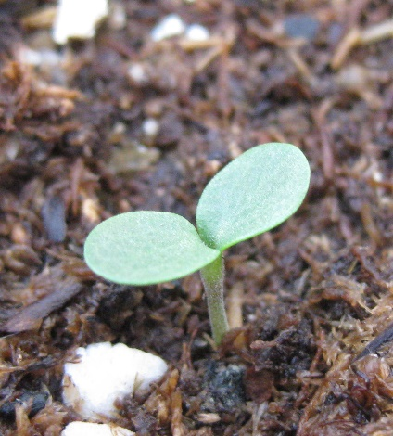
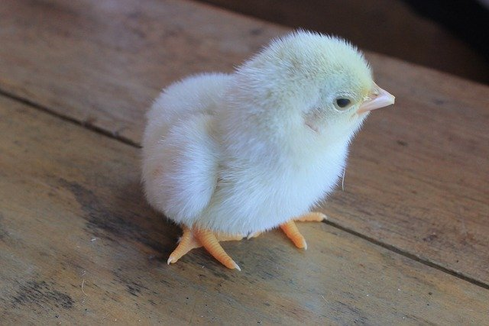
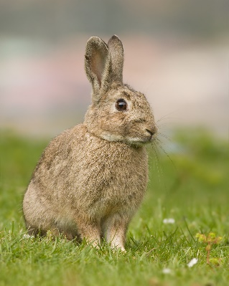
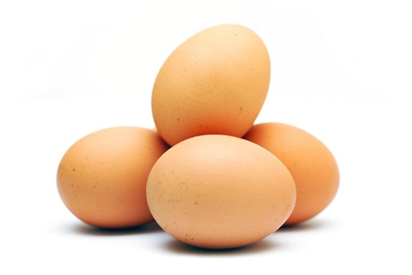
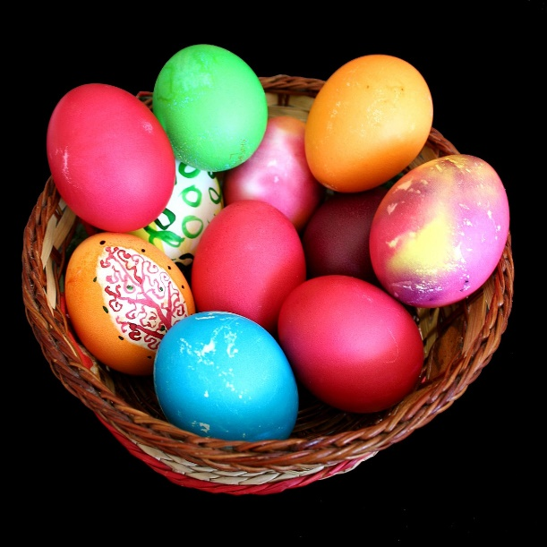
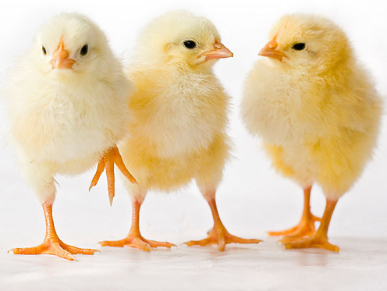
LO: Today we are learning about new life in the church and the world.
Easter Eggs and rabbits are a symbol of Easter because they remind us of new life. Chicks hatch from eggs and rabbits have lots of babies each year! These remind us of the new life of the resurrection.

Slide 2
Today I am learning about new life in the church and in the world.
Make some drawings of new life;
eggs, rabbits and plants.
Label your pictures.

