Slide 1
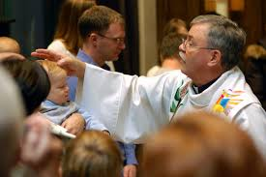
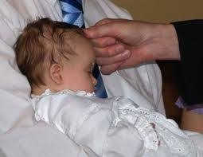
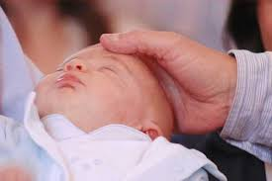
Lesson 5 Thursday June 11th
LO: To think about the sacrament of Baptism.
When we are baptised we become members of the Church and we are anointed with special oil. When we anoint people at Church we show our care and love for them and pray for them to be strong.
Speak to your child about when they were Baptised. Tell them about what a special day it was. Look at pictures together. Discuss how the priest anointed them with oil.

