Slide 1
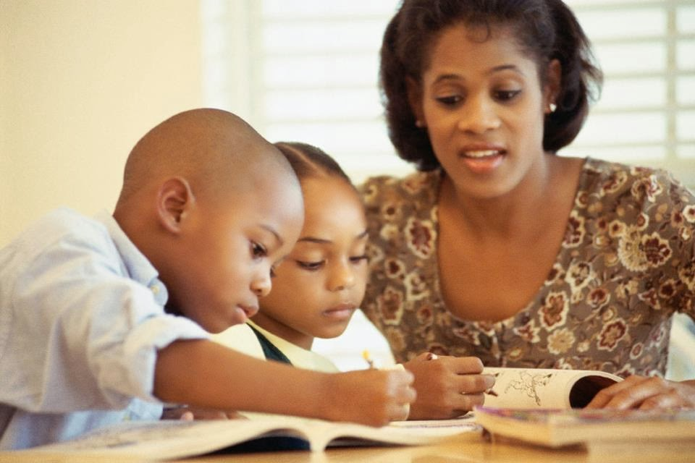
Lesson 6 Tuesday 16th June
Retell the story of the Good Samaritan with your child. Explain that it is an example story and that we are called to act like the Samaritan – he is the example!
Think of people in your family who are a ‘good example’.
Try and explain to a grown up who is a good example in your family and why.
This Photo by Unknown Author is licensed under CC BY-NC

