Slide 1
Week beginning 6th July 2020
RE lesson 1
The feast day of Saint Peter and Saint Paul was on 29th June 2020. This lesson will teach us all about these two important saints

Slide 2
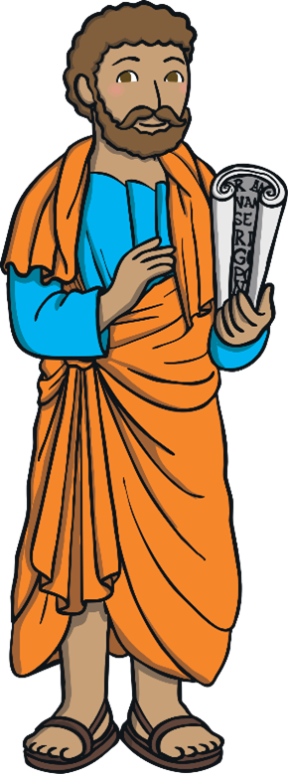
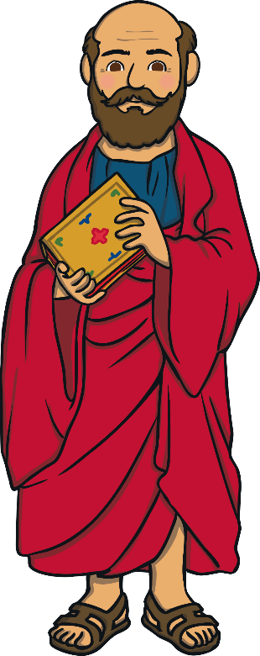
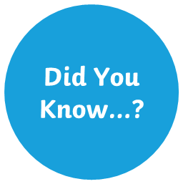
Who were Saint Peter and Saint Paul?
Saint Peter and Saint Paul were two men who taught people about Jesus, the stories he told people and the miracles he performed. They converted to Christianity.

Slide 3
The Life of Saint Peter
Saint Peter was one of Jesus’ disciples. Jesus described him as a ‘rock’ because he could be depended on.
Peter was a fisherman on the Sea of Galilee. Jesus called Peter to become a disciple and he agreed. He gave up his life as a fisherman and instead, learned from Jesus about living a good Christian life and helping others change their lives too.
What do you think it was like for Peter, giving up the life he knew and following Jesus?

Slide 4
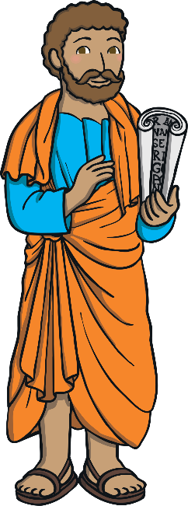
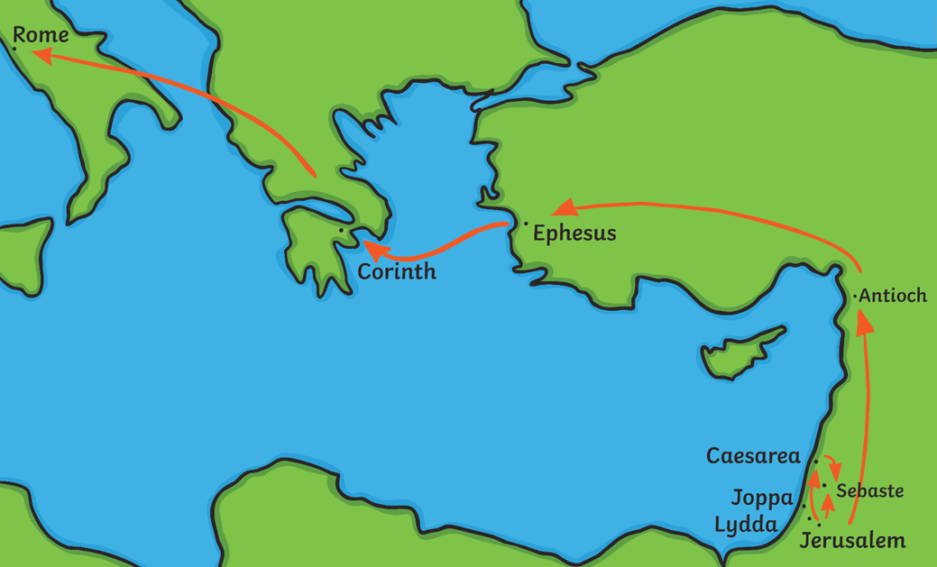
Peter’s Journey
Jesus asked Peter to lead the disciples after his death. After Jesus died, Peter began to travel, teaching people about the new religion which became Christianity
Peter travelled from Jerusalem to Syria, then to Ephesus. He crossed the Mediterranean Sea to Corinth and then crossed the Adriatic Sea to Italy.
He baptised people who wanted to become Christians
What skills do you think Peter had that meant he could travel a long way, telling people about Jesus?

Slide 5
The Life of Saint Paul
Saint Paul was a Roman Jew who was called Saul. He made tents in Galilee and although Jesus was often in Galilee, Saul did not know Jesus.
Saul did not like Christians at all
Then, one day, he had a vision of Jesus and believed he was filled with the Holy Spirit. After that, he changed his name to Paul and became a Christian
It is said that Paul wrote many of the books of the Bible.

Slide 6
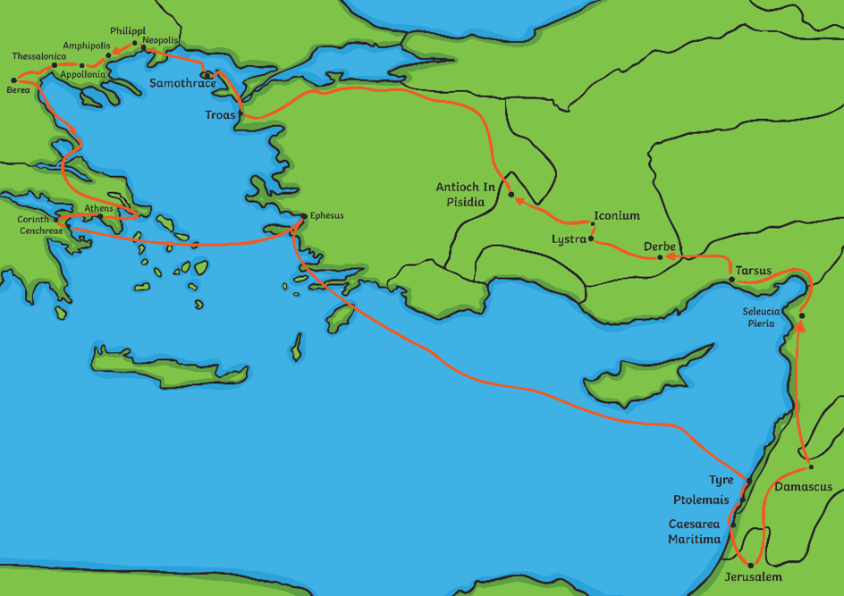
Paul’s Journey
Paul then travelled through Israel, Syria, Turkey and Greece, teaching people about Christianity and the life of Jesus.
He faced terrible dangers, becoming shipwrecked many times, as well as dangers from robbers and wild animals
What skills do you think Paul had that meant he could travel a long way, telling people about Jesus?

Slide 7
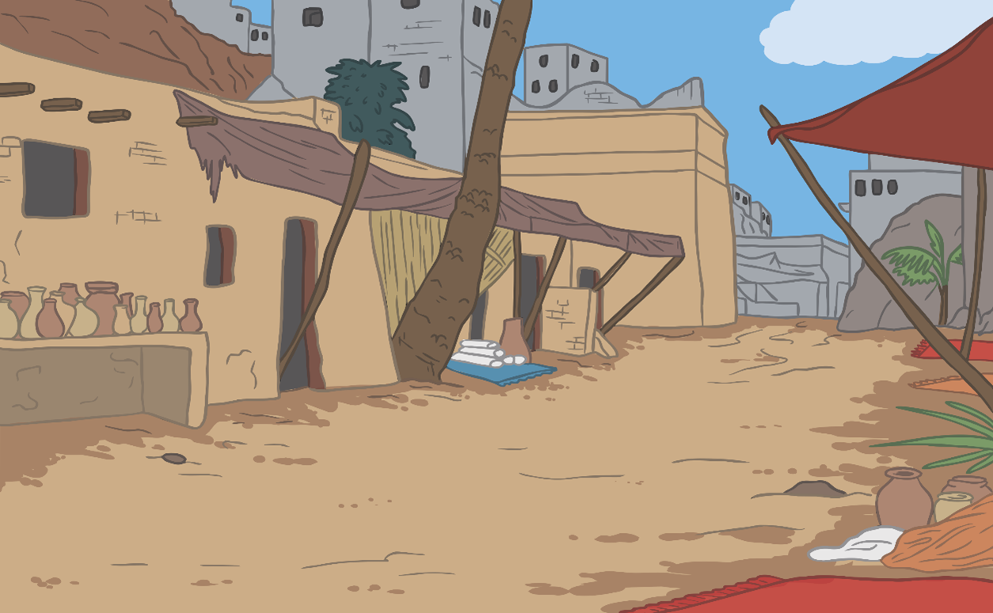
Peter and Paul met after Jesus died.
When Peter was put in prison for teaching people about Jesus, Paul went to visit him.
Peter and Paul both were killed because of their beliefs.

Slide 8
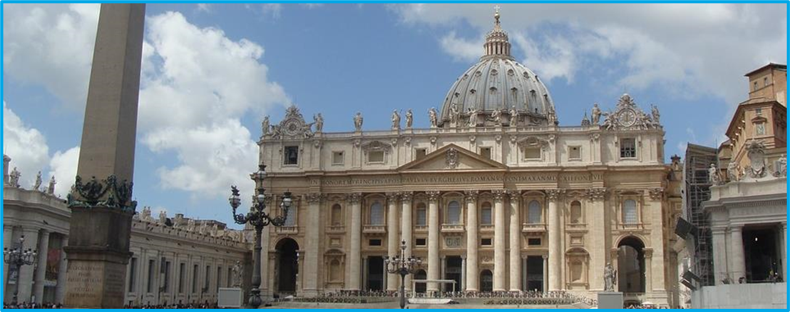
The Catholic church think of Peter as being the very first Pope.
Paul is said to have been one of the main reasons why so many people became Christians when it first began. Paul is now buried in the Papal Basilica of St. Paul Outside the Walls. Peter is buried in the Vatican Basilica in Rome.
Both men were made saints and 29th June became the day when their lives are celebrated. It is known as the feast day of Saint Peter and Saint Paul.

Slide 9
Using information from the slides can you find and write two facts about each saint?
Saint Peter fact
Saint Paul fact
Saint Paul fact

