Slide 1
Make a sea creature Puppet and Ocean Scene.
https://www.youtube.com/watch?v=9Ym-SST_dwQ

Slide 2
Sketch your ocean scene.

Slide 3
Then go over your lines with crayon.

Slide 4
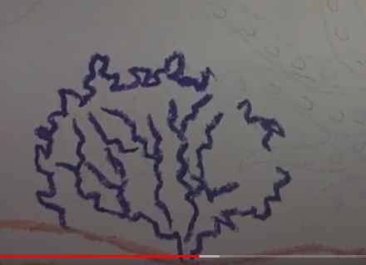
Make sure you draw seaweed, coral, and anenomes.

Slide 5
Use different colours for different plants and creatures.

Slide 6
Add details to the fish.

Slide 7
Now paint over with watery blue paint. You can try chalk or coloured pencil.

Slide 8
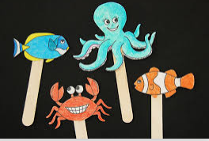
Cut out one of the templates and decorate it with paint, pencil, felt tips or stickers.
Glue it onto a lollystick to make a stick puppet or attach string and dangle it.
Now you can move your sea creature across your ocean scene.

Slide 9
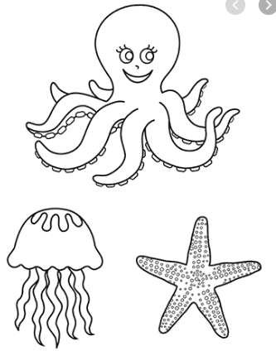

Slide 10
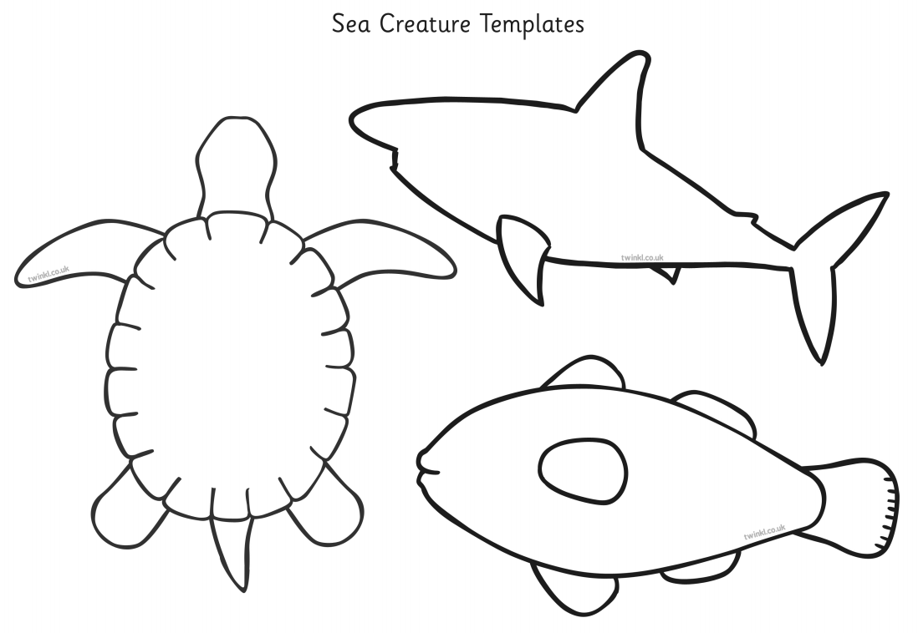

Slide 11
