Slide 1
Lesson 3

Slide 2
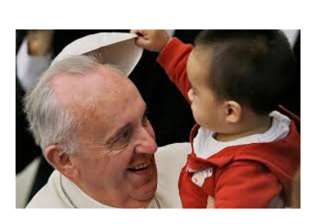

Slide 3
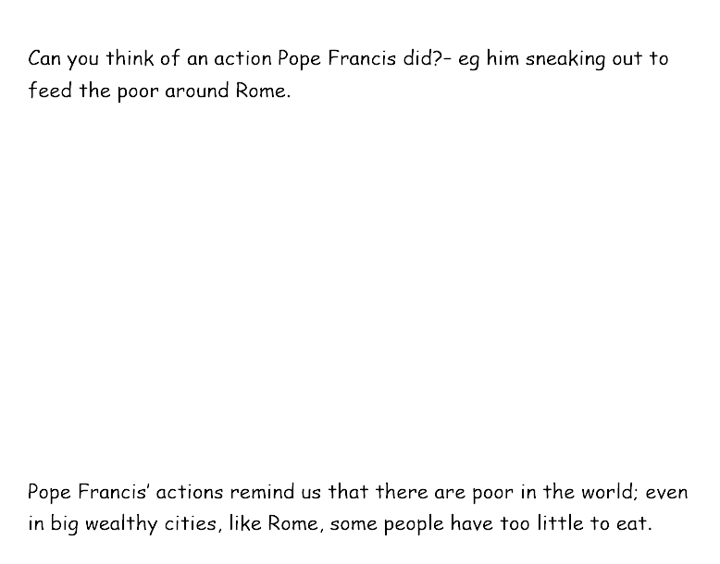
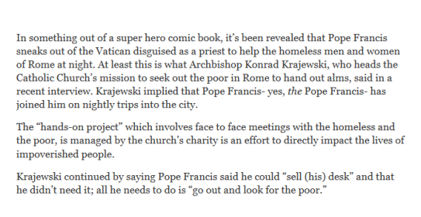

Slide 4
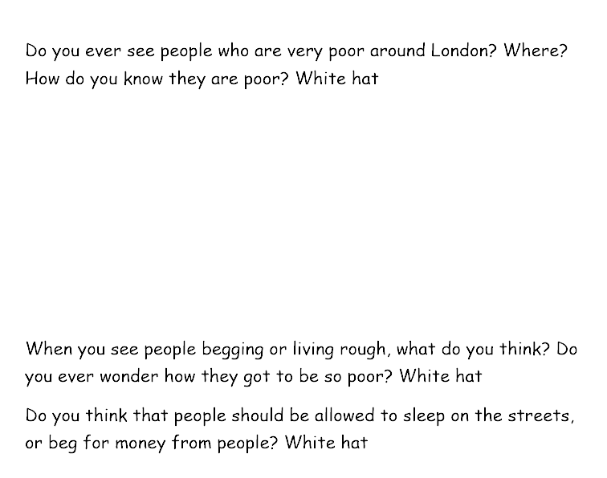
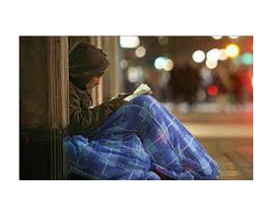
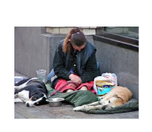
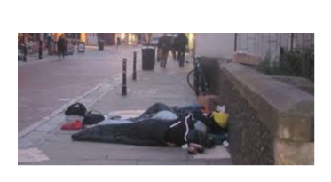

Slide 6
On the worksheet, under the flame, write a sentence about what Pope Francis did and why he did these thing.
Then complete the sentence : I think Pope Francis does these things because he believes……..

Slide 7
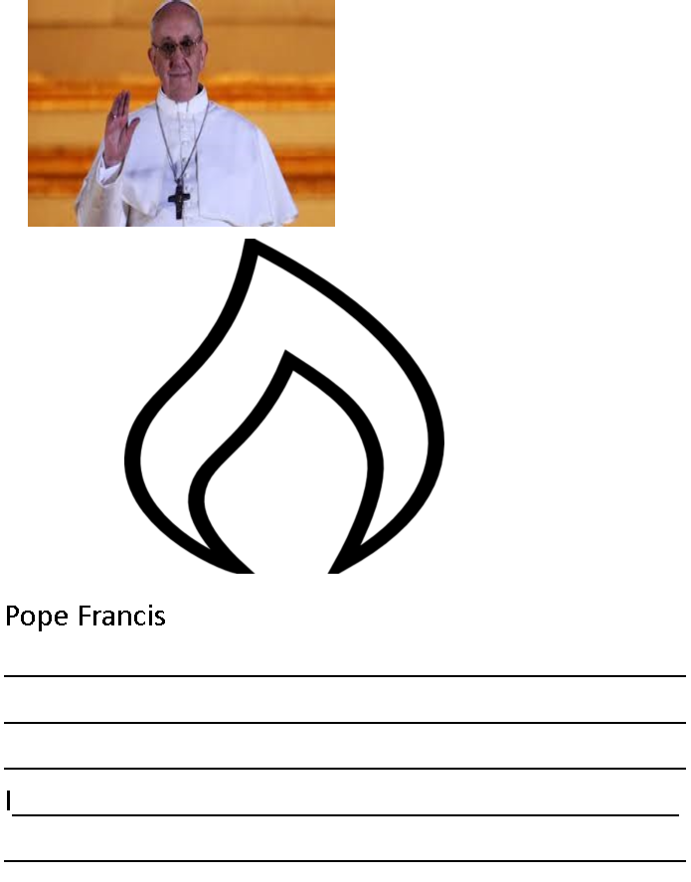
Today I am learning about Pope Francis and his actions

