Slide 1
Week 5
Lesson 2
Making a May altar to Mary

Slide 2
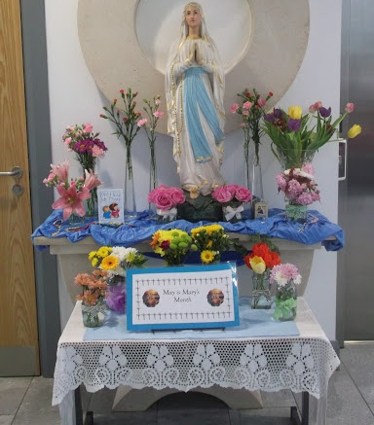
During the month of May, we can create a May altar in honour of Mary. Have you ever seen a May alter before?

Slide 3
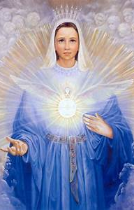
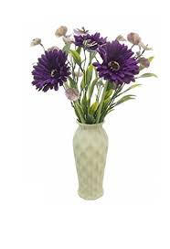
Where Will Our May Altar Go?
You can create a May altar almost anywhere! It could be in your Sacred Space, on a windowsill or on top of a cupboard.

Slide 4
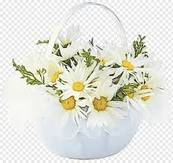
What can we put on our altar?
The first thing that should go on all May altars is a statue or picture of Our Lady.
A blue or white cloth is usually laid on the altar as these are the colours we think of when we think of Mary.
As May is the first month of summer, fresh flowers and plants are usually used to decorate the altar.
Can you name any flowers or plants we can use?

Slide 5
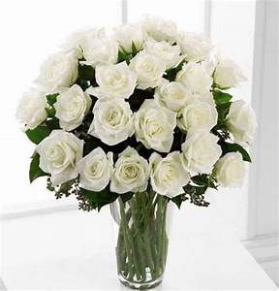
These flowers are commonly associated with Mary:
Roses
Ivy
Carnations
Baby Breath
Violets
Marigolds
Carnations

Slide 6
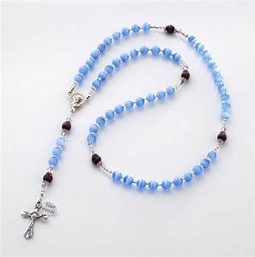
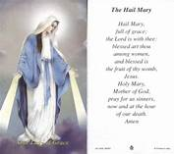
What Else Can Go on Our Altar?
Rosary beads. You could say a decade of the rosary every day during the month of May
Prayers to Mary. Why not write your own special prayer to Mary and display it on your altar?

Slide 7
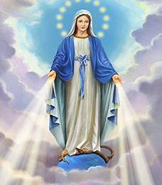
Once you have made a lovely May Altar set up in your home, you should remember that Mary loves us all and she wants you to live as Jesus would like you to.

Slide 8
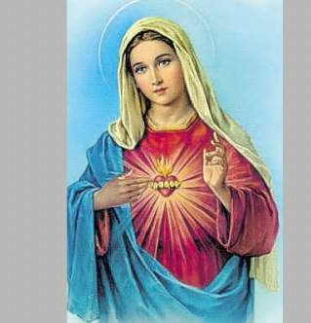
The Hail Mary
Hail Mary, full of grace.
The Lord is with thee.
Blessed art thou among women,
and blessed is the fruit of thy womb, Jesus.
Holy Mary, Mother of God,
pray for us sinners,
now and at the hour of our death.
Amen

