Slide 1
Design your own garden

Slide 2
Draw your garden and then label the plants, bushes and trees. Will you have a pond?

Slide 3
You can have a seating area and a pool!

Slide 4
Will you grow vegetables?

Slide 5
What would you like to grow?

Slide 6
Are these herbs or fruit trees? What would you plant?

Slide 7
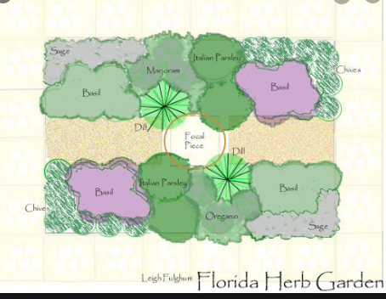
This is a herb garden. Would you add a grassy place, or a fruit tree?

Slide 8
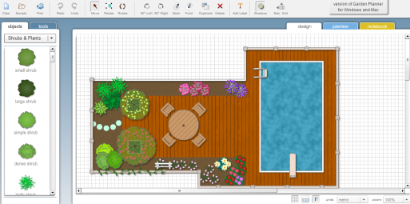
Would you have a swimming pool?

Slide 9
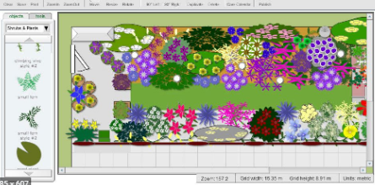
You can plant lots of colourful flowers. Can you name and label them?

Slide 10
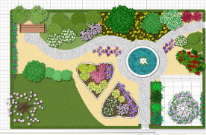
Look at the heart-shaped flower beds.

Slide 11
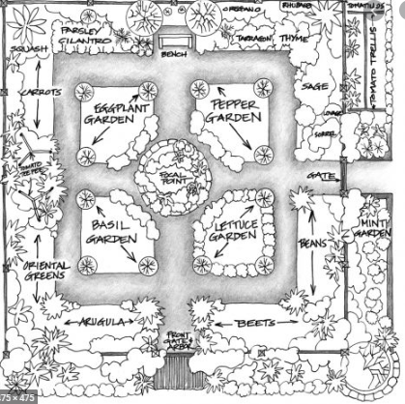
Find out the names of some plants you like. Are they pretty? Do they smell good? Are they tasty?

Slide 12
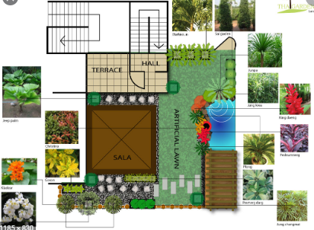
It could be on a rooftop. You decide!

Slide 13
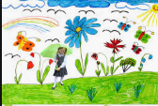
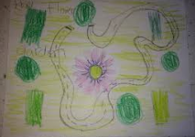
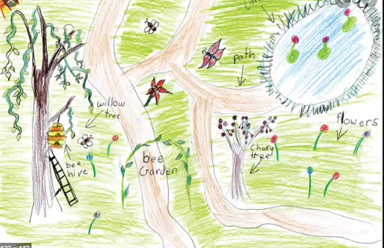
Have fun!

