Slide 4
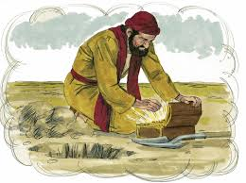
The parable of the Hidden Treasure and the Pearl
The Kingdom of heaven is like treasure hidden in a field. When a man found it, he hid it again, and then in his joy went and sold all he had and bought that field.
Again, the kingdom of heaven is like a merchant looking for fine pearls. When he found one of great value, he went away and sold everything he had and bought it.

Slide 5
