Slide 1
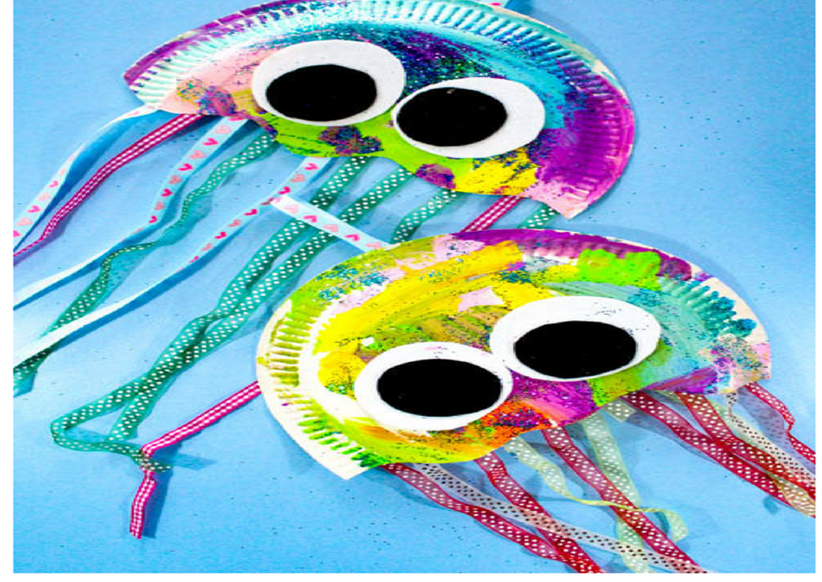
D&T: Week 3
Making paper plate jellyfish

Slide 2
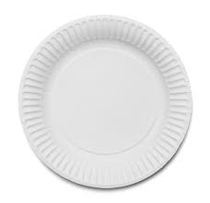
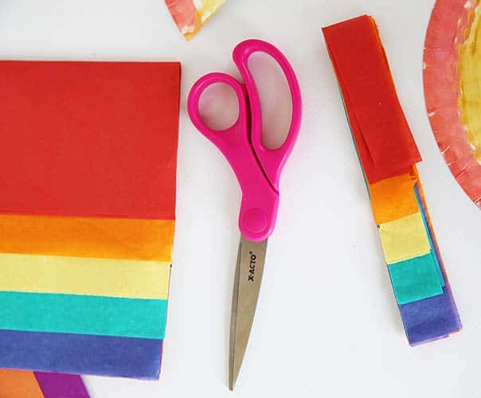
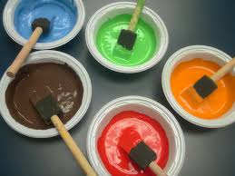
You will need:
Paper plate Paint/colouring pencils glitter/sequences ribbon or coloured paper PVA glue Scissors Stapler

Slide 3
Instructions First, choose the appropriate colours for your jellyfish and paint/colour all of the paper plate. Second, when the plate is dry spread the pva glue on the plate and sprinkle with glitter or sequences. Third, trim the plate into the shape of a jellyfish, see the picture below to help you.

Slide 4
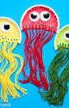
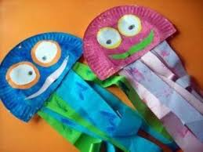
Fourth, cut out stands of ribbon or coloured paper of various lengths and attach to the plate using the glue.
Fifth cut our a pair of black and white circles for the eyes and attach to the jellyfish.
Finally, finish off with a hanging hook using a small piece of ribbon or thread and secure with a staple.

