Slide 1
Week 3 lesson 2 Today I am learning to explain what the Kingdom of God is I will try to relate the parable to my own life and beliefs

Slide 2
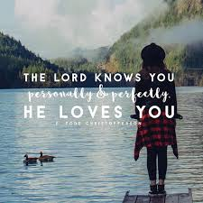
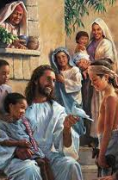
How do parables make you feel?
Parables make you think by proposing that something is like something else
The Kingdom of God is like…….

Slide 3
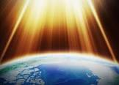
What is the Kingdom of God?
In Matthew’s Gospel Jesus talks about the Kingdom of God, but what does he mean?
The Kingdom of God could be described as follows:
a society where God rules
a place where death is overcome
a place where diseases are cured
a place where evil spirits are thrown out
a place where people find a home and shelter in difficult times
Its characteristics and values could be as follows:
faith
simplicity of a child / purity
belongs to those who suffer
love God and love your neighbour
honesty / truth
humility
joy in others’ achievements
wealth and ambition must be sacrificed
The parables tell us that:
The Kingdom of God is a mystery (grows secretly).
It is present in the lives of those who believe.
People respond differently to the message of the Kingdom of God.
It begins with Jesus’ words and teachings.
The Kingdom of God starts small with the individual and increases to include the whole of society.
The Kingdom of God is a future reward.

Slide 4
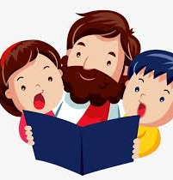
https://www.youtube.com/watch?v=S1Y8Naj3RFk
There are many songs which mention the Kingdom of God
Singing is a ways of praising God. When do we sing to praise God?

Slide 5
Our Father is a prayer that prays for the coming of God’s kingdom.
The final doxology, ‘For the kingdom, the power and the glory are yours, now and forever, Amen’

