Slide 1
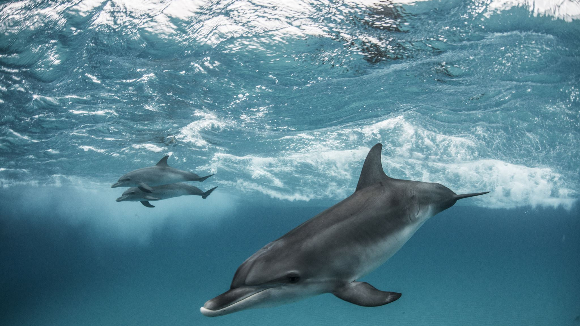
Animals including Humans
I can group animals

Slide 2
Let’s remember the different types of animal, and what makes them different. Humans are mammals.

Slide 3
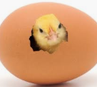
How do birds have babies?

Slide 4
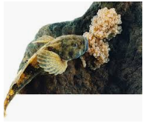
Fish also lay eggs.

Slide 5
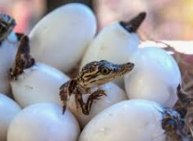
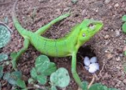
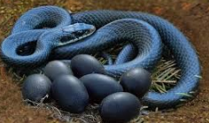
Most Reptiles lay eggs. They are cold blooded so prefer to live in hot countries.

Slide 6
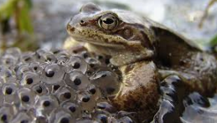
Amphibians lay their eggs in water.

Slide 7
Now see if you can group the animals into reptiles, amphibians, mammals, fish and birds.

Slide 8
We can also group animals by what they eat.

