Slide 1
Lesson 1

Slide 2
Today I am recognising the characters in the story of the resurrection of Jesus based on Matthew 28:1-10

Slide 3
What is the first story in Holy Week? White Hat
What happened on Palm Sunday?
Then what was next? Blue Hat
Discuss the different events during Holy Week:
Palm Sunday (Matthew 21:1-11)
Holy Thursday (Matthew 26: 17-30)
Good Friday (Matthew 27: 32- 50)
If you google the above events if you are unsure of how to explain them remember it is currently the year of Matthew so we read from Matthew’s Gospel. . Twinkl have some nice powerpoints for each event also to use in addition to this.

Slide 4
Activity 1:
Create an information leaflet about the key events during Holy Week:
Palm Sunday
Holy Thursday
Good Friday
You can include some drawings of the different events.
Features of an information leaflet:
Title
Headings and sub-headings
Paragraphs with a main introductory paragraph
Diagrams, pictures or photographs with captions
Bullet points
Text boxes

Slide 5
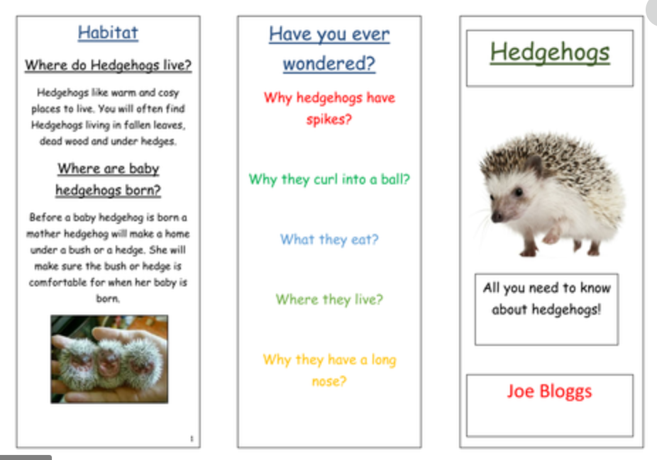
Text boxes
Headings and sub-headings
Title page:
You could have:
Holy Week
Learn all about Holy week
Include a brief description and some pictures
Diagrams, pictures or photographs with captions

Slide 6
Matthew 28:1-10
Jesus Has Risen
After the Sabbath, at dawn on the first day of the week, Mary Magdalene and the other Mary went to look at the tomb.
There was a violent earthquake, for an angel of the Lord came down from heaven and, going to the tomb, rolled back the stone and sat on it. His appearance was like lightning, and his clothes were white as snow. The guards were so afraid of him that they shook and became like dead men.
The angel said to the women, “Do not be afraid, for I know that you are looking for Jesus, who was crucified. He is not here; he has risen, just as he said. Come and see the place where he lay. Then go quickly and tell his disciples: ‘He has risen from the dead and is going ahead of you into Galilee. There you will see him.’ Now I have told you.”
So the women hurried away from the tomb, afraid yet filled with joy, and ran to tell his disciples. Suddenly Jesus met them. “Greetings,” he said. They came to him, clasped his feet and worshiped him. Then Jesus said to them, “Do not be afraid. Go and tell my brothers to go to Galilee; there they will see me.”

Slide 7
Where was the setting?
What day was it?
Who were the characters in the story if the Resurrection?
White Hat

Slide 8
The day of the week:
Dawn on the day after the Sabbath
The setting was the tomb

Slide 9
Characters in Matthew’s story of the Resurrection
Mary Magdalene – one of the women disciples. She is named in all the accounts of the resurrection as the first one to know that Jesus had risen. She is often called the ‘apostle to the apostles’ for her role in taking the message of the resurrection to the other disciples. Mary Magdalene is named after the place she lived in: Magdala, on the shores of Lake Galilee.

Slide 10
The other Mary – we don’t know who this Mary is but she and Mary Magdalene are at the death of Jesus, his burial and now his resurrection.
An angel of the Lord – a messenger of God
Guards – In Matthew’s Gospel we are told that two guards have been put by the tomb to stop anyone stealing the body. This detail is not in other accounts.
Jesus

Slide 11
Today I am recognising the characters in the story of the resurrection of Jesus based on Matthew 28:1-10
Task 2:
Write down the characters from the story and a short description about each character.

Slide 12
Lesson 2

Slide 13
Today we are retelling the resurrection of Jesus according to Matthew.

Slide 14
We looked at Matthew 28 (1-10) in the last lesson. White Hat
Today we are going to look at Matthew 28 (5-7)
We are going to focus on the words of the angel.

Slide 15
Matthew 28:5-7
The angel said to the women, “Do not be afraid, for I know that you are looking for Jesus, who was crucified.
He is not here; he has risen, just as he said. Come and see the place where he lay.
Then go quickly and tell his disciples: ‘He has risen from the dead and is going ahead of you into Galilee. There you will see him.’ Now I have told you.”

Slide 16
Who are the women that the angel spoke to? White Hat
How were they feeling before the angel spoke to them? Red Hat
What does he say to them to make them feel better? Yellow Hat

Slide 17
What message did the angel give to the women? White Hat
How do you think the women felt now?
Red Hat
What was the last instruction the angel gave to the women? White Hat

Slide 18
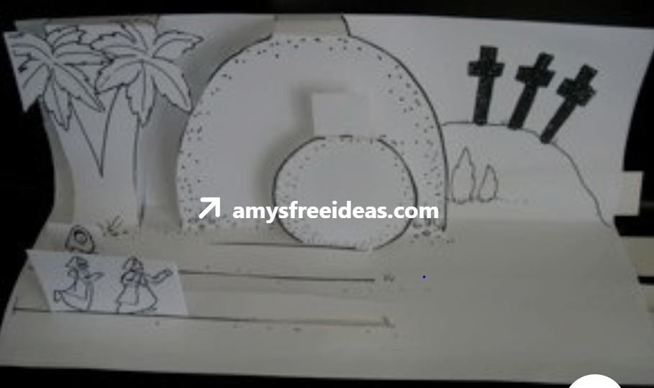
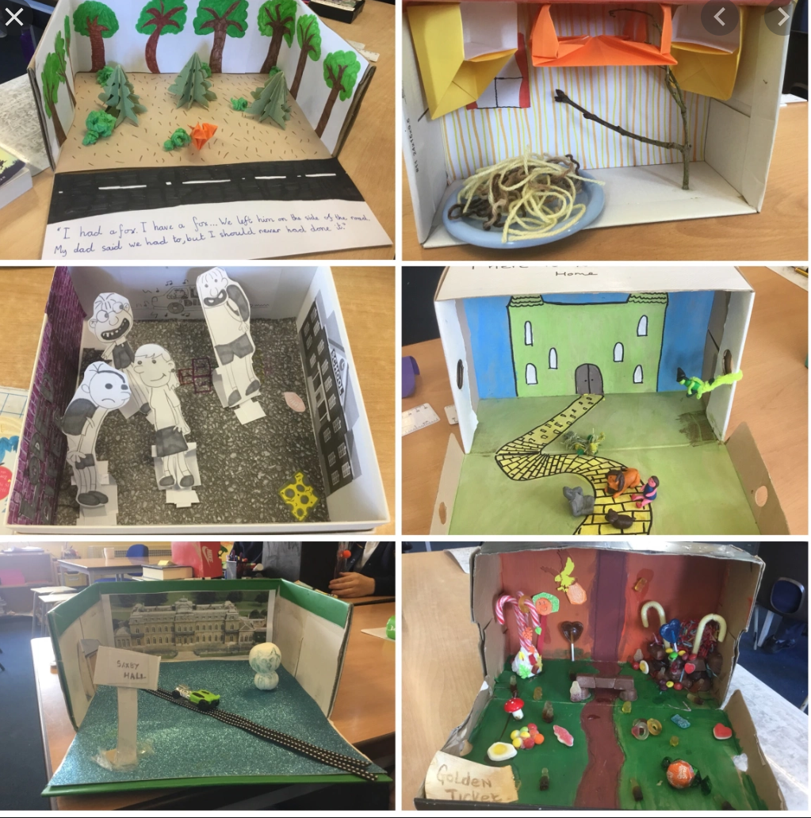
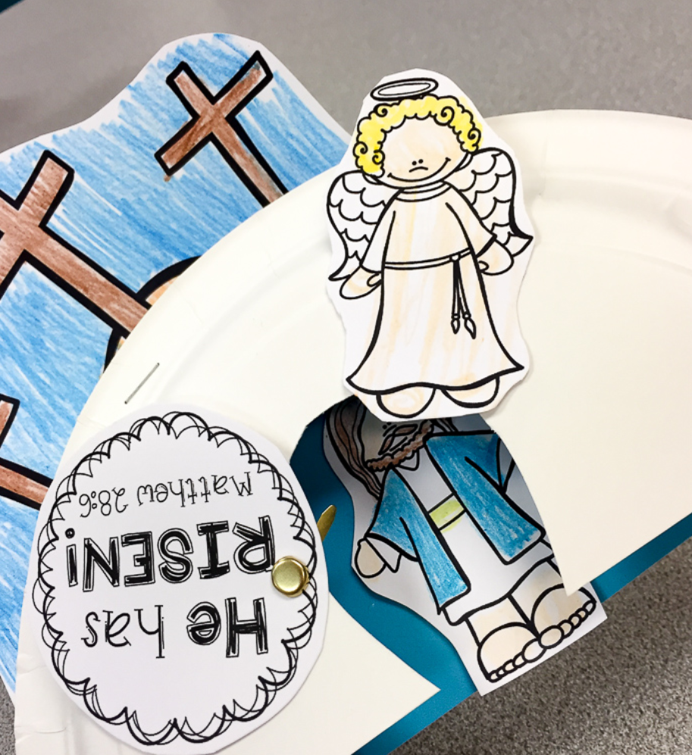
Tasks:
You can role play the story and write a short description about what you did.
Or
You could create a story scene/box to help you to retell the story.

Slide 19
Lesson 3

Slide 20
Today I am retelling the story of the resurrection of Jesus based on Matthew 28:1-10

Slide 21
Today I am retelling the story of the resurrection of Jesus based on Matthew 28:1-10
Jesus Has Risen
After the Sabbath, at dawn on the first day of the week, Mary Magdalene and the other Mary went to look at the tomb.
There was a violent earthquake, for an angel of the Lord came down from heaven and, going to the tomb, rolled back the stone and sat on it. His appearance was like lightning, and his clothes were white as snow. The guards were so afraid of him that they shook and became like dead men.
The angel said to the women, “Do not be afraid, for I know that you are looking for Jesus, who was crucified. He is not here; he has risen, just as he said. Come and see the place where he lay. Then go quickly and tell his disciples: ‘He has risen from the dead and is going ahead of you into Galilee. There you will see him.’ Now I have told you.”
So the women hurried away from the tomb, afraid yet filled with joy, and ran to tell his disciples. Suddenly Jesus met them. “Greetings,” he said. They came to him, clasped his feet and worshiped him. Then Jesus said to them, “Do not be afraid. Go and tell my brothers to go to Galilee; there they will see me.”

Slide 22
All the Gospels have a story about the Resurrection. White Hat
that Jesus is incarnate
that Jesus resurrection offers us a chance of new life now
that our spirit will be with God for eternity after we die

Slide 23
Discuss symbols of Easter and how they show new life.
http://www.kidsgen.com/events/easter/easter_symbols.htm

Slide 24
Task
Today you are going to retell the Resurrection story in the form of a letter from Mary Magdalene to a friend.
How do we begin a letter?
Will we say Mary Magdalene or I?
On the next page you will find an template that you can use to help you but try your best not to copy it and use some of you own ideas.

Slide 25
Dear Sue
When had died, I went to the ______where Jesus was laid. I felt
very ____________ but I enjoyed visiting where he laid as it gave me comfort.
All of a sudden an came down from
and rolled away the stone. Mary and I were surprised and ______________.
The angel said Jesus has
from the dead. We were shocked and confused.
Go to Galilee and tell his that Jesus has __________.
We felt excited that we would see Jesus again, we were filled with ______________.
From,
Mary Magdalene.

Slide 26
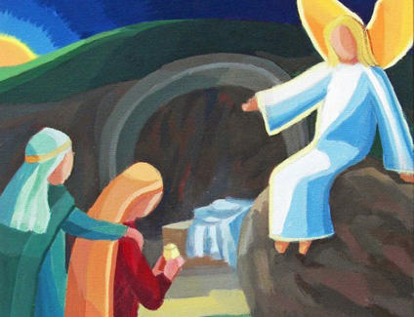
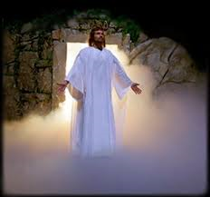
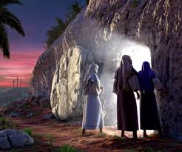
Today I am retelling the story of the resurrection of Jesus based on Matthew 28:1-10
Key Words
angel earthquake
tomb ‘do not be afraid’
‘he has risen’ Jesus dead

Slide 27
Lesson 4

Slide 28
Today I am learning to retell the events of the Holy Spirit appearing to the disciples.

Slide 29
Explain that after the resurrection Jesus appeared to the disciples and promised that he would send the Holy Spirit to be their support and guide. White Hat

Slide 30
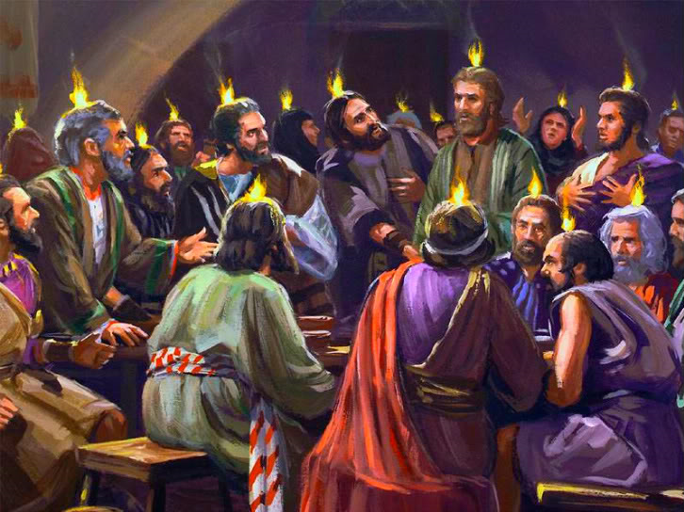
The Holy Spirit Comes at Pentecost
When the day of Pentecost came, they were all together in one place.
Suddenly a sound like the blowing of a violent wind came from heaven and filled the whole house where they were sitting.
They saw what seemed to be tongues of fire that separated and came to rest on each of them.
All of them were filled with the Holy Spirit and began to speak in other tongues as the Spirit enabled them.

Slide 31
Pentecost celebrates and remembers the coming of the Holy Spirit, 50 days after Passover. White Hat
Matthew does not have a story of the coming of the Holy Spirit: we find it in Luke’s writing. Read Acts 2:1-4

Slide 32
The passage says the coming of the Spirit that comes ‘like the sound of a powerful wind from heaven’. We will use instruments and voices to explore what this noise might have sounded like.

Slide 33
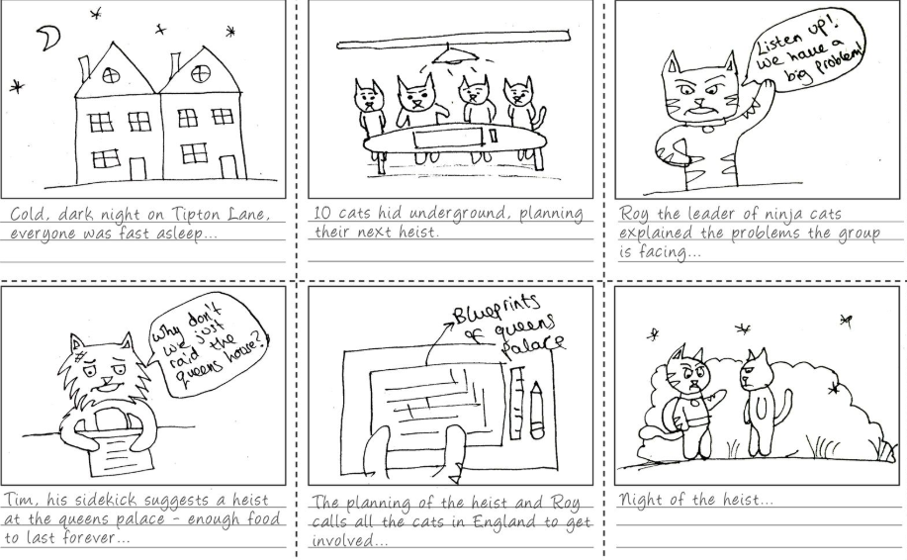
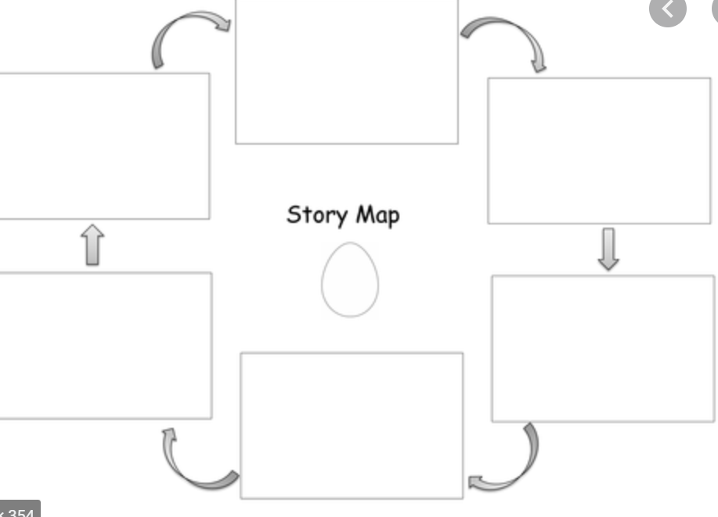
Today I am retelling the story of Pentecost based on the Acts 2:1-4
The Holy Spirit Comes at Pentecost
KEY WORDS:
wind heaven Pentecost
tongues of fire Holy Spirit other languages
Today you are going to create a story board about the story of Pentecost.

