Slide 1
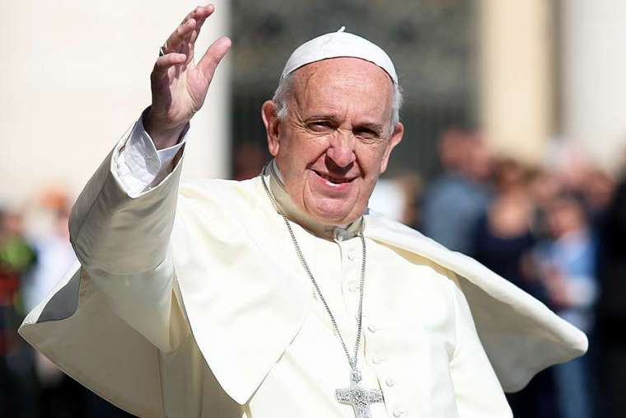
Thursday 14th May 2020
RE LESSON
L.O: To learn about Pope Francis and make links about his actions and beliefs.
* Go through this with an adult, if you can, to help you to understand it.

Slide 2
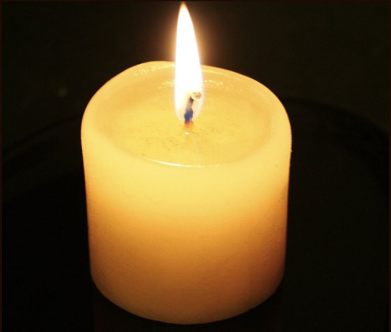
Quiet reflection time to start the lesson (5 minutes)
Sit still, and listen to some quiet, calming music.
Think about in class we would have a candle lit .
(DO NOT DO THIS! LET AN ADULT DO IT IF THEY WANT TO, BUT THEY DO NOT NEED TO)
What does the flame remind us of?
That Jesus is the Light of the World and that He Guides us down the right path.

Slide 3
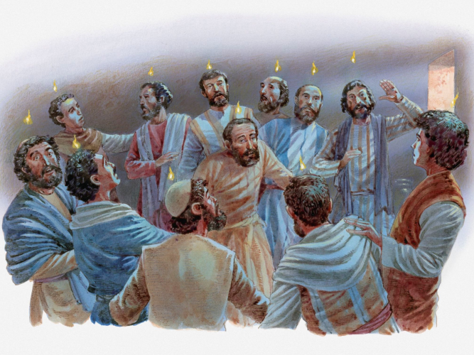
The Church believes that the Spirit, which came at Pentecost, remains in the Church and world today. Just as it energised and enabled (gave them the power) the disciples to speak in different languages to the crowds in Jesus’ day, it now guides Christians today. The Spirit is the ‘life force’ that helps us and guides us.

Slide 4
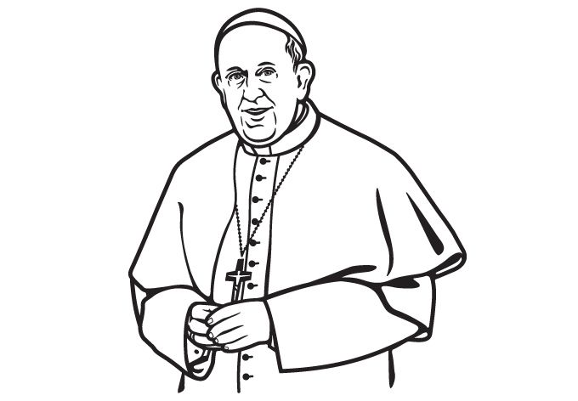
This next section of learning teaches us about someone who lives as a person who is led and inspired by the Spirit. Inspired means that you want to be like that person.

Slide 5
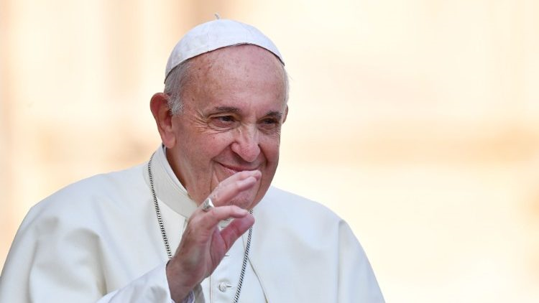
Who is this person? White hat question
What is his name?
What does he do? White hat question
What is he wearing?
Why does he wear white? White hat question
Why is he important? Yellow hat question

Slide 6
…He is Pope Francis
He is from Argentina (in South America) and became the 266th Pope on 13th March 2013. He was born on the 17th December 1936 and is now 83 years old (May 2020). His birth/real name is Jorge Mario Bergoglio, but the Pope chooses a new name, known as the ‘papal name’, when he is chosen as the new Pope. This name gives people an idea about how he will lead the Catholic church. Pope Francis is the first ever Pope to be named Francis, out of respect for Saint Francis of Assisi.

Slide 7
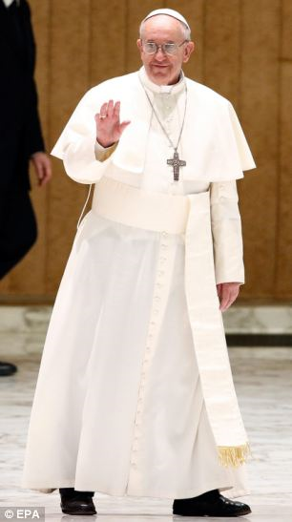
Pope Francis is important
because he is the HEAD of the Roman Catholic Church, he
LEADS it.
He wears a white cassock (robe) and zucchetto (skull cap), as well as a pellegrino or mozzetta (the short shoulder cape).
He wears white as a sign that he is humble, which means showing that he is just like everyone else, not more important than anyone else. Jesus was humble too.

Slide 8
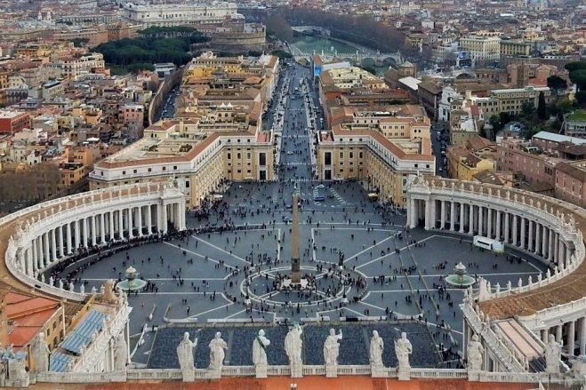
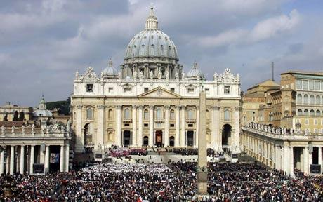
Pope Francis lives in an apartment in Vatican City in Rome, Italy.
The Pope leads services from the Vatican in St.Peter’s Square.

Slide 9
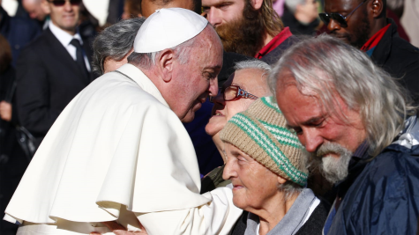
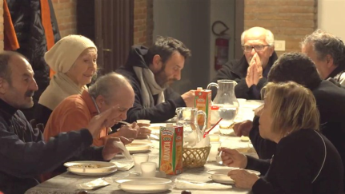
Pope Francis is a person who acts because he believes things about God and about people.
He helps the HOMELESS:
On his 77th birthday (December 2013), he ate breakfast with homeless people.
Pope Francis turned an old Palace, near to the Vatican, into a shelter for homeless people earlier this year (February 2020).
It was even reported a few years ago that the Pope went out at night, dressed as a regular priest, to meet with homeless men and women.

Slide 10
He helps the POOR:
"As believers, we must stretch out our hands as Jesus does with us,“ the Pope said in November 2018 when about 1,500 needy people had lunch with the pope in the Vatican’s large hall. Others were being taken to eat as guests in nearby church colleges.
The Pope referred to the Matthew in the Bible and said that after Jesus fed the thousands with only five fish, He went to the mountain to pray. Jesus didn’t show off about what He did.
“Helping the poor is a duty,” the Pope says.

Slide 11
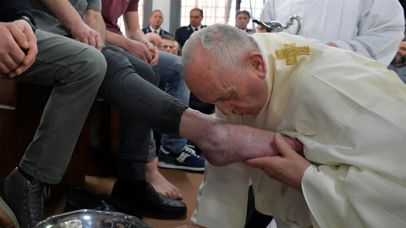
He shows FORGIVENESS and being HUMBLE:
Many times on Maundy Thursday, the Pope has washed and kissed the feet of people who have done wrong things, and gone to prison. The prisoners show that they want to be forgiven for what they have done. Pope Francis was also being humble by doing this, showing that he was willing to do this, just like Jesus was humble when He washed the disciples feet at the Last Supper.
Pope Francis said Jesus added a part to the Lord’s prayer“Forgive us our trespasses”, which relates our being forgiven by God to us forgiving others.
He said God is always willing to forgive “the sins of those who are sorry and ask to be embraced again.”

Slide 12
WORK/
ACTIVITY
TIME

Slide 13
Use the fact-file frame to write information about Pope Francis.
Or
You can use the ‘Y diagram’ worksheet to show how Pope Francis helps the homeless, the poor, and shows forgiveness. Draw a picture in each section and write a sentence about it.
- Maybe challenge yourself to complete BOTH sheets, but only if you can.

Slide 14
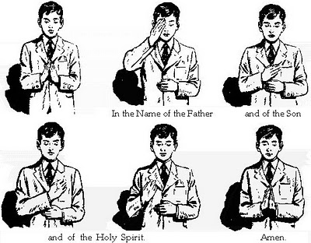
When you have finished the work that you have chosen to do, let us finish the lesson with the school afternoon prayer… Remember to Bless yourself with …In the name of The Father, The Son, and The Holy Spirit, Amen.
God our Father I come to say,
Thank You for Your love today.
Thank You for my family, and all the friends You give to me.
Guard me in the dark of night, and in the morning send Your light,
Amen

Slide 15
Well done for completing what you can during this lesson

