Slide 1
Lesson 1

Slide 2
Quest stories are stories about a journey with a goal, which requires the characters to overcome obstacles.

Slide 3
Today you are going to listen to the story Lost and Found
Before you listen to the story complete the inference grid on the next slide.

Slide 5
Now listen to the story:
https://www.youtube.com/watch?v=cRAAQ8EWzig
Discuss key events from the beginning, middle and end of the story.
Who are the characters?
Where is the story set?
What happened at the beginning of the story?
What happened in the middle of the story?
What happened at the end of the story?
What obstacles are there in this quest story? How did they overcome these obstacles?

Slide 6
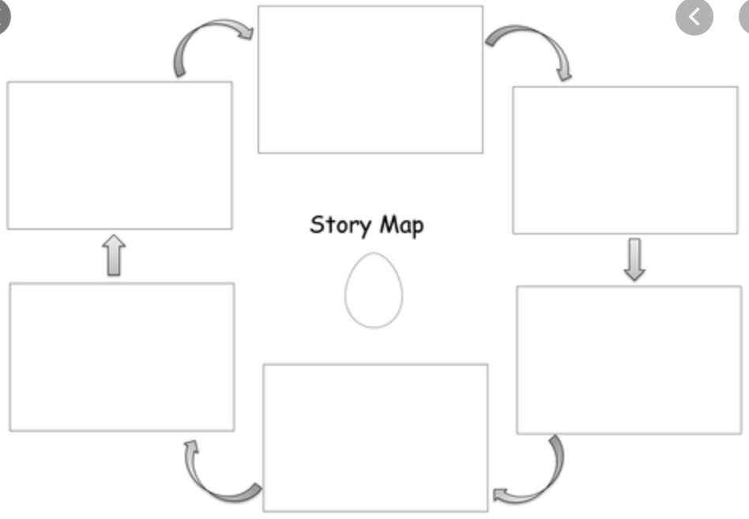
Activity:
Create a story map putting the story in the correct order and adding words/sentences to your images. Remember to include arrows in your story map so people know what sentence/image to read/look at next.
Examples of story maps:

Slide 7
Lesson 2

Slide 8
Remind children that quest stories include a journey.
Reread Lost and Found https://www.youtube.com/watch?v=cRAAQ8EWzig and discuss the journey/journeys taken.
Look at the illustrations, descriptive language and past tense verb forms.
Discuss possible alternative journeys to cheer the penguin up.
Where might they go?
How would they get there?
What would they see on the way?

Slide 9
Activity:
Give children a starter sentence and get them to describe one of the journeys discussed.
E.G. The little boy wanted to help the penguin home.
Remember to include information about:
How did they travel (boat, aeroplane, bike……)
At least 3 things they saw on the way
End with arriving at the destination.
Children check and edit their work by rereading their writing aloud.

Slide 10
Lesson 3

Slide 11
What is a verb?
A verb is a doing word
Run
Jump
Swim
Crawl
Laugh
Present tense verbs:
The present tense is used when describing an action that is currently happening, or an event that happens regularly:
Walking, running, crawling, go
Past tense verbs:
The past tense is used when describing an action that has already taken place/happened.
Walked, ran, saw, crawled, went

Slide 12
Regular verbs (add –ed in past tense)
play
laugh
need
look
ask
call
played
laughed
needed
looked
asked
called

Slide 13
Irregular verbs (they break the rules! You just have to learn them)
go
say
make
take
think
is
went
said
made
took
thought
was

Slide 14
Now try these: Put these sentences into the past tense
It is sunny
We have Assembly today
We go swimming
I think P.E. is fun
My dad helps me with my homework
We need to tidy up the cloakroom
It was sunny
We had Assembly today
We went swimming
I thought P.E. was fun
My dad helped me with my homework
We needed to tidy up the cloakroom

Slide 15
Activity:
Write sentences about the images on the next slide.
When sentences are written go back and underline the verbs, noting whether they are past or present tense verbs.

Slide 16
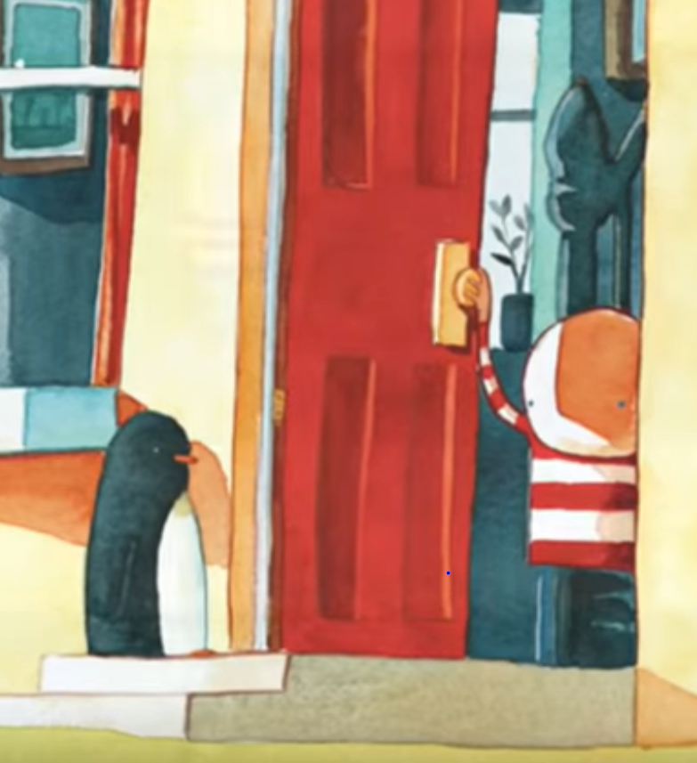
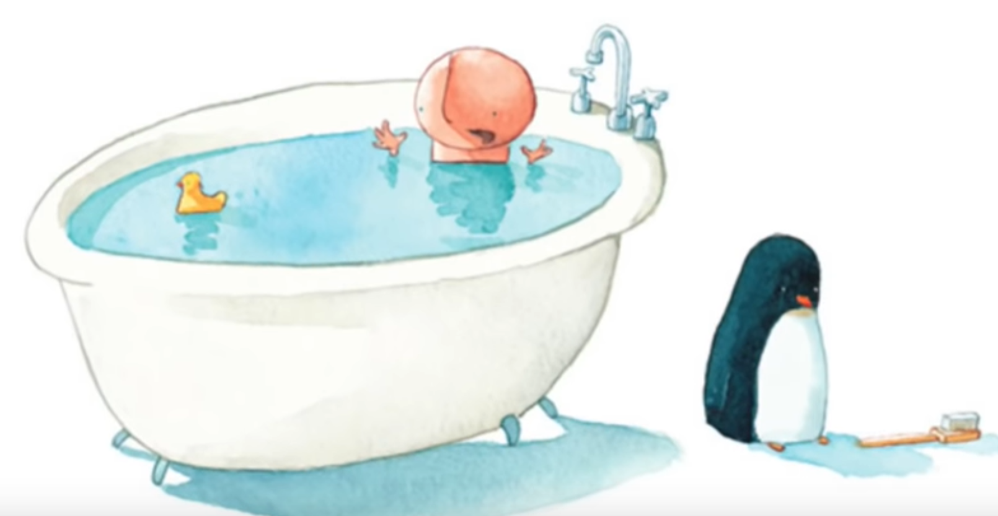
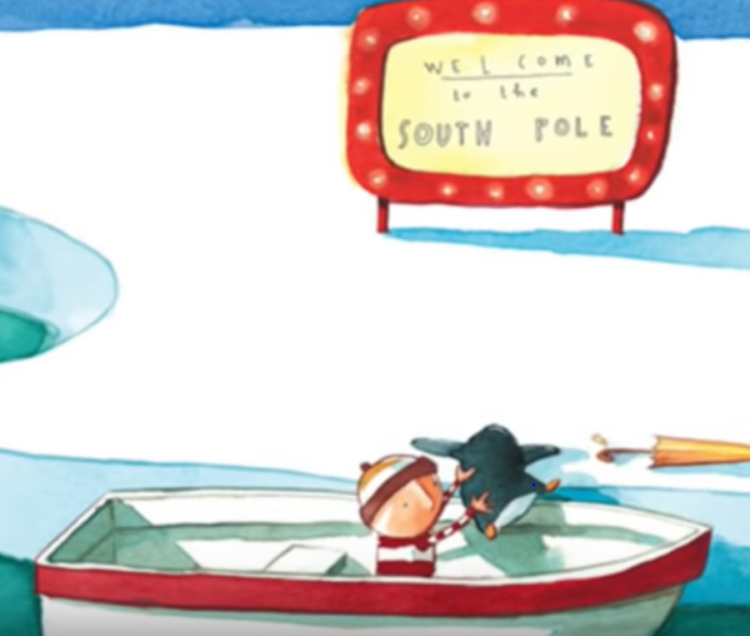
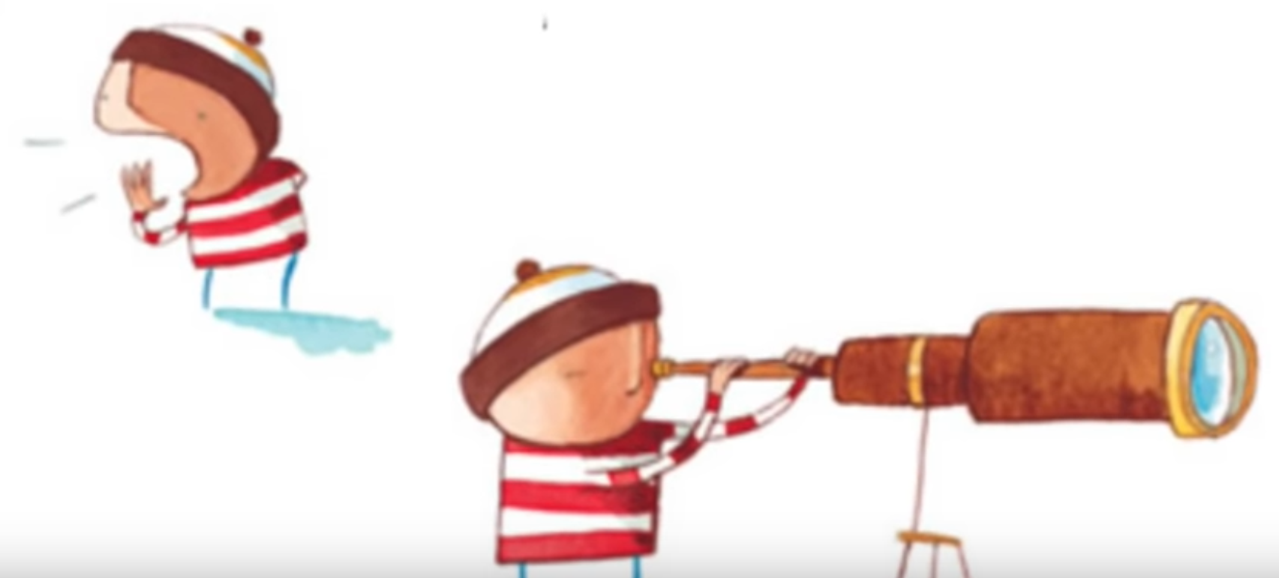
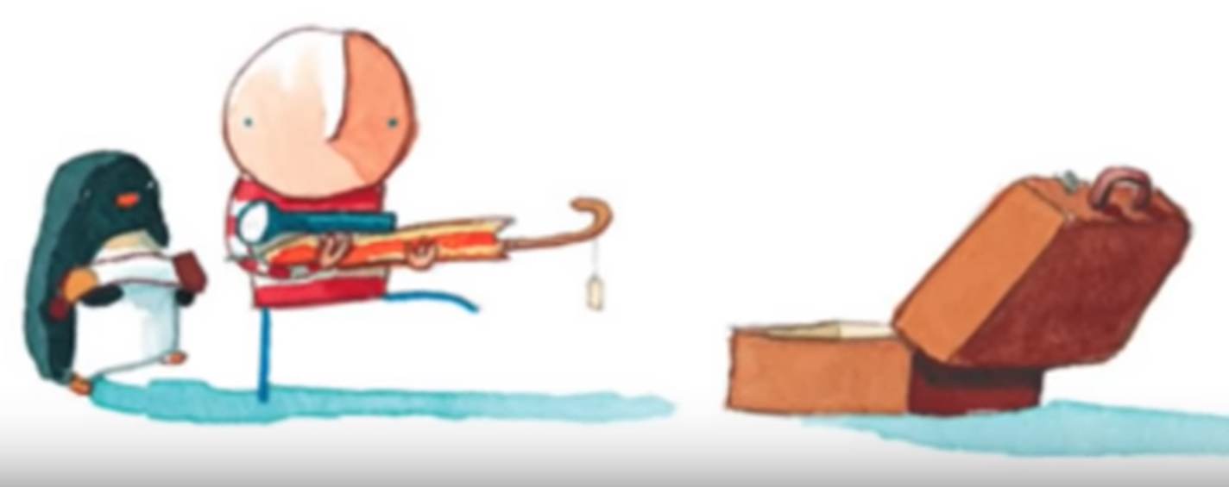

Slide 17
Lesson 4

Slide 18
Look back at Lost and Found and discuss how the penguin could have delayed the boy’s preparations to journey to the South Pole.
Discuss different ideas and act out what the penguin might have done to sabotage the journey:
E.g. made a whole in the boat.

Slide 19
Activity:
Write an imagined scene where the penguin was sabotaging the journey.
When you have finished writing draw an image of the event.
You can create as many different imaged scenes as you wish.
Remember to use:
Neat handwriting
Punctuation (capital letters, full stops, !, ? Etc)
Adjectives
Read over your work and edit.

Slide 20
Lesson 5

Slide 21
Have a look online and look at different newspaper reports and try and find the features.

Slide 22
Task 1: Create your own poster sharing information about the features of a newspaper report.
Task 2: Create a newspaper report about the story Lost and Found detailing what happened. Remember to include the key features of a newspaper report on your poster.
Name of newspaper
Title: e.g. ‘Boy finds Penguin’ ‘Penguin on the Street’
Subheadings
Pictures with captions

