Slide 1
Week 2 Lesson 1

Slide 2
This week we are going to look at another quest story ‘The Way Back Home.’
What do you remember about quest stories?
What story did you learn about last week?
https://www.youtube.com/watch?v=RbyUrb0X5iU
Read and display the first few pages then pose questions and make predictions.
Discuss the sentence types and punctuation for the questions and predictions (statements).

Slide 3
Statements and Questions
Statement:
Question:
Statements are sentences which tell you a fact, opinion or idea.
The boy had a red and white stripped top.
Questions are sentences that ask you something.
They usually end with a question mark.
Why did the boy have an aeroplane in his cupboard?

Slide 4
Activity:
Imagine you are a news reporter.
Write at least 3 questions you want answered about the story, with a prediction (statement) for each.
Make sure to punctuate your questions correctly and then read your questions and predictions to someone.
E.g. Why did the boy have an aeroplane?
He had an aeroplane in the cupboard because he was given it as a gift for his birthday.

Slide 5
Week 2 Lesson 2

Slide 6
Yesterday we learnt about statements and questions
Statement:
Question:
Statements are sentences which tell you a fact, opinion or idea.
The boy had a red and white stripped top.
Can you think of some more?
Questions are sentences that ask you something.
They usually end with a question mark.
Why did the boy have an aeroplane in his cupboard?
Can you think of some more?

Slide 7
Today we are looking at exclamation and command sentences.
Command
Exclamation sentences
They are often urgent or angry, can be very short and contain an imperative (bossy) verb.
Don’t touch the boat!
Stop!
Listen to me.
An exclamation is used when someone is surprised.
It always starts with ‘How’ or ‘What’ and ends with an exclamation mark.
What a big boat that is!
How kind you are! and a verb.

Slide 8
Activity:
Today you are going to create a range of sentences for the story of the Way Back Home. You can use some of the sentences you created yesterday and some from the story to help you. Please remember write neatly and use punctuation accurately. Remember to read back over your sentences
Questions | Commands
Exclamation Sentences | Statements

Slide 9
Week 2 Lesson 3

Slide 10
Recap on quest features.
Today you are going to plan your own quest story using a story map.
You can use the boy from Lost and Found as your main character, deciding where his journey will lead, what obstacles he will meet and what his goal will be.

Slide 11
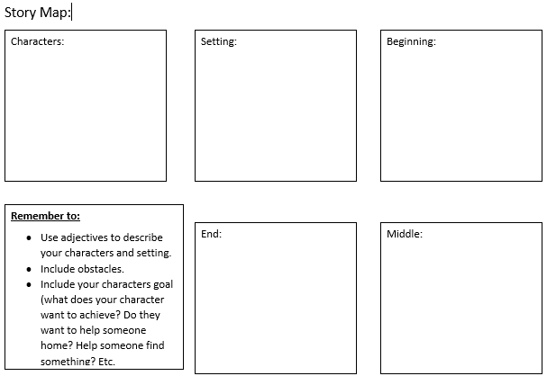
Complete the story map: Write notes in the different sections to help you when you are writing your story. (if you can’t print off the plan just draw it or write the titles into your book)

Slide 12
Week 2 Lesson 4

Slide 13
Today you are writing the beginning of your story.
Think about how you want your story to begin.
Introduce characters and setting (remember to use your plan to help)
Look back at Lost and Found and note how it uses a question to draw the reader in. Children think of questions to intrigue their readers.
Briefly recap other forms of sentence and model writing.

Slide 14
Week 2 Lesson 5

Slide 15
Today you are going to continue your story and write your middle and ending.
Middle:
Ending:
Think about the middle section of the story: a series of increasing obstacles, which must be overcome.
Model writing an obstacle, making mistakes with tenses. Can children spot the error and correct it?
Now think about the ending.
Think back to Lost and Found.
How would you feel if the story stopped when the boy and penguin parted at the South Pole?
Explain that stories are disappointing when they stop abruptly and are boring when they go on too long.

Slide 16
When you have completed your story read back over it all and make any revisions and corrections needed.

