Slide 1
Bonjour year 4!
Building on last week’s vocabulary, this week you are going to learn how to express your opinion about different types of food.

Slide 2
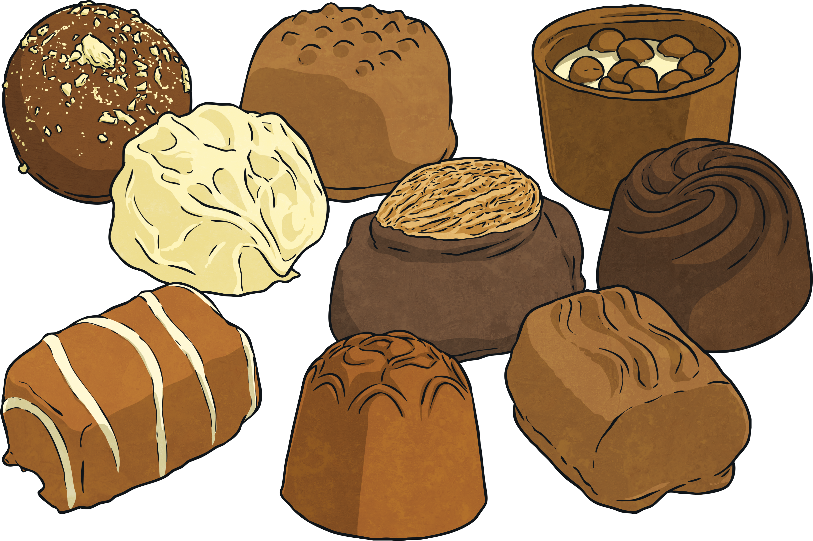
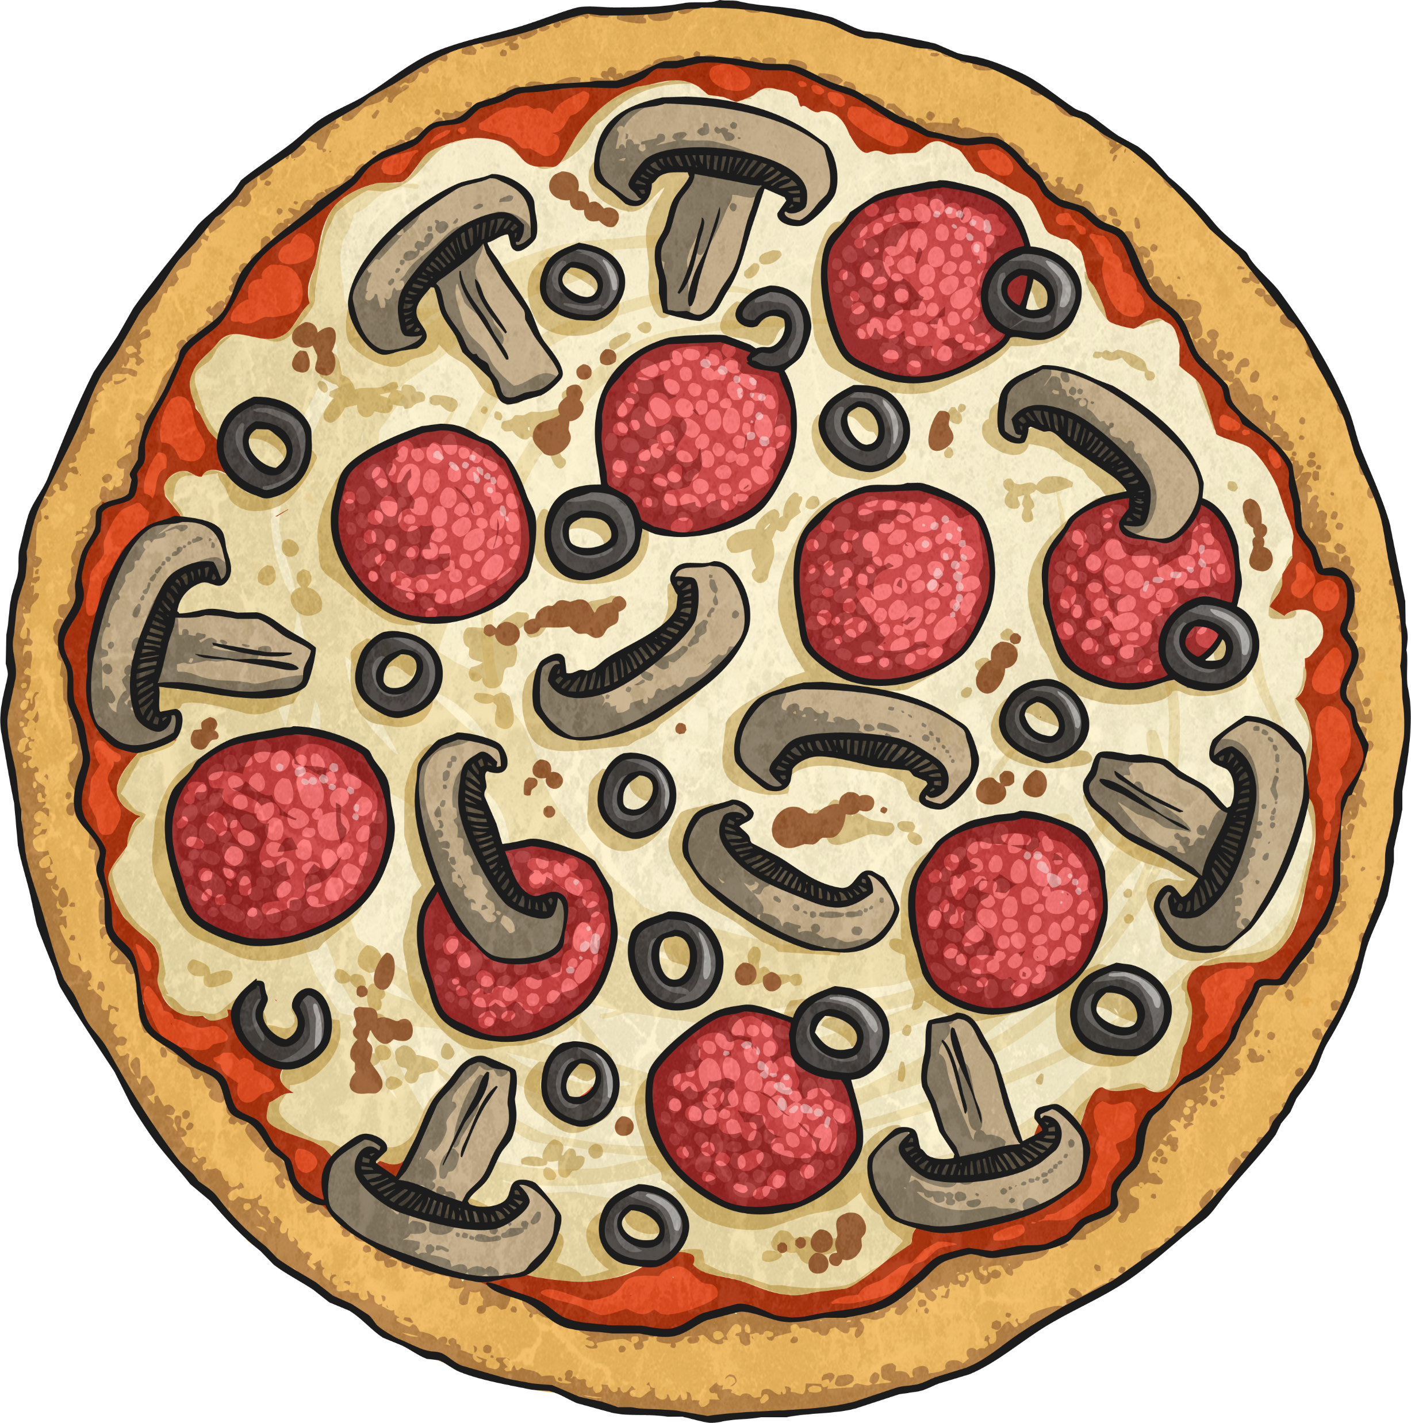
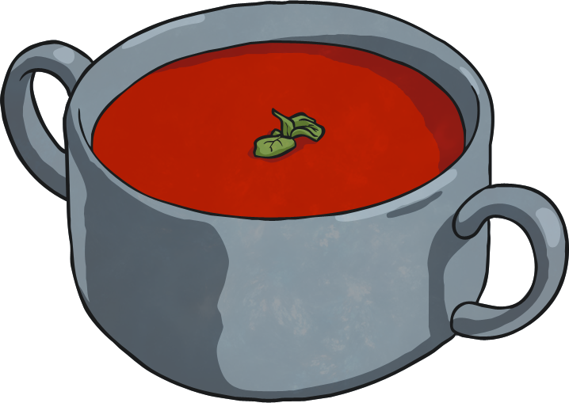
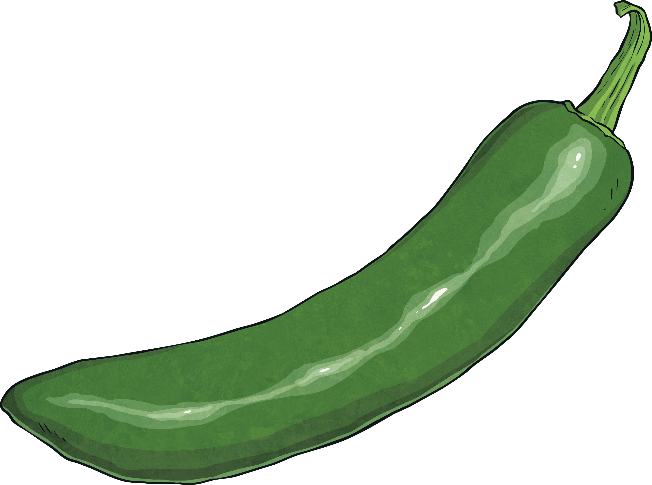
When you give an opinion about food in French, you have to put an article before the food. E.g: j’aime la pizza
J’aime | le chocolat la pizza
Je n’aime pas | le café la soupe
J’adore | les frites
Je déteste | les piments

Slide 3
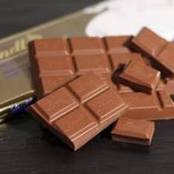
I like…
J’aime
le chocolat

Slide 4
coffee
I don’t like…
Je n’aime pas
le café

Slide 5
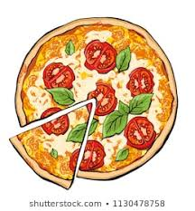
I love
la pizza
J’adore

Slide 6
I hate
Je déteste
la soupe

Slide 8
ANSWERS
 |  | J’aime les frites
 |  | J’adore la pizza
 |  | Je déteste les piments
 |  | J’adore le chocolat
 |  | Je déteste le café
 |  | Je n’aime pas la soupe

Slide 9
Have a go at the other fun activities and try and memorise as many words as you can.

