Slide 1
Bonjour year 6!
For your last lesson you are going to revise the rules around the use of adjectives in French. We’ll use the topic of clothes so that you are familiar with the vocabulary.
Remember, Spanish has similar rules with adjectives so you can transfer this knowledge to Spanish if you study it next year.
Success Criteria
I can use the correct order to describe nouns, using foncé and clair.
I can use the masculine and feminine form of colours when necessary.

Slide 2
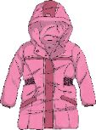
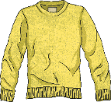
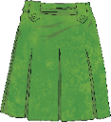
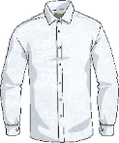
Les Vêtements Clothes
Click play buttons throughout to hear phrases and words.
Qu’est ce-que c’est ?
These two nouns are masculine.
un manteau
un pull
These two nouns are feminine.
une jupe
une chemise

Slide 3
Recap on Colours
Quelle couleur?
bleu
blanc
jaune
noir
rouge
vert
gris
violet
marron
orange
rose
rose marron bleu rouge blanc noir jaune
vert violet gris orange

Slide 4
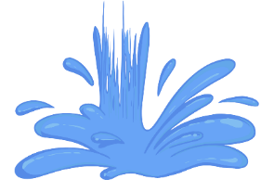
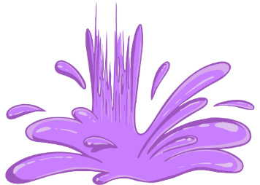
Feminine Form of Some Colours
Colours are adjectives. When they describe a noun, they agree with its gender (whether it is masculine or feminine).
Colour | Feminine form
blanc | blanche
violet | violette
noir | noire
gris | grise
bleu | bleue
vert | verte
These colours stay the same
orange | orange
rouge | rouge
rose | rose
marron | marron
jaune | jaune

Slide 5
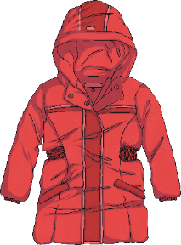
What Colour Is It?
Colour | Feminine form
blanc | blanche
violet | violette
noir | noire
gris | grise
bleu | bleue
vert | verte
These colours stay the same
orange | orange
rouge | rouge
rose | rose
marron | marron
jaune | jaune
un manteau
Un manteau rouge.
Unlike English, the French adjective in French is after the noun.

Slide 6
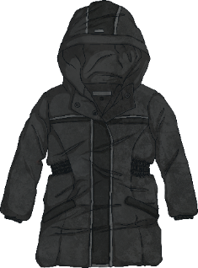
What Colour Is It?
Colour | Feminine form
blanc | blanche
violet | violette
noir | noire
gris | grise
bleu | bleue
vert | verte
These colours stay the same
orange | orange
rouge | rouge
rose | rose
marron | marron
jaune | jaune
un manteau
Un manteau noir.
Remember, the adjective in French is after the noun.

Slide 7
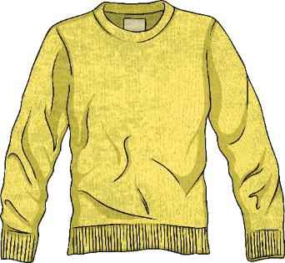
What Colour Is It?
Colour | Feminine form
blanc | blanche
violet | violette
noir | noire
gris | grise
bleu | bleue
vert | verte
These colours stay the same
orange | orange
rouge | rouge
rose | rose
marron | marron
jaune | jaune
un pull
Un pull jaune.
What do you need to remember?

Slide 8
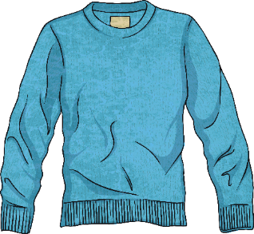
What Colour Is It?
Colour | Feminine form
blanc | blanche
violet | violette
noir | noire
gris | grise
bleu | bleue
vert | verte
These colours stay the same
orange | orange
rouge | rouge
rose | rose
marron | marron
jaune | jaune
un pull
Un pull bleu.
What do you need to remember?

Slide 9
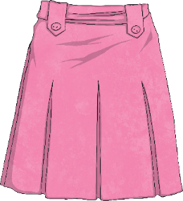
What Colour Is It?
Colour | Feminine form
blanc | blanche
violet | violette
noir | noire
gris | grise
bleu | bleue
vert | verte
These colours stay the same
orange | orange
rouge | rouge
rose | rose
marron | marron
jaune | jaune
une jupe
Une jupe rose.
What do you need to remember?

Slide 10
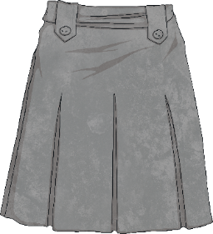
What Colour Is It?
Colour | Feminine form
blanc | blanche
violet | violette
noir | noire
gris | grise
bleu | bleue
vert | verte
These colours stay the same
orange | orange
rouge | rouge
rose | rose
marron | marron
jaune | jaune
une jupe
Une jupe grise.
What do you need to remember?

Slide 11
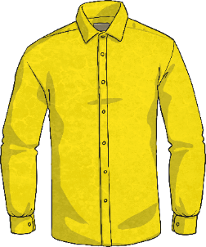
What Colour Is It?
Colour | Feminine form
blanc | blanche
violet | violette
noir | noire
gris | grise
bleu | bleue
vert | verte
These colours stay the same
orange | orange
rouge | rouge
rose | rose
marron | marron
jaune | jaune
une chemise
Une chemise jaune.
What do you need to remember?

Slide 12
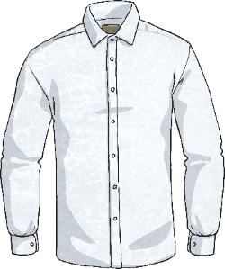
What Colour Is It?
Colour | Feminine form
blanc | blanche
violet | violette
noir | noire
gris | grise
bleu | bleue
vert | verte
These colours stay the same
orange | orange
rouge | rouge
rose | rose
marron | marron
jaune | jaune
une chemise
Une chemise blanche.
What do you need to remember?

Slide 13
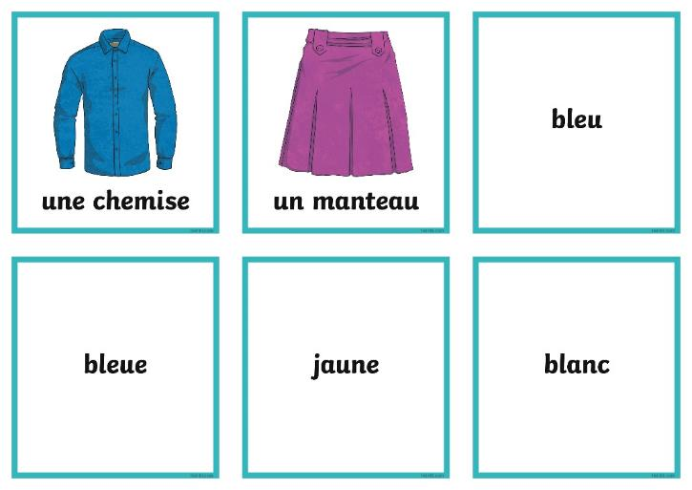
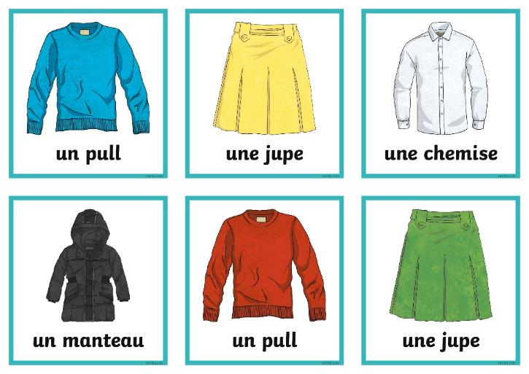
Match the Cards
With a partner, use the Colour Clothes Matching Cards and choose a picture, then match it with the correct colour card. Make sure you choose the correct masculine or feminine form of the adjective.

Slide 14
Light and Dark
We can also say whether the colour is a dark or light shade.
The French word for light is clair.
The French word for dark is foncé.
But the good news… when using clair and foncé with a colour, there is no need to change the colour into a feminine form.
Light brown is marron clair
and light green is vert clair.
So dark pink is rose foncé
and dark grey is gris foncé.

Slide 15
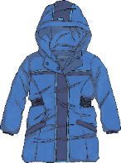
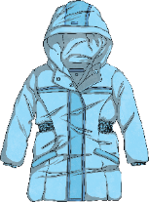
Describing Clothes Using Foncé and Clair
In French the words are the opposite way to English:
English: shade, colour, noun
French: noun, colour, shade
un manteau
un manteau
un manteau bleu foncé
un manteau bleu clair
blanc violet noir gris bleu vert orange rouge rose marron jaune

Slide 16
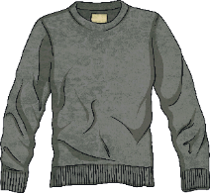
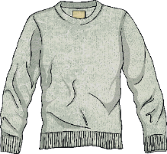
Describing Clothes Using Foncé and Clair
In French the words are the opposite way to English:
English: shade, colour, noun
French: noun, colour, shade
un pull
un pull
un pull gris foncé
un pull gris clair
blanc violet noir gris bleu vert orange rouge rose marron jaune

Slide 17
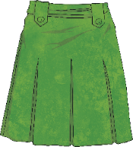
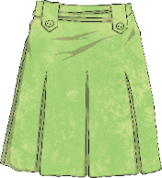
Describing Clothes Using Foncé and Clair
In French the words are the opposite way to English:
English: shade, colour, noun
French: noun, colour, shade
une jupe
une jupe
une jupe vert foncé
une jupe vert clair
blanc violet noir gris bleu vert orange rouge rose marron jaune

Slide 18
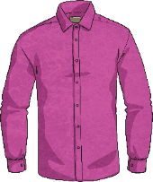
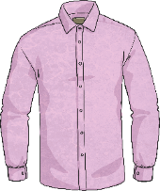
Describing Clothes Using Foncé and Clair
In French the words are the opposite way to English:
English: shade, colour, noun
French: noun, colour, shade
une chemise
une chemise
une chemise rose foncé
une chemise rose clair
blanc violet noir gris bleu vert orange rouge rose marron jaune

Slide 19
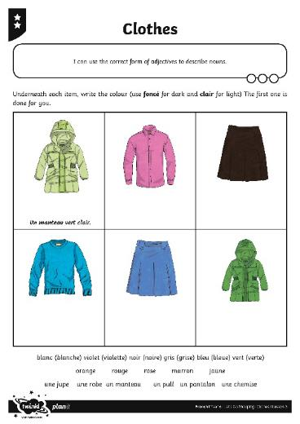
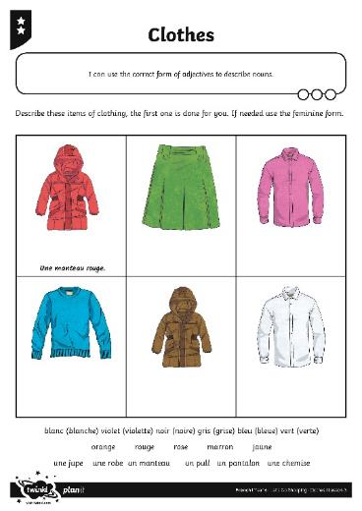
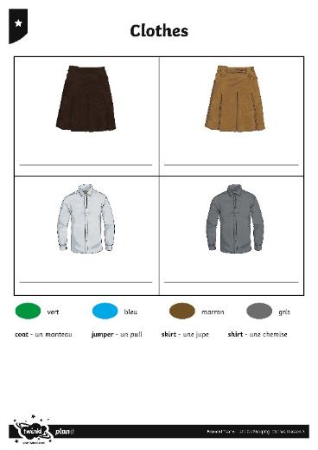
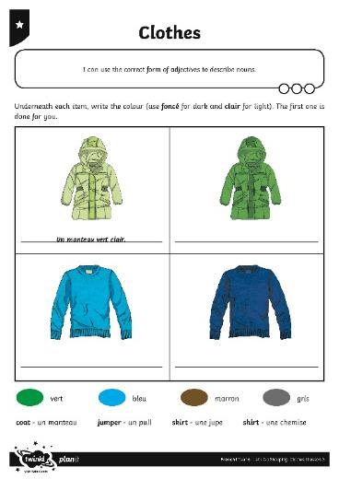
Allez-y ! Off You Go!
Complete the Clothes Activity Sheets and play online quizzes
https://www.languagesonline.org.uk/French/Primary/Clothes/Index.htm.

