Slide 1
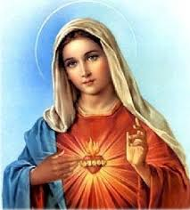
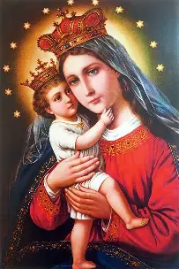
month of Mary’

Slide 2

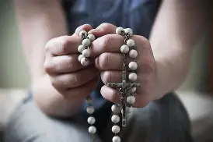
The month of Mary, the month of Mary is when we pray to her by saying the rosary .Can you guess what time we say the Rosary we mostly say it when it the month of October

Slide 3

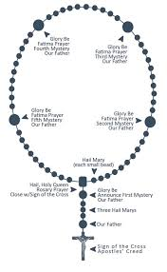
These are some prayers you can say in the rosary there about 10 decades in the Rosary. Are school invited some of us to pray the Rosary and it was very fun

Slide 4
