Slide 1
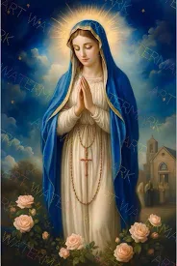
The Rosary
Mary praying the rosary

Slide 2
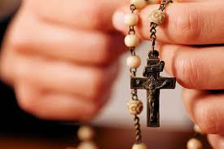
The Rosary
The rosary is a catholic devotion to the Virgin Mary that involves meditating on the life of Jesus and reciting a specific set of prayers, such as the Hail Mary and Our Father, which are counted on beads.

Slide 3
Month of October
The month of October is dedicated to the rosary and Mary our Mother. There are 10 Hail Marys in one decade and each day of October has a different Mystery. There are 5 decades so we say 50 Hail Marys because there are 10 Hail Marys in a decade. As a catholic school, each day in the month of October, we say one decade of the Rosary after school. Also, parents are invited in our small hall to pray the Rosary together. Sometimes, individual classes pray the Rosary together.

Slide 4
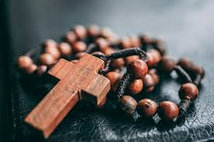
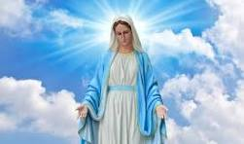
Facts about the Rosary
1. The word ~Rosary~ comes from the Latin phrase ~Rose garden~ or ~ crown roses~ and each prayer is considered a spiritual rose for Mary
2. The practice has historical roots dating to early Christian monks and was popularized in the 13th century.
3. The rosary is a prominent symbol in Catholicism, with historical events like the Battle of Lepanto being attributed to prayers for the rosary.

Slide 5
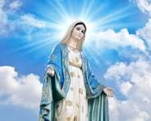
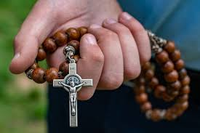
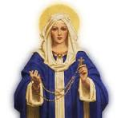
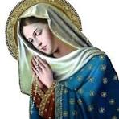
Pictures

