Slide 1
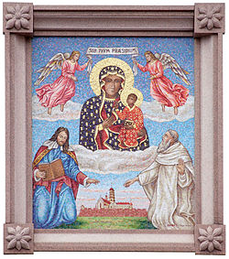
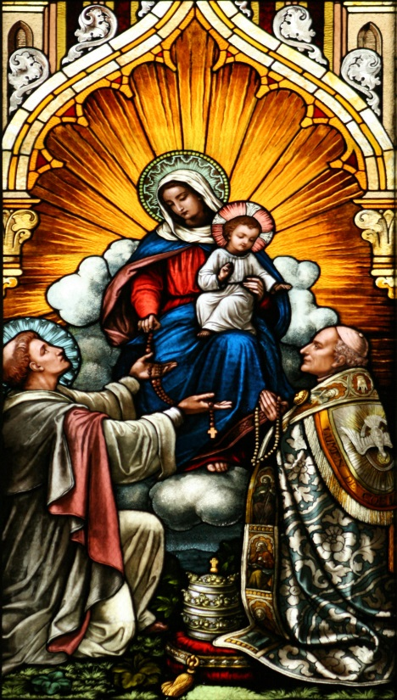
“I have come so that they may have life and have it to the full.” (Gospel of John)
The Rosary – St. Mary’s Catholic Primary School

Slide 5
