Slide 1
Welcome to Year 2
Fatima Class
Ms Soto

Slide 2
Agenda
Start & Finish times Year 2 Class Rules & Expectations Homework Reading Records PE Assertive Mentoring

Slide 3

Start and Finish times
The school day begins at 9:00, this is when the class register will be taken. As you know, gates are opened before this, usually around 8:45.
It is extremely important your child is on time as much as possible. This allows them to set up and feel ready for the day.
The school day ends for KS1 children at 3:00. We would appreciate children being collected on time as KS2 begin their dismissal at 3:15 and the playground can become quite crowded.
The gate is locked around 3:25, after this time you will need to collect your child from the Main Office and sign them out.

Slide 4

Golden Rules (School Rules)
Show good manners and consideration to everyone at all times.
Be responsible for our own behaviour.
Keep hands, feet and objects to ourselves.
Follow instructions the first time we are asked.

Slide 5
Year 2 Class Rules
The children have helped to devise the class rules and try to abide by the rules every day. We have displayed these and ‘signed’ with our handprint.
The children are expected to behave according to our Class Rules at all times. They understand that this is one of the ways they can earn table points each week.
Children who do not follow the Rules can expect to deal with consequences including: time out during breaks, letters home, talks with Miss Creed/Parents.

Slide 6
Year 2 Class Expectations
As the children are older now, and nearing the end of KS1, it is important that they know our expectations for behaviour and standards of work.
All work is to be completed on time, (in school and at home) and to a quality standard. We will be working hard to make sure presentation is neat and that children fully understand these expectations. Work will be marked regularly and the children will be expected to respond to marking and feedback to help them make progress.
If work is not completed to an acceptable standard, the children will be expected to spend part of their lunchtime making corrections or finishing work where necessary. Children will never miss an entire lunch or play time. The children are given enough time during lessons that this should not be the case, however there may be some exceptions when children have not applied themselves fully.
We hope that you will continue to offer your support for these routines. Please feel free to discuss any matters relating to your child with us after school.

Slide 7
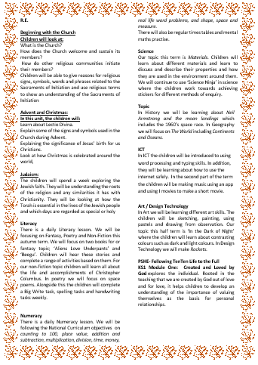
Autumn Topics
Please refer to the class newsletter or webpage for more details and overviews of each subject, including Literacy and Numeracy.
RE- Beginning with God, Judaism, Advent and Christmas
History- Neil Armstrong
Geography- Continents and Oceans
Science- Materials
Art/D&T- A Starry Night
ICT- Basic Skills, Word Processing, PowerPoint

Slide 8
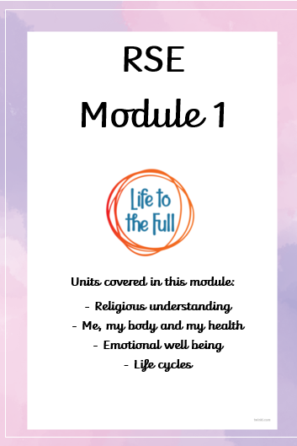
RSE
We will be teaching Relationships and Health Education at the appropriate primary level so that the children will be given the opportunity to discuss issues and topics for the year group. The programme which we will use to help to teach these areas come from, ‘Ten Ten’ and ‘Life in the Full’ which help us always to focus our teaching from a Christian perspective.
KS1 Module One: Created and Loved by God explores the individual. Rooted in the teaching that we are created by God out of love and for love, it helps children to develop an understanding of the importance of valuing themselves as the basis for personal relationships.

Slide 9
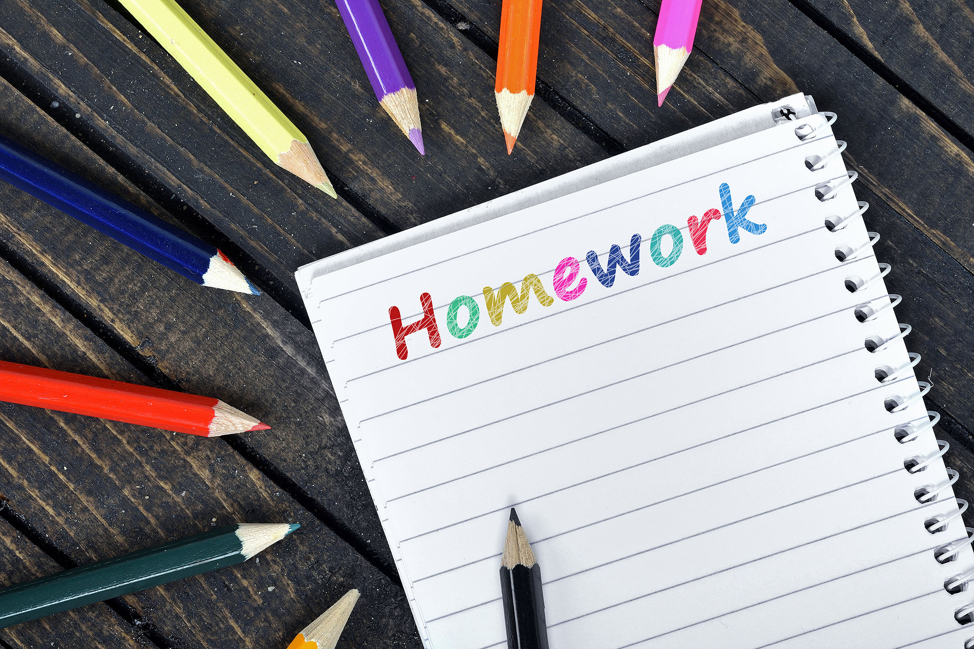
Homework
Homework is given to the children every Thursday and should be returned to school the following Monday. Homework will be given out in their Homework Folder and we expect it to be returned in their Homework Folder. The children will normally have to complete a piece of English, Maths and RE homework. They will also receive spellings and handwriting. It is important that adults check that their child has completed all the homework.
Some children will still need help at home to complete their homework but even if they don’t, you should check that your child has understood the work which has been set and if there is a comment that you want to write about how your child has got on, you can do so on the homework pack. It is very important that the children get used to completing their homework and managing their own time but will need you to help them organise their time.
Homework will be marked during the week and returned to the children to take home.

Slide 10

Reading Records
Reading records should come into school everyday, children are read with in groups during the week and they must have their reading record present for the adult to sign.
Reading Records may form part of the Moderation process at the end of Year 2 to support teacher assessment of a child’s level.
At the front of the Reading Records we have attached the Assessment Focus sheets. These are to help you focus on an area of the child’s reading and make a comment based on these.
Children will bring a reading book aligned with our phonics scheme home each week, but are also encouraged to select and read books that appeal to their interests. You may read these books with your child at home and use this as an entry to your child’s reading record. You may comment on words your child could read or a small comment about what your child could discuss from this book.

Slide 11
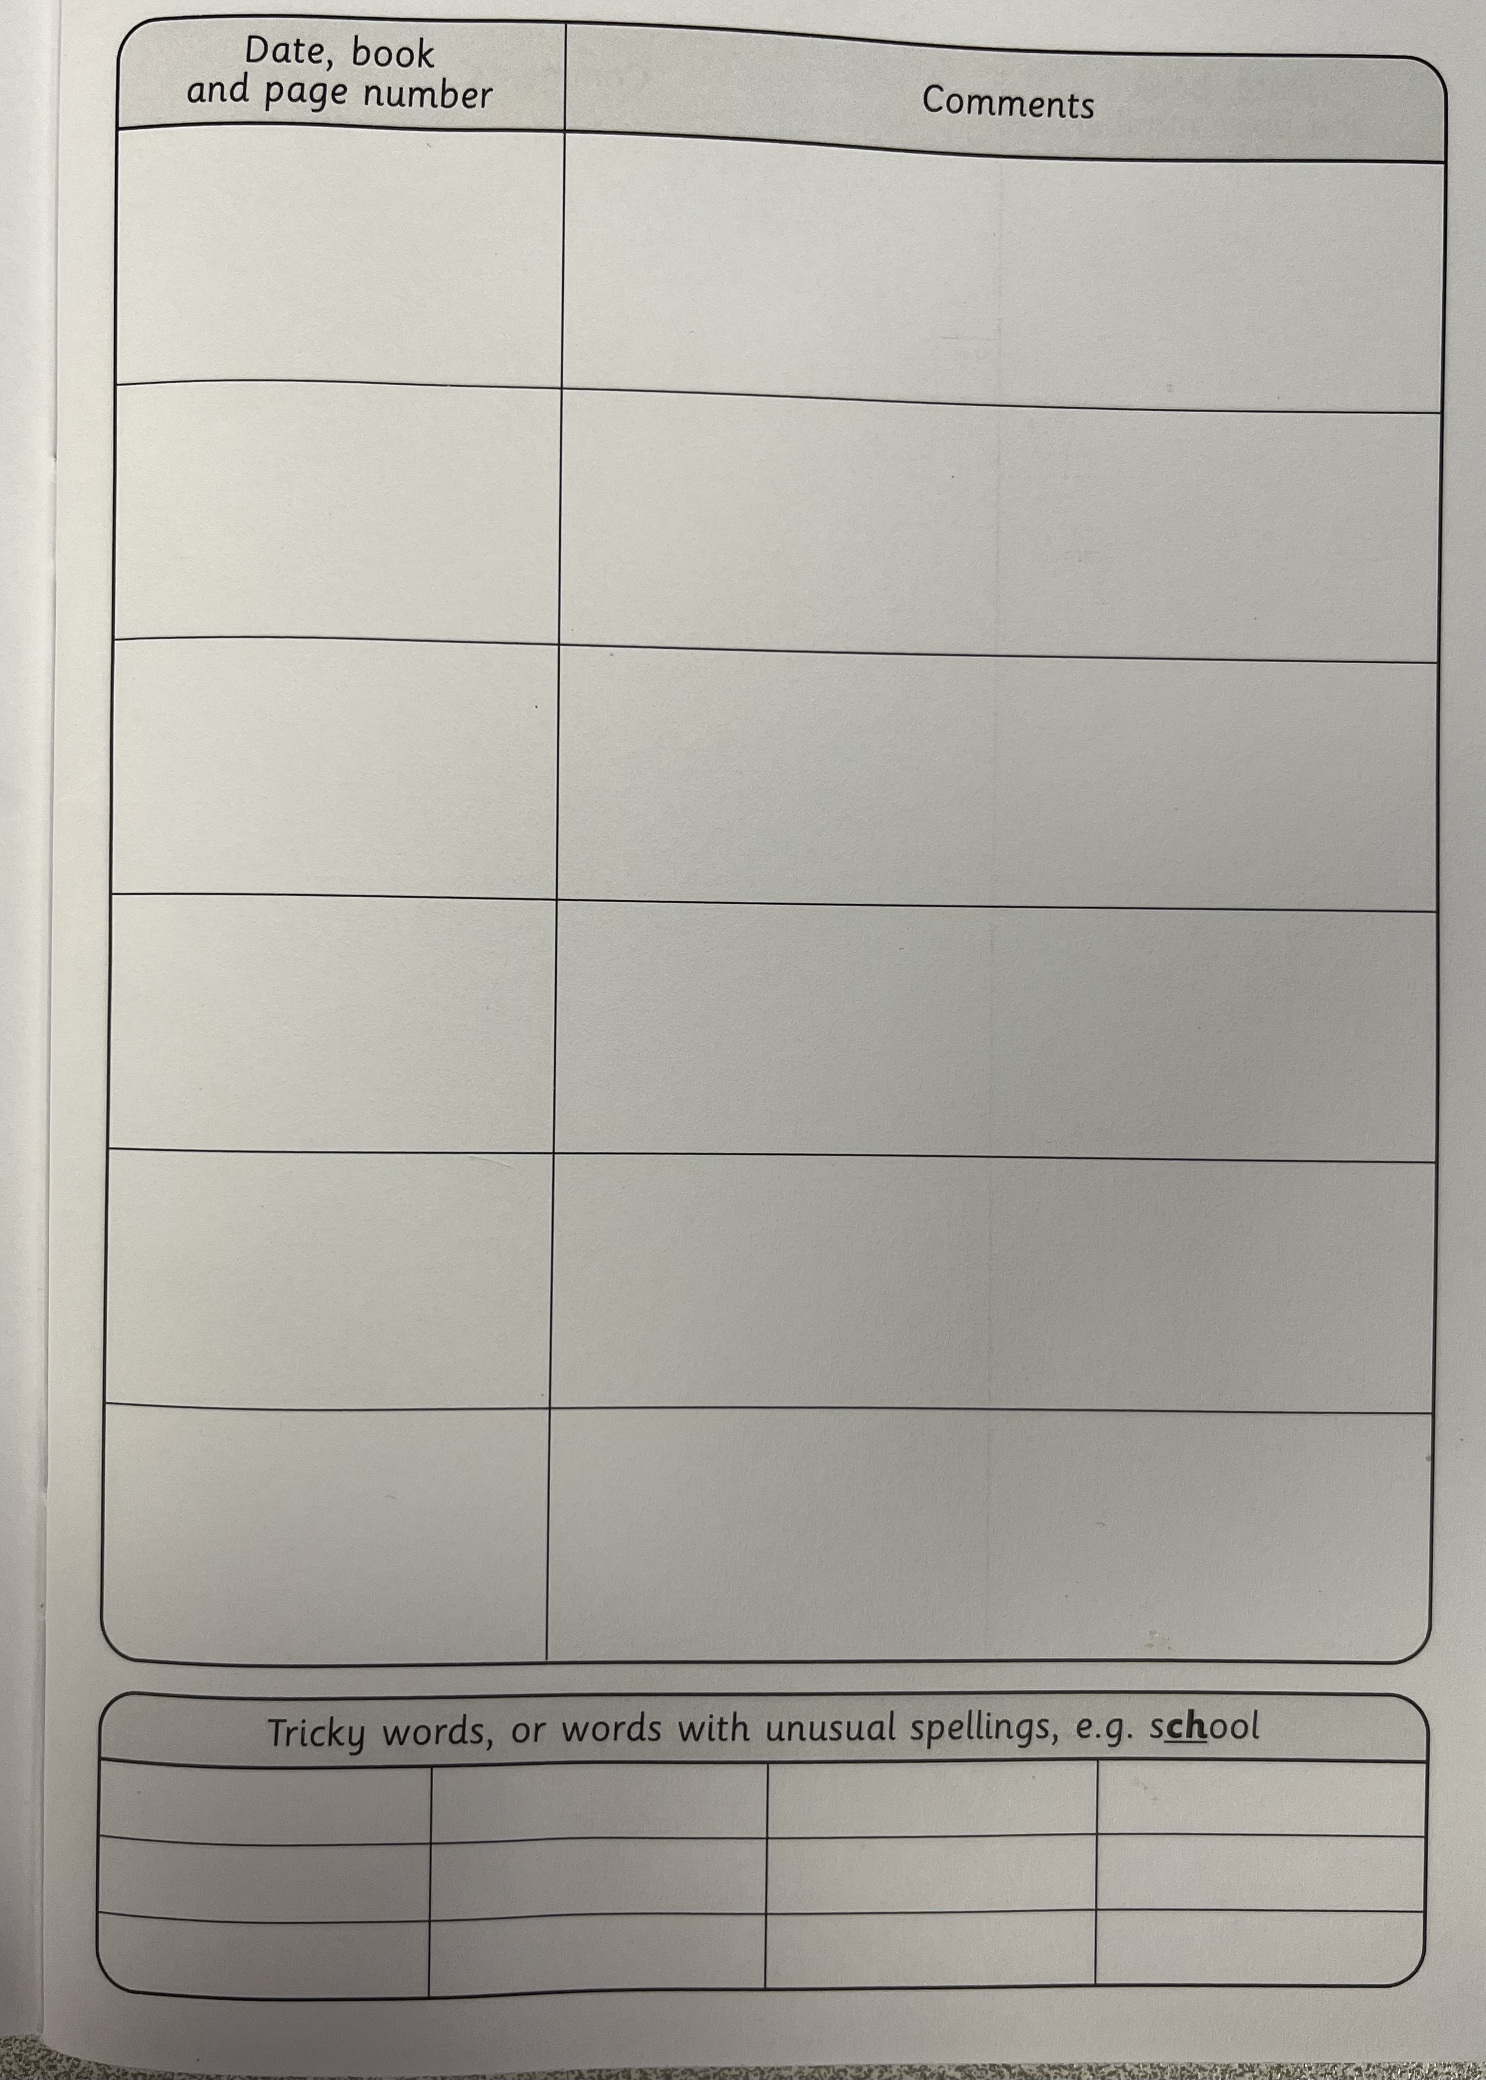
How to fill in your child’s Reading Record
Any book read can be recorded in your child’s reading record. This may be a book from school, home or library.

Slide 12

Phonics
This year we will continue using the scheme Monster Phonics throughout KS1. Within this scheme we will be teaching daily phonics lessons in class.
Alongside this scheme are a number of books matched to the phonics sounds we are learning in class. These books will be used to support guided reading. The aim is for children to read this book through three sessions in school. Following the final in school guided reading session, your child will then get to bring this book home to read with you.
It is extremely important this book is then returned to school on Monday (alongside their reading record and homework) as it will be needed for the next group of children to use.

Slide 13

P.E.
Our PE slots are on a Monday and Tuesday . Children should wear their PE kit coming to school. They should wear their school shoes and bring their plimsoles/trainers in a separate bag to change in to.
The PE uniform consists of:
A white T-shirt
Blue jogging bottoms or navy shorts
School jumper
Please note that black or navy leggings/cycling shorts are not permitted as part of the PE uniform.

Slide 14
Assertive Mentoring
The children’s Assertive Mentoring Targets have been sent home to you already. A copy of these targets are kept in school, in your child’s Assertive Mentoring Folder. These targets are updated termly and are linked to the learning objectives of the term.

Slide 15

Water Bottles
We encourage all children to bring in their own water bottle to drink from. They can refill the bottle using the tap in our classroom.

Slide 16

Tissues
As you know, the school does not provide tissues for each class. Therefore, we kindly ask for each child to bring in a box of tissues to be kept in class and used throughout the year. This is particularly important as we come into the winter months.

Slide 17
Thank you for coming this evening
Year Group email: Year2@stmarys.enfield.sch.uk

