Slide 1

Welcome to Year 3
St. Cecilia

Slide 2
Agenda
Who I am.
What the School Day Looks like.
Learning Expectations.
Behaviour and Routines.
Practical details.
Communication

Slide 3
Who I Am.
Hello my name is Miss Tanak and I am vey excited to be teaching your child in Year 3 this year. I am also proud to be the PE leader along side Mr Dixon at our school. This will be my fourth-year teaching, and I still have the same energy, structure and enthusiasm that I had in my first year.
My teaching style is firm and consistent, but always fair. I believe strongly in setting clear expectations, building positive routines, and helping children feel safe and confident in their learning environment. I also understand that children are still learning how to manage themselves – mistakes are part of the process, and as long as they learn from them and don’t repeat them, I know they will have a wonderful and successful time in Year 3.

Slide 4
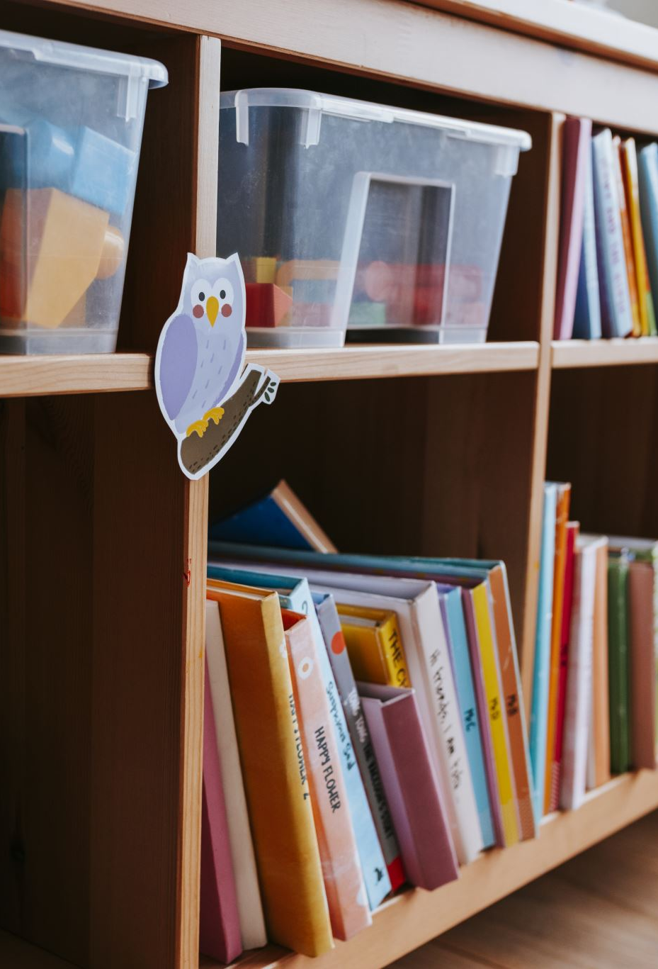
A Typical Day in Year 3
School starts promptly at 8:45am – Children should arrive in time to use the toilet, hang up their coats, wash their hands, choose lunch, set up their books for the first lesson of the day and settle into morning reading.
Lesson begins at 9am, after registration and our morning prayer.
We have playtime at 10:45am until 11:00am.
Next lesson starts at 11:00am and finishes at 12:25pm.
After lunch and our prayer, we will do our third lesson and this will finish at 2:50pm so children can have 10 minutes to tidy up and get their belongings.
3:00pm to 3:10pm I will read the class book.

Slide 5
Learning Expectations
In Year 3, we build on strong foundations and develop greater independence in learning. Key areas we’ll focus on this term include:
Writing full sentences, using punctuation confidently.
Developing times tables knowledge.
Reading for meaning, fluency, and expression.
Children are expected to:
Read at least 5 times a week at home – this will be checked every Monday. If children do not have 5 signatures, they will be given a comprehension for them to bring in the next day.
Complete homework fully and on time. Children are welcome to hand it in earlier once you have checked it.
Always try their best and take pride in their work
If work is not completed to Year 3 standard, the children will be expected to spend their lunchtime making corrections or finishing work when necessary. The children are given enough time during lessons that this should not be the case, however there may be some expectations where children have not applied themselves fully.

Slide 6
Behaviour & Routines
I run a calm and structured classroom where routines are clear and consistent. I have high expectations for:
Listening when others are speaking.
Sitting sensibly and not calling out.
Walking silently into the room and moving around only when needed and permission has been given.
Speaking politely and kindly to everyone in the school community.
There is a simple behaviour system in place:
Children will be given a reminder first.
If behaviour continues, there will be a consequence, such as time in at lunch or loss of a privilege.
Positive behaviour is recognised daily – through praise, class rewards, and whole school systems. I will also let you know at the end of the day when your child has achieved a goal or done something kind.

Slide 7
Behaviour
The children are also expected to behave according to our class rules at all times. We do not tolerate any child disrupting their own or others learning. ( St Mary’s Catholic Primary School Behaviour Policy Pg 3 & 11)
We hope that you will continue to offer your support for these routines. Please feel free to discuss any matters relating to your child with us after school.
‘If positive approaches fail, certain sanctions are used to deter negative behaviour. When problem behaviour is repeated the following examples of possible sanctions are: missing playtime, removal of a privilege eg, loss of team point, ‘time-out’ from class for short periods, to another teacher or send to Phase / Key Stage Leader for serious or prolonged difficulties.’ - St Mary’s Catholic Primary School Behaviour Policy.

Slide 8
Classroom Management
I will develop a positive relationship with pupils, which include:
Greeting pupils in the morning.
Establishing clear routines.
Communicating expectations of behaviour in ways other than verbally.
Highlighting and promoting good behaviour.
Concluding the day positively and starting the next day afresh.
Having a plan for dealing with low-level disruption.
Using positive reinforcement.

Slide 9
Homework
Homework will be set weekly and must be completed in full using pencil only.
Children must read five times per week at home. If this is missed:
They will be given a comprehension task.
If that is not completed, they will stay in for 10 minutes at lunch time to read silently at their table.
Homework must be kept neat, with no doodling, and all pages completed. They will need to hand this in every Monday with the folder that is given to them at the start of the school year. If they lose their homework wallet, we will not give a replacement.

Slide 10
What Children Need
A labelled water bottle
A small pencil case (optional)
PE kit on PE days (they must come in with their school shoes on and change into their PE shoes at school. No earrings are allowed on PE days).
Their reading book and reading record every day.

Slide 11

Communication
If you ever have any questions, concerns, or information you’d like to share:
You can leave a message with the office
Write a short note in your child’s reading record
Or speak to me briefly at the end of the day
If there is ever anything important from my side, I will contact you promptly.

Slide 12
Guided Reading
Some children will continue to read daily in school with an adult and discuss the text on a one-to-one basis. However, other children will be having a weekly guided reading session where a book will be shared with a group of children at the similar reading level and there will be the opportunity to discuss the text, language and vocabulary used as well as having a specific Assertive Mentoring focus which the child will work on.
Children need to have their reading records in their bags at all times.

Slide 13
Final Thoughts
Year 3 is a big step forward in your child’s learning journey, and I’m here to support them every step of the way. It’s important that we, as teacher and parent, work closely together throughout the year. When school and home are consistent and supportive of each other, children feel more likely to succeed both academically and socially.
If any small incidents occur in class and are resolved quickly, I won’t usually pass these on – it’s part of helping children learn from their mistakes. However, if I notice any ongoing patterns or behaviours that needs extra support, I will keep you informed so that we can work together to help your child make positive changes.
I’m really looking forward to a calm, productive, and exciting year ahead. Thank you for your support – I can’t wait to see what your child will achieve in Year 3.
Miss Tanak

